Slide 1
Hematopoietic and Lymphoid Neoplasm Coding (per 2010 rules)
Kentucky Cancer Registry
Abstractor’s Training, March, 2012
Notes:
There were new coding rules for the Hematopoietic neoplasms introduced in 2010. Today I will
-Give an OVERVIEW of the new classification structure
-Introduce you to the new references and resources
-Point out the specific changes for coding these neoplasms
We’ll look at the new MP and PH rules, use the Hematopoietic database, work some practice exercises and finish with a review of the CSv2 schemas relevant to the hematopoietic diseases.

Slide 2
Circulatory system
Includes
The cardiovascular system
Heart and blood vessels
Carries nutrients, oxygen, and waste products to and from cells
The lymphatic system
Lymphatic vessels, lymph nodes, lymphoid tissue in spleen, thymus, tonsils, and small intestine
Notes:
These are neoplasms of the circulatory system.

Slide 3
Lymphatic system
It is the interconnected system of spaces and vessels between body tissues and organs which carry lymph. It regulates fluid balance in the body and helps fight infection.
Functions:
Drainage of tissue fluid and transport of lymph to the venous system
Defense of body, through filtration and phagocytosis
Notes:
Lymph vessels are distributed throughout the body. The lymphatic system carries fluid away from tissues (NOT to tissues). Lymph originates as interstitial fluid which drains into the lymphatic system via the lymph capillaries and flows into larger and larger collecting vessels, until it finally enters into subclavian veins which return lymph to the bloodstream. The lymphatic system Functions are: Drainage of tissue fluid and transport of lymph to the venous system AND Defense of the body, through filtration of fluid and phagocytosis, which is the engulfing of microorganisms and foreign particles by certain cells.

Slide 4
Hematopoiesis
Hematopoiesis is the formation of blood cells
Blood is made up of plasma and formed elements:
Red blood cells (erythrocytes)
White blood cells (leukocytes)
Platelets (thrombocytes)

Slide 5
Hematopoiesis
Red blood cells and platelets are formed in the bone marrow (myeloid tissue)
White blood cells are produced in bone marrow and in lymphoid tissue. Some leukocytes (granulocytes, lymphocytes, and monocytes) originate in bone marrow but multiply in lymphoid tissue.

Slide 6
Historical classification
Originally thought to be separate systems and separate diseases (leukemias and lymphomas). Classified by size and shape of tumor cells; pattern of spread
Medical advances led to re-classification
Immunophenotyping, molecular and genetic testing
Revised WHO Classification of Hematopoietic and Lymphoid Neoplasms; published in 2008; coding changes in 2010
Notes:
Historically, diseases of lymphoid tissues and the hematopoietic system were believed to be separate entities, and the coding structure of the ICD was developed with this in mind, having separate and distinct codes for lymphomas and leukemias. Prior to the early 1990s, the classification systems for lymphomas described malignant cells by their morphologic characteristics; for example, the size and shape of the tumor cell and its pattern of tumor growth and spread.
The World Health Organization Classification of Tumors of Hematopoietic and Lymphoid Tissues, 3rd Edition, published in 2001, was based on classifications that group borderline and malignant tumors into broad categories by hematologic lineage: myeloid, lymphoid, histiocytic/dendritic, and mast cell. Histiocytes are special cells in lymph nodes which ingest old erythrocytes and foreign particles; mast cells are generated by precursor cells in the bone marrow but mature after circulating to a tissue site. They too have a protective role against pathogens in the body. When specialized testing demonstrated one or more disease-defining characteristics using immunophenotyping and/or genetic testing, these characteristics were incorporated into the WHO Classification , 4th Ed.
Part or all of these descriptive characteristics are now included in the 2010 hematopoietic or lymphoid neoplasm terms and even in the disease classification (group) to which a specific disease entity is assigned.
Within these broad categories or phenotypes, tumors may present in solid or circulating phases. Solid phase is the presence of malignant cells in tissue, such as lymph nodes, soft tissues, or organs; generally these have historically been called lymphomas. The circulating phase is characterized by the presence of malignant cells in the circulating blood or bone marrow; historically these have been called leukemias. According to the introduction to the WHO Classification of Tumours of Haematopoietic and Lymphoid Tissues, 4th Edition, the “…distinction between them (lymphomas and leukemias) is artificial. “ You’ve been aware of this since ICD-O-3 introduced the concept of cross-referenced histologies.
Several newly recognized conditions have been added to the 2008 classification as malignant, some conditions previously classified as borderline malignancy are now to be treated as malignant disease, and transformations are now to be abstracted as new primaries as the 2008 publication was implemented in cancer registry coding in 2010.

Slide 7
WHO Classification
Notes:
Once again, this is the primary reference book for the classification of these diseases, starting in 2010. You do not need to purchase this book, but it is the source upon which the hematopoietic disease classification scheme and database were built.

Slide 8
Cell Lineages
Notes:
The WHO classification scheme is based on blood cell lineage. Hematopoiesis is the process of formation, development and differentiation of blood cells within the body. It starts with the stem cell – an undifferentiated blood cell whose daughter cells may either become new stem cells or differentiate into other cell types. The 2 primary cell lines of blood cells are Myeloid and Lymphoid lineages.

Slide 9
“acute” “chronic”
“immature” “mature”
“undifferentiated” “differentiated”
Reference: Hoffbrand, Pettit, Vyas: Color Atlas of Clinical hematology (4th ed.), 2010
Notes:
This is the same diagram turned sideways but it includes significant milestone events encountered during the process of hematopoiesis.– as stem cells commit to becoming mature cells (either lymphoid or myeloid) … or they commit to regenerating stem cells – a unique feature of the stem cell.
Again, all blood cells are divided into 2 main lineages – myeloid and lymphoid.
Lymphoid cells are the cornerstone of the adaptive immune system. Lymphoid lineages (T cells, B cells, NK cells) are derived from common lymphoid progenitors (CLP) and are composed of white blood cells.
Myeloid lineages (monocytes, microphages, neutrophils, basophils, eosinophils, erythrocytes, megakaryocytes (platelets) and dendritic cells are involved in innate immunity, adaptive immunity and blood clotting.
Once committed, each cell will mature and differentiate as a specific type. However, if during the process of maturation and differentiation something goes wrong – malignancies of the blood and lymphatic system may arise.

Slide 10
Myeloid Line – Tables 1-4
Myeloproliferative Neoplasms
Myeloid and Lymphoid Neoplasms with Eosinophilia and Abnormalities of PDGFRA, PDGFRB or FGFR1
Myelodysplastic/Myeloproliferative Neoplasms
Myelodysplastic Syndromes
Notes:
The revised classification scheme for hematopoietic neoplasms is going to be based on these cell lineages, using an integrated, multidisciplinary approach to classify these neoplasms. There are 12 groupings. For the myeloid line, there are six tables, or groupings, of similar histologies.The WHO relies on morphologic, cytochemical, and immunophenotypic features of the neoplastic cells to establish their lineage and degree of maturation. These features, (BM cellularity, % blasts, maturation, morphology, etc.) are used to identify the major subgroups of myeloid neoplasms.

Slide 11
from presentation by Graca M. Dores, MD, MPH, Classification, Characteristics, and Behavior of Myeloid Neoplasms, given at the SEER Advanced Topics Workshop on April 19, 2010.
Notes:
Slide taken from presentation by Graca M. Dores, MD, MPH, Classification, Characteristics, and Behavior of Myeloid Neoplasms, given at the SEER Advanced Topics Workshop on April 19, 2010. These are the conditions based on aberrations in counts.

Slide 12
from presentation by Graca M. Dores, MD, MPH, Classification, Characteristics, and Behavior of Myeloid Neoplasms, given at the SEER Advanced Topics Workshop on April 19, 2010.
Notes:
Slide taken from presentation by Graca M. Dores, MD, MPH, Classification, Characteristics, and Behavior of Myeloid Neoplasms, given at the SEER Advanced Topics Workshop on April 19, 2010. MDS and MPN are generic descriptions; often a provisional diagnosis until a more specific disease can be identified.

Slide 13
from presentation by Graca M. Dores, MD, MPH, Classification, Characteristics, and Behavior of Myeloid Neoplasms, given at the SEER Advanced Topics Workshop on April 19, 2010.
Notes:
Slide taken from presentation by Graca M. Dores, MD, MPH, Classification, Characteristics, and Behavior of Myeloid Neoplasms, given at the SEER Advanced Topics Workshop on April 19, 2010.
Myeloid and lymphoid neoplasms associated with rearrangement of PDGFRA, PDGFRB and FGFR1 (growth factor receptors) make a one of the newer groups in this classification scheme. This group includes 3 specific diseases that share certain genetic and clinical characteristics. All result from the formation of a fusion gene underlying the formation of an aberrant enzyme – and it is believed the cell of origin is a mutated pluripotent stem cell. In other words, these malignancies are felt to originate in stem cells before they commit to being either lymphoid or myeloid. For now, they are grouped with the myeloid neoplasms, due to eosinophilia and other myeloproliferative characteristics, but in a group all their own.

Slide 14
Myeloid Tables 5 and 6
Acute Myeloid Leukemia and Related Precursor Neoplasms
Acute Leukemias of Ambiguous Lineage
Show no clear differentiation along a single lineage
Includes those with mixed phenotypes

Slide 15
Lymphoid Line –6 Tables
Precursor Lymphoid Neoplasms
Mature B-Cell Neoplasms
Mature T-Cell and NK-Cell Neoplasms
Hodgkin Lymphoma
Histiocytic and Dendritic Cell Neoplasms
Post-Transplant Lymphoproliferative Disorders
Notes:
The lymphoid line includes 6 Tables as well. B cell and T/NK cell neoplasms are clonal tumors of mature and immature B cells, T cells, or natural killer cells at various stages of differentiation. B cell and T/NK cell neoplasms appear to recapitulate stages of normal B cell and T cell development, so they can be classified according to their corresponding normal stages of development. Thus, the lymphoid Tables include precursor lymphoid neoplasms, mature B cell neoplasms, mature T cell neoplasms, and Hodgkin lymphoma. The histiocytic and dendritic cell neoplasms are related to several different lineages, but PRESENT in lymph nodes are spleen. Historically, some large cell lymphomas were thought to be histiocytic or reticulum cell sarcomas, but with more precise diagnostic tools, it is now apparent that only a small number of these diseases are of true microphage or dendritic cell origin.
PTLD is in a category all its own. It is newly reportable in 2010. Note—monomorphic PTLD is almost always diagnosed with a concomitant lymphoma or plasmacytoma, and should be coded as the associated disease (not PTLD).

Slide 16
at: www.lymphomation.org/about-details.htm
Notes:
Again, note that B cell and T/NK cell neoplasms appear to recapitulate stages of normal B cell and T cell development, so they can be classified according to their corresponding normal stages of development.

Slide 17
WHO Classification 2008: Principles
Term ‘NHL’ becoming obsolete
Neoplasms of precursor cells classified separately from those of more mature cells
Leukemia/Lymphoma are different manifestations of the same disease
Mature lymphoid neoplasms are subclassified on the basis of differentiation, morphology, immunophenotype, genetic tests, and clinical presentation
Notes:
These are the principles in 2008 for the WHO classification of lymphoid neoplasms.

Slide 18
Classification based on:
Morphology and biologic features
Lymphoma, Myeloid sarcoma, and plasma cell tumors are diagnosed by tissue biopsy
Leukemias by blood counts and BM biopsy
Genetic tests – DNA analysis
FISH for follicular lymphoma
Karyotyping of CML for Philadelphia chromosome
Notes:
Once again, this approach to classification uses all available information – morphology, genetic features, immunophenotype, and clinical features – to define these diseases. The relative importance of each of these features varies among diseases, depending on the state of current knowledge.

Slide 19
Classification based on:
Immunophenotype
Identifies molecules associated with some lymphomas and leukemias which are expressed on the outer surface of the cell
Includes IHC and flow cytometry
Examples are Burkitt lymphoma and Adult T cell leukemia/lymphoma
Clinical features
Myeloproliferative neoplasm, unclassifiable
Notes:
Immunophenotyping studies are now routinely used in the diagnosis of hematopoietic malignancies, both to determine lineage and to distinguish malignant from benign processes.

Slide 20
Special Types of Diagnoses
Provisional diagnoses
NOS histology – could be awaiting further test results or could be only information available. Update if more info comes in
NOS with possible/probable specific histology – DO NOT USE these ambiguous terms – code the NOS term until more definitively diagnosed
Ex. MPN (9960/3), probably PV (9950/3). Code 9960 until you have a definitive diagnosis
Diagnosis of exclusion – based on equivocal tests and clinical presentation
Examples: MDS, refractory thrombocytopenia
Notes:
Which brings me to a couple of special considerations for hematopoietic diseases.
The basic principle of classifying the hematopoietic and lymphoid neoplasms is that diagnosis is NOT based on morphology, tissue biopsy, bone marrow biopsy or CBC, alone. Classification often depends upon genetic testing, immunophenotyping and clinical presentation. Histology alone will provide cell lineage but it will not give the specific diagnosis. To obtain a definitive diagnosis, there generally needs to be one or more specific tests. Because of this process, you will frequently find first a provisional diagnosis with a general or NOS histologic term.

Slide 21
Diagnostic Confirmation
Code | Label | Definition
1 | Positive histology | Tissue microscopically examined and positive
2 | Positive cytology | Fluid cells microscopically examined and positive
3 | Positive histology PLUS • Positive immunophenotyping AND/OR • Positive genetic studies | Histology is positive for cancer, and there are also positive immunophenotyping and/or genetic test results.
…
Notes:
The additional testing had led to a new diagnostic confirmation code 3 for hematopoietic neoplasms only. Code 3 is positive histology with positive immunophenotyping or genetic testing supporting the histologic diagnosis. Use code 3 as top priority if it is applicable to the case you are abstracting.

Slide 22
‘Other’ Treatment
Do NOT collect blood transfusions as treatment for any of these diseases.
Collect phlebotomy as treatment for polycythemia vera ONLY
Collect blood thinners (such as aspirin and heparin, etc.) for:
9740/3 Mast cell sarcoma 9741/3 Systemic mastocytosis 9742/3 Mast cell leukemia 9875/3 Chronic myelogenous leukemia BCR/ABL1 positive 9950/3 Polycythemia vera 9961/3 Primary myelofibrosis 9962/3 Essential thrombocythemia 9963/3 Chronic neutrophilic leukemia 9975/3 Myelodysplastic/myeloproliferative neoplasm, unclassifiable

Slide 23
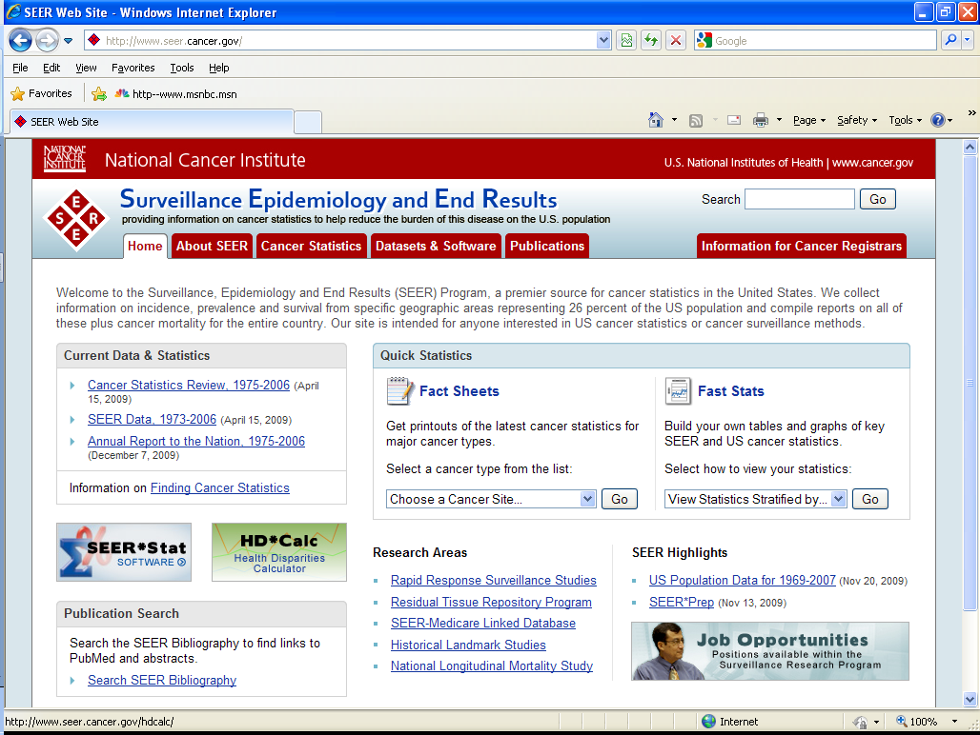
Notes:
The hematopoietic database and coding manual are available from the SEER web site. Click on information for cancer registrars.

Slide 24
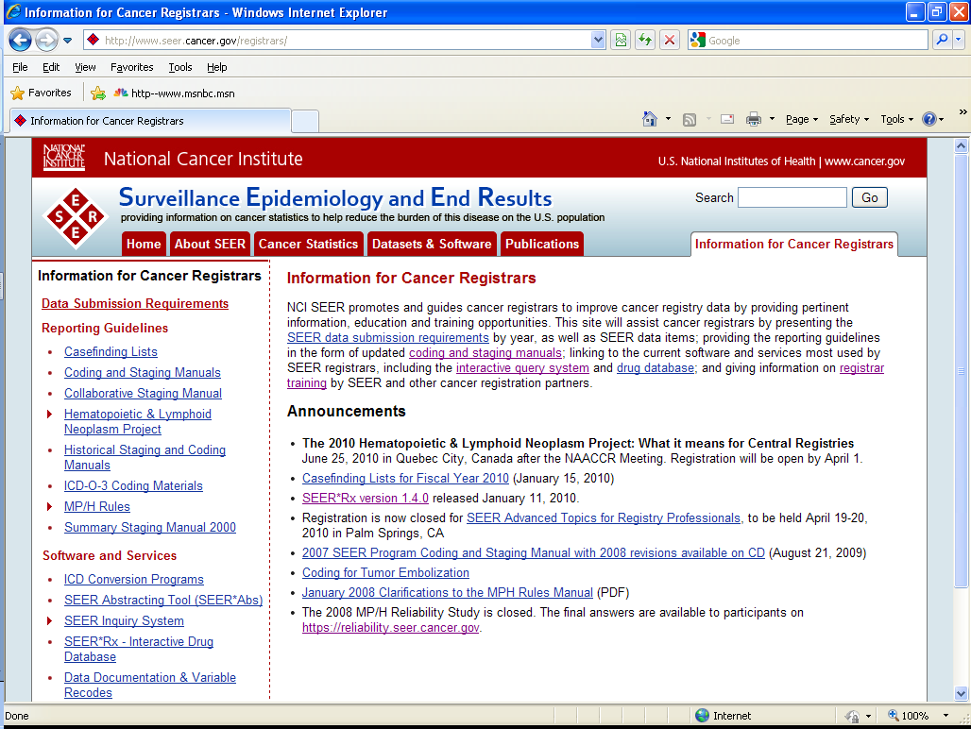
Notes:
Then click on Hematopoietic and lymphoid neoplasm project.

Slide 25
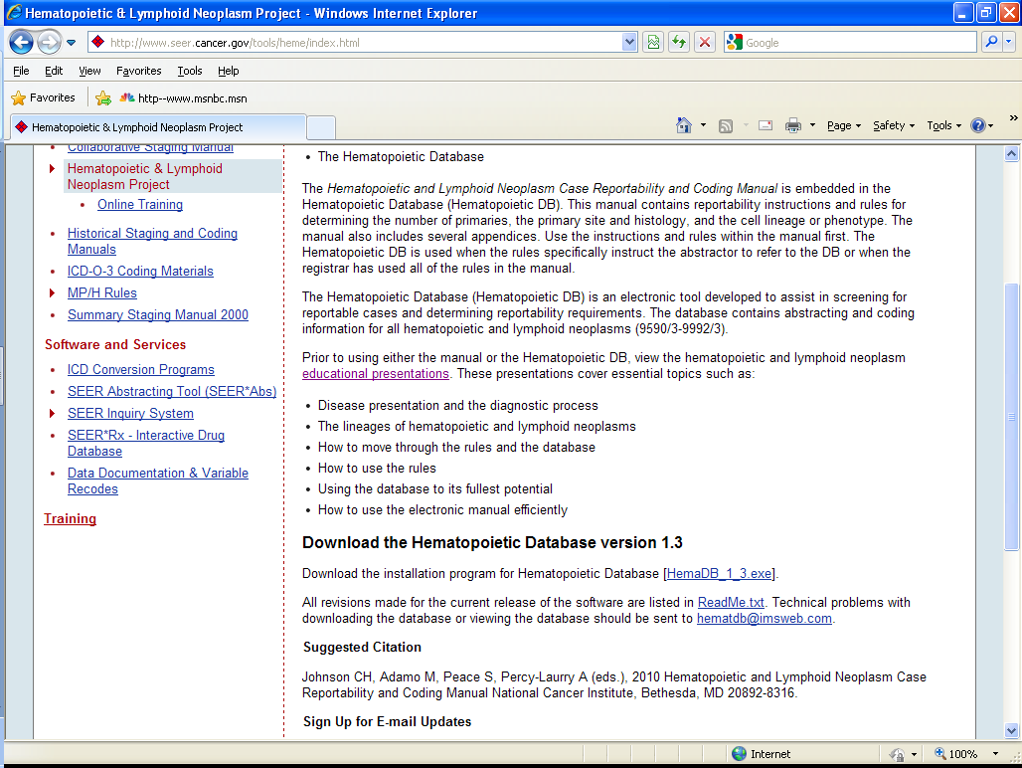
Notes:
Go to the SEER web site, click on Information for Cancer Registrars. Then click on the left side for Hematopoietic and Lymphoid Neoplasm Project. This is the link to download the educational presentations for this project, as well as the database itself. You are asked to enter you name and email address so that you can be notified when updates are posted. Simply download and install the program – it looks very similar to SEER Rx which you use to identify cancer therapy agents.

Slide 26
Hematopoietic Database
Notes:
Once installed, you can click on the icon on your desktop and the program launches to this screen.

Slide 27
2010 Reference – the Hematopoietic Database
Manual (Rules)
Database
Reportability
Multiple primary rules
Site and histology codes
Grade
Glossary
Tables
MP Calculator
Disease definition
Synonyms
Definitive diagnostic method
Genetic tests and Immunophenotyping
Treatments
Transformations
Abstractor notes
Notes:
We now have a new reference for coding and abstracting hematopoietic diseases. Throw out the Red Book and the fold out table (Single vs Subsequent Primaries of Lymphatic & Hematopoietic Diseases) and any previous casefinding or reportability lists. The new database has it all! You can download it from the SEER web site.

Slide 28
Review Manual Sections
What’s New
Reportability rules
Multiple Primary rules
Primary site and histology rules
Grade rules
Glossary and Appendices
Notes:
So now I have provided a very basic outline of the structure and approach of the new classification system. You may want to watch the educational presentations on the SEER web site for more details and reinforcement of what you have heard here. There are 13 approximately half hour sessions for a total of 7 CEUs.
However, note that there will probably be a revised Hematopoietic database and manual coming out sometime in 2012.
Now let’s take a look at the Hemato database, starting with the embedded manual. Go to Handout 2.

