Slide 1
NON-SURGICAL CANCER TREATMENTS
Abstractors Training
Chemotherapy
Hormone Therapy
Immunotherapy
Transplant/Endocrine Therapy
Radiation Therapy
Other Therapy
Notes:
The cancer treatments covered in this section include Chemotherapy, Hormone Therapy, Immunotherapy, Transplant or Endocrine Therapy, Radiation Therapy, & Other Therapy.

Slide 2
CHEMOTHERAPY:
Treatment method in which chemicals (not hormones) are used to kill cancer cells within the patient’s body, resulting in tumor reduction or eradication.
Notes:
These drugs are “definitive therapy”; they directly affect the tumor….

Slide 3
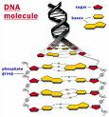
How Does Chemotherapy Act?
Chemotherapy drugs interfere with DNA production and cell division.
Notes:
Some drugs interrupt the replication of DNA in the nuclei of cells, or they cause problems with one of the stages of mitosis, or cell division. As a result, the affected cancer cells cannot grow and reproduce anymore.

Slide 4
Types of Chemotherapy Drugs
Alkylating agents
Antimetabolites
Natural products
Other miscellaneous
Notes:
Cytoxan, Leukeran
5-FU, Methotrexate
Daunomycin, Mitomycin C
Cisplatin, Hydroxyurea

Slide 5
What NOT to code!
Code Chemotherapy – NOT the method of administration.
Do NOT code radiosensitizer drugs – these are classified as ancillary drugs.
Notes:
Chemotherapy may be administered intra-operatively (such as intra-peritoneal chemotherapy). Code the chemotherapy only in the chemotherapy treatment fields. Do not record as a definitive surgery.
Chemotherapy administered at a low dose concurrently with radiation therapy is considered a radiosensitizer. A radiosensitizer enhances the effect of the radiation therapy by making tumor cells more sensitive to radiation therapy. Because the chemotherapy is given in a low dose as a radiosensitizer, it is not considered a definitive treatment. When radiosensitizing chemotherapy is administered concurrently with radiation therapy, record only the radiation therapy as definitive treatment.

Slide 6
Is this drug “chemotherapy”?
Use SEER*Rx to determine whether or not to code drug as a true chemotherapy drug.
Ancillary drugs are NOT coded as chemotherapy drugs.
Notes:
Before automatically coding what you THINK is a cancer drug, look it up on SEER*Rx, which can be viewed on the SEER website or can be downloaded and installed as an icon on your registry computer. We began using SEER*Rx in 2005, and all registrars should currently use this method to determine if an agent is a chemotherapy drug or some other category of therapy or not. Ancillary drugs are sometimes given at the same time as chemotherapy drugs, but because they do not directly affect the CANCER, they should NOT BE CODED as chemotherapy.

Slide 7
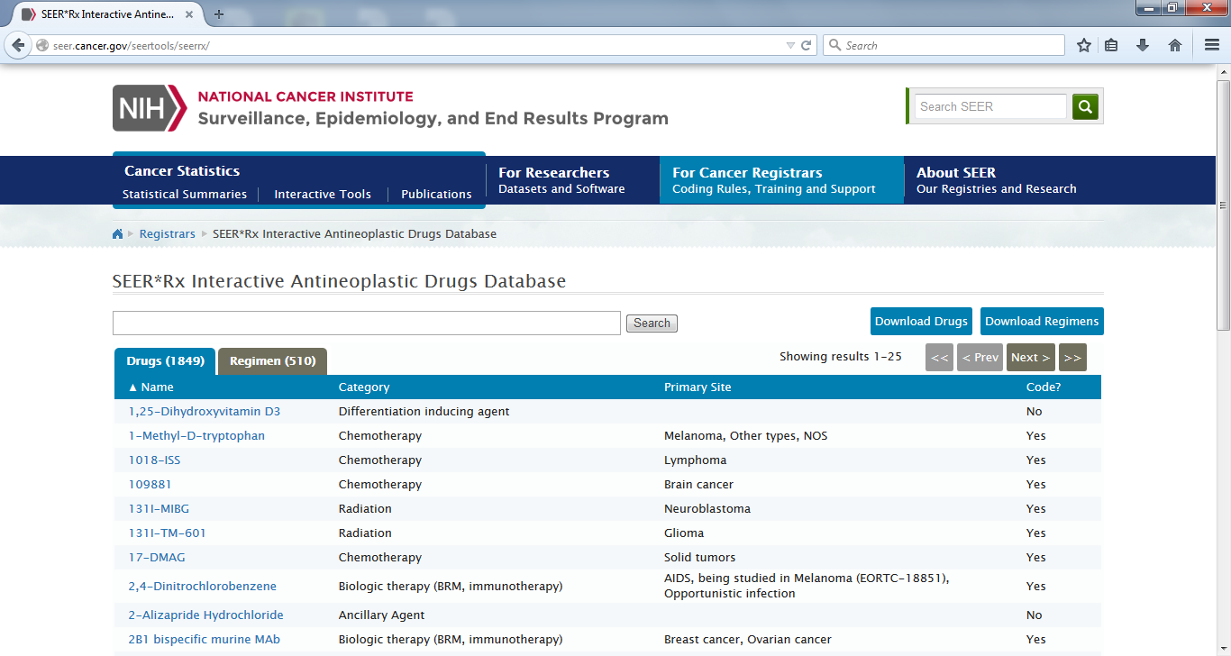
Using SEER*Rx
Notes:
Beginning with cases diagnosed in 2005, registrars have been able to use the handy SEER*Rx module for identifying types of drug therapies. There is a box for single drugs and one for multiple drug regimens. Just type the name or regimen abbreviation, and click on submit. The resulting box will show the category of the drug and which therapy type to enter. When you have entered something that isn’t in the database, it will show you! For cases diagnosed prior to 2005, use the list in Appendix H of the CPDMS abstractors manual. That list is not up-to-date for current therapies, so do not use it for cases from 2005 forward.
Note that a few chemotherapy drugs were re-classified as immunotherapy drugs starting with 1/1/13 diagnoses. Be sure and read the notes in SEER*Rx in order to correctly classify the therapy type for the drugs you are recording.

Slide 8
Chemotherapy Fields
Tx Type
Tx Course
Date Tx Started
Therapy Facility
At This Facility
Chemotherapy Code
Treatment Notes
Notes:
The paper abstract shows a set of therapy fields for chemo, hormones, immuno, transplant/endocrine, and other therapies altogether. Of course, we just fill in the fields that are appropriate for the case in question. Some cases require multiple treatments to be completely filled out. We choose “C” for chemotherapy, “F” for 1st course, and enter the date chemotherapy began. Therapy facility is coded or spelled out, either way….’At this facility’ means was it done at YOUR facility? Enter the appropriate code… The chemotherapy code is explained on the next slide…

Slide 9
Single or multiple drugs?
Code “1” = chemo drug(s), NOS
Code “2” = single chemo drug
Code “3” = multiple chemo
drugs; a drug regimen
Notes:
For cases where chemotherapy is administered, but you do not have any information as to which or how many drugs, use code 1…chemotherapy NOS. When just one drug is administered, use code 2. Administration of multiple drugs at the same time in a chemotherapy “regimen” is coded as 3. Be careful when coding two or more drugs; check to see if one is ancillary, or if one or some of them are hormone therapy instead of chemotherapy.
Code chemoembolization as 01, 02, or 03 depending on the number of chemotherapeutic agents involved.

Slide 10
Single chemo drug + ancillary drug?
Ancillary drugs are NOT coded!
For patients receiving a single chemotherapy drug plus an ancillary medication, code as single chemotherapy drug, code “2”.
Notes:
Remember---- ANCILLARY drugs aren’t coded at all. If a patient is taking an ancillary drug along with a chemotherapy drug, code the chemotherapy as a single drug, code 2.

Slide 11
Chemoembolization
Chemoembolization is a procedure in which the blood supply to the tumor is blocked surgically or mechanically and anticancer drugs are administered directly into the tumor.
Code as chemotherapy when the embolizing agent(s) is a chemotherapeutic drug(s) or when the term ‘chemoembolization’ is used with no reference to the agent.
Notes:
This procedure permits a higher concentration of drug to be in contact with the tumor for a longer period of time. Use SEER*Rx to determine whether the drugs used are classified as chemotherapy agents.
Also code as chemotherapy when pt has primary or metastatic Ca in the liver and the only information about embolization is a statement that the pt had chemoembolization, tumor embolization or embolization of tumor in the liver; HOWEVER, if alcohol is specified as the embolizing agent, even in the liver, code as Other Therapy.

Slide 12
How to handle a change in chemo:
Drug(s) may be changed due to pt sensitivity; still 1st course treatment as long as substitution is from same drug group.
Drug changes due to treatment failure/disease progression are no longer 1st course; they become subsequent therapies.
Notes:
Sometimes a patient will have a reaction to a particular chemotherapy drug, and the physician has to make a change to the treatment plan. The substituted drug will still be counted as 1st course therapy, as long as it is from the same drug group or category. Check SEER*Rx or check with the oncologist to determine if the new drug(s) are of the same group/category. If a pt develops disease progression or metastasis while on 1st course chemotherapy, the physician will change the chemotherapy drugs. The 2nd set of drugs would no longer be 1st course – they would be called “subsequent” chemotherapy. Recording of subsequent therapies is not required by KCR or the CoC; however, they can be recorded if that is your hospital registry practice.

Slide 13
Sample Coding…
Colon cancer patient treated with 5-FU & Leucovorin. Chemo code?
Colon cancer patient dx 12/27/12 receiving FOLFOX with Avastin. Chemo code?
Colon cancer pt goes to neighboring town and receives chemo, NOS. Chemo code?
Notes:
2 (Leucovorin is ANCILLARY and not coded!)
3 (Multiple chemotherapy agents – Oxaliplatin, 5-FU, Avastin) NOTE: If the patient was diagnosed in 2013, Avastin would need to be recorded as
immunotherapy.
1 (Chemo given but type unknown)

Slide 14
HORMONE THERAPY
Hormones or hormone antagonists may be administered as definitive cancer treatment.
This is NOT the same as “hormone replacement therapy”!

Slide 15
How does Hormone Therapy act?
Changing the levels of or activity of
some hormones can slow down or kill
cancer cells.
One or more agents may be used.
Hormones are often given to treat breast, prostate, endometrial, and thyroid cancers, as well as lymphomas and leukemias.

Slide 16
When to code Prednisone….
Code Prednisone, a steroid, when it is given as part of a combination regimen (Ex = MOPP, CHOP).
Do NOT code Prednisone when given for reasons other than “definitive” cancer treatment.
Notes:
Decadron (dexamethasone) is another hormone that is given as an antiemetic drug or as a definitive cancer treatment. Code it ONLY if it is administered as a definitive therapy.

Slide 17
Is this drug “hormone therapy”?
Use SEER*Rx to determine whether or not to code drug as a true hormone agent.
HRT (hormone replacement therapy) is not coded except in certain thyroid cases.
Notes:
Be sure to look up all agents in SEER*Rx. It is helpful in categorizing treatment types, and also in spelling agents correctly!

Slide 18
Coding Thyroid hormone therapy…
Code thyroid replacement hormone therapy when it is given for papillary and/or follicular carcinoma of thyroid. Do not code as hormone therapy for medullary thyroid carcinoma.
Notes:
According to the 2007 SEER Manual, thyroid hormone is coded as therapy for papillary &/or follicular cancers only.

Slide 19
Hormone Therapy Fields
Tx Type “H”
Tx Course
Date Tx Started
Therapy Facility
At This Facility
Hormone Therapy Code “1”
Treatment Notes
Notes:
For all cases receiving hormones as cancer therapy, create “H” for hormone therapy, “F” for 1st course, and enter the date hormones were actually 1st received. Therapy facility is coded or spelled out, either way…. At this facility means was it done at YOUR facility. Enter the appropriate code, which is “1” for all codeable hormone therapies. Record the name of the hormone therapy agent(s) given in treatment notes.

Slide 20
Sample Coding…
Patient with breast Ca was started on Femara. HRT code?
Lymphoma patient underwent CHOP therapy. HRT code?
Notes:
Breast case: Confirm on SEER*Rx, Create “H” Therapy, code “1” for therapy received.
Lymphoma case: Check SEER*Rx for therapy type(s), code appropriately! Create “C” for 3 chemos (combination), create “H” for 1 hormone.

Slide 21
IMMUNOTHERAPY
Also known as biological response
modifiers or biotherapy, these agents
use the immune system to fight
cancer.

Slide 22
ImmunoTx works in various ways…
Makes cancer more recognizable
Increases killing power of immune cells
Changes cancer growth patterns
Prevents cancer cells from spreading
Notes:
These are just a sampling of the various ways immunotherapy may work to enhance the immune system’s defense mechanisms. By and large, these agents either alter the immune system or change the body’s response upon identifying cancer cells.

Slide 23
Types of Immunotherapy
Cancer Vaccine – still experimental
Interferons – natural proteins made by WBC’s
Interleukin (IL2) – kidney Ca & melanoma
Monoclonal Antibodies (Mab) – made in lab; check SEER*Rx for category to code
Notes:
Ca vaccines are not coded at this time in this category. They MAY be coded as ‘other’ therapy, code 0. Clinical trials are taking place using vaccines in brain, breast, colon, kidney, lung, melanoma, & ovarian cancer cases.
Alpha interferon slows tumor growth directly; it is used for multiple myeloma, CML, hairy cell leukemia, & melanoma. Monoclonal antibodies are artificial antibodies used in a variety of ways in systemic therapy. Some disrupt cancer cell activities & “act like” chemotherapy; some are attached to radioisotopes & “act” as radiation therapy. Remember to check SEER*Rx to identify the category for coding of each one.

Slide 24
Immunotherapy Code
Create “I” therapy, record the course of treatment and treatment start date.
Record “1” to show that immunotherapy was given.
Spell out the treatment agent in the text line at the end of the therapy field.

Slide 25
Sample Coding…
Patient with advanced colon cancer diagnosed 2/3/13 receiving FOLFOX with Avastin.
Create “I” therapy; code “1” for treatment received.
Check SEER*Rx for treatment type; code appropriately!
Notes:
1 (Avastin is coded as immunotherapy starting with cases diagnosed 1/1/13 and forward)

Slide 26
TRANSPLANT OR ENDOCRINE THERAPY
Create “T” for any of these procedure types :
Bone marrow transplant
Stem cell harvest
Endocrine surgery
Endocrine irradiation

Slide 27
Types of bone marrow transplants
Autologous – marrow originally taken from patient is reintroduced after total body irradiation/ chemotherapy.
Allogeneic – marrow is donated by another person; includes donation from identical twin.

Slide 28
Endocrine Treatments
Endocrine surgery – removal of endocrine glands results in beneficial effect on cancer of another site due to absence of hormones. (Ex = bilateral orchiectomy for advanced prostate Ca).
Endocrine irradiation – this treatment shrinks glands, which then produce fewer hormones, having a beneficial effect on cancer of another site.
Notes:
Endocrine surgery performed for hormonal effect is coded only as endocrine therapy…not as definitive surgery.

Slide 29
Transplant/Endocrine Tx Codes
00 No transplant procedure or endocrine therapy administered; diagnosed at autopsy
10 Bone marrow transplant procedure administered, type not specified
11 Bone marrow transplant – autologous
12 Bone marrow transplant – allogeneic
20 Stem cell harvest (and infusion); umbilical cord stem cell transplant
Notes:
When recording stem cell harvest, must have evidence that subsequent stem cell infusion took place. Stem cell harvest alone is not definitive therapy.

Slide 30
Transplant/Endocrine Tx Codes (Cont’d)
30 Endocrine surgery &/or endocrine radiation therapy
40 Combination of endocrine surgery &/or radiation with a transplant procedure (combination of codes 30 and 10, 11, 12, or 20)

Slide 31
Sample Coding…
80 y/o male presents with bone pain, elevated PSA, and DRE evidence of nodular prostate. Biopsies are positive for Gleason score 9 prostate adenocarcinoma. Bone scan reveals bone metastases. Patient opts for removal of bilateral testes instead of ongoing hormone therapy.
Treatment code ?
Notes:
This procedure, which is done on an outpatient basis, is called a bilateral orchiectomy. It is an endocrine surgery which results in no more testosterone being produced; this lack of the male hormone slows down the growth or progression of the patient’s prostate cancer. This would be coded as “30”. This would not be coded as a definitive surgery.

Slide 32
Sample Coding…
25 y/o male with acute leukemia is scheduled for a bone marrow transplant. He receives marrow tissue from a sibling. Following recovery, he is in complete remission.
Therapy code?
Notes:
The bone marrow was from relative – allogeneic transplant. This is coded as “T” for transplant and the type of transplant is coded “12”.

Slide 33
RADIATION THERAPY
  “Radiation therapy (or radiotherapy) is the medical use of ionizing radiation as part of cancer treatment to control malignant cells”.
  (source: Wikipedia, 8/6/08)

Slide 34
Types of Radiation Therapy
External Beam Radiation
Brachytherapy
Radioisotopes
Notes:
The major categories of radiation therapy are External Beam Radiation, Brachytherapy, and Radioisotopes.

Slide 35
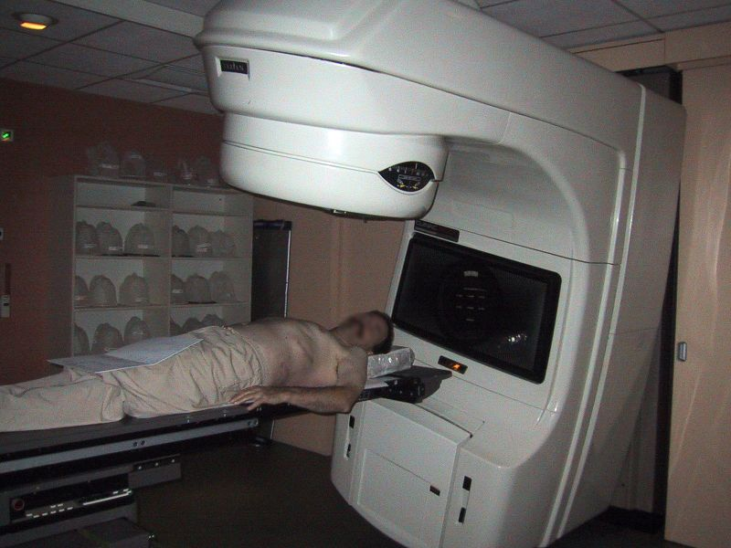
Linear Accelerator
(delivers external beam)
(source: Wikipedia)
Notes:
This photo shows a patient getting ready to be treated with external beam radiation by a linear accelerator.

Slide 36

Brachytherapy
(seed implants)
(Source: Dept of Human Oncology, University of Wisconsin School of Medicine & Public Health website)
Notes:
Here, we see tiny seeds, a type of brachytherapy, which are implanted in a patient’s body. In the case of prostate seeds, the implants are left inside the organ being treated. Mammosite radiation therapy delivered to a breast lumpectomy site via a balloon containing seeds is another example of brachytherapy. Other primary sites commonly treated with brachytherapy include, lung, endometrium, and cervix.

Slide 37
Radiation Therapy Fields – required by KCR
Therapy Type
Therapy Course
Date Therapy Started
Therapy Facility
At This Facility
Radiation Therapy Code
Radiation Site 1/Radiation Site 2/Radiation Site 3
Number of Rads
Treatment Notes
Notes:
The data elements in bold are required to be coded by all Kentucky hospitals. All Kentucky hospitals must code treatment type, course, date started, therapy at this facility, radiation therapy code, and treatment notes.

Slide 38
Radiation Therapy Fields – Required by ACoS
Location of Radiation Treatment
Radiation Treatment Volume
Regional Treatment Modality
Regional Dose
Boost Treatment Modality
Boost Dose
Number of Treatments to this Volume
Date Radiation Ended
Notes:
ACoS-accredited programs are required to record additional details including Location of Radiation Tx, Tx Volume, Modality, etc. We WILL go over each of those items, and they can be found in the CPDMS Abstractor’s Manual online. Each field has an assigned KCR Data Item # for locating those items! There may be times when 1st course of treatment is incomplete. It is important to continue follow-up efforts to be certain the complete treatment information is collected.

Slide 39
Radiation Therapy Codes
1 = Beam Radiation
2 = Radioactive Implants
3 = Radioisotopes
4 = Combination Beam + 2 or 3
5 = Radiation Therapy, NOS
These codes are required by the Kentucky Cancer Registry. Registries that are part of ACoS-accredited cancer programs must apply different/extended codes required by the CoC (specified in the FORDS manual).
Notes:
When creating radiation therapy for your case, you must choose the appropriate code for the type or types received. When you have no specific information as to type, use code 5 for radiation NOS.

Slide 40
Location of Radiation
Identifies facility where Rad Tx took place:
1= All Tx at this facility; Dx at autopsy
2= Regional Tx at this facility; boost elsewhere
3= Boost at this facility; regional Tx elsewhere
4= All radiation Tx elsewhere
8= Radiation therapy administered, but doesn’t fit descriptions above
9= Unknown where administered; death certificate patient
Notes:
This data item shows if the treatment was performed at your facility or elsewhere. Radiation treatment is frequently delivered in two or more phases which can be summarized as “regional” and “boost” treatments. This data item is broken down by regional radiation Tx and boost radiation Tx.

Slide 41
Radiation Treatment Volume
The main target of 1st course
radiation Tx.
Found on radiation chart and
radiation oncologist’s summary
letter upon completion.
Consult local radiation oncologist for
help in determining exact treatment
volume.
Notes:
What is treatment “Volume”? You might think it is how MUCH radiation is given; however, the Commission on Cancer has designated “Volume” to mean the anatomic TARGET that receives the most clinically significant radiation therapy. (Read slide) If two discrete volumes are treated and one of those includes the primary site, record the treatment to the primary site. Refer to the list of treatment volumes in FORDS 2013 (pg’s 239-241) or the CPDMS Abstractor’s Manual to determine the correct volume and corresponding code.

Slide 42
Regional Tx Modality
The main type of radiation Tx used to deliver the largest regional dose to the main target during 1st course.
Record the dominant modality if multiple types were used.
Code IMRT or conformal 3D whenever either is mentioned. [Tomotherapy is a type of IMRT and is coded ’31’.]
Code radioembolization as brachytherapy.
Notes:
Refer to list in FORDS 2013 (pg’s 243 & 244) or CPDMS. These codes include external beam NOS, photons (specific ranges), electrons, IMRT, 3D conformal, radiosurgery, brachytherapy, radioisotopes, and combinations. Ask for guidance from your local radiation oncologist or in order to code these fields consistently.
Tomotherapy is coded as IMRT
‘Photons’ equivalent to ‘x-rays’.

Slide 43
Regional Dose
Major dose of regional radiation Tx in centiGray (cGy).
Keep separate from boost dose.
Code 88888 for brachytherapy or radioisotopes.
Occasionally given in “rads”.
Notes:
The Regional Dose is the actual main DOSE of radiation. (READ) The unit of measure for recording this data element is “centiGray” (cGy). If radiation therapy delivered in “rads”, the number of rads delivered would be equivalent to total centiGray (cGy)—one rad = 1 cGy. Sometimes radiation therapy is delivered in “gray” (Gy). “Gray” x 10 = centiGray. Example – Patient received 500 Gy. Record as 5,000 cGy.

Slide 44
Boost Tx Modality
The main type of radiation Tx used to deliver the major boost to the volume “of interest” in 1st course.
Record dominant modality if multiple modalities used.
MAY precede regional Tx.
Notes:
Boost may entail external beam of reduced size, implants, stereotactic radiosurgery, or other types. Refer to FORDS 2013 (pg’s 247-248) or CPDMS to review actual codes. Request help from local radiation oncologist for clarity in coding these fields.
‘Photons’ equivalent to ‘x-rays’.

Slide 45
BOOST DOSE
Record dose delivered in centiGray (cGy).
Do not include regional dose.
Code 88888 for brachytherapy or radioisotopes.
MAY be given in “rads”.
Notes:
(Same as Regional Tx dose info)

Slide 46
# Tx’s to this Volume
Record the number of treatments or fractions given during 1st course Tx.
Add number of regional Tx sessions and number of boost Tx sessions to obtain total.
Brachytherapy or implants (ie I125 seed implants for prostate cancer) are counted as one treatment
Notes:
This field shows how many fractions or treatments were given. It pertains to 1st course treatment. Add the number of regional treatments plus the number of boost boost treatments to get the total. Brachytherapy counts as just one session.

Slide 47
MammoSite Brachytherapy
MammosSite radiation therapy delivered to a breast lumpectomy site via a balloon containing seeds is a form of brachytherapy.
  HDR (high dose rate) intracavitary brachytherapy
  MammoSite seeds are inserted into the balloon one-at-a-time and the insertion of each seed is counted as a separate treatment/fraction per ACoS Canswer Forum
Notes:
Example:
Balloon inserted 04/10/12, the patient started tx twice a day x 5 days, then balloon was removed 4/15/12
The date rad started 04/10/12
The date rad ended 04/15/12
The total number of tx – 10 (the radioactive seeds were implanted 10 times)

Slide 48
Date XRT Ended/Tx Notes
Record date of LAST radiation therapy received during planned1st course of therapy.
Briefly describe radiation treatment in notes section.
Work case problems!
Notes:
The treatment end-date, or last date may be at another facility, but record the latest date anyway! Treatment notes in abbreviated form help back up your coded information and are easier to review by QA workers than numbers alone.

Slide 49
OTHER TREATMENT
Treatment not defined as surgery, radiation, or systemic therapy.
For hematopoietic diseases, this can include phlebotomy, transfusions, or aspirin (check SEER*Rx & the SEER Hematopoietic Database).
Notes:
Refer to the online SEER Hematopoietic Database to check on treatment categories for these diseases. It is most helpful in directing registrars whether to code a procedure and which category to create. The SEER Hematopoietic Manual and Database should be used beginning with cases diagnosed on or after 1/1/10. The hematopoietic database can be downloaded from the SEER website. The manual can be accessed through the hematopoietic database. **Demonstrate where on-line version and download instructions can be found online.** For hematopoietic cases diagnosed prior to 1/1/10, refer to the red Abstracting and Coding Guide for the Hematopoietic Diseases book for treatment details.

Slide 50
Other Therapy Fields
Tx Type “O”
Tx Course
Date Tx Started
Therapy Facility
At This Facility
Other Therapy Code
Treatment Notes
Notes:
Some cases require multiple treatments to be completely filled out. For Other Therapy agents, we choose “O” for treatment type, “F” for 1st course, and enter the date Other Therapy began. Therapy facility is coded or spelled out, either way…. At this facility means was it done at YOUR facility? Enter the appropriate code… The other therapy codes will be explained on the next slide…

Slide 51
Other Therapy Codes
0 Nondefinitive Tx (Optional: MAY record
stent placement, supportive care, ancillary drugs)
1 Other (hematopoietic Tx’s; embolization w/o chemotherapy or radiotherapeutic agents)
2 Other – Experimental (institutional clinical trials)
3 Other – Double Blind (clinical trials)
5 Antibiotics (CONSULT SEER*Rx)
6 Unproven (Unconventional methods such as acupuncture, yoga, etc)
Notes:
Be sure to refer to the CPDMS Abstractor’s Manual for a full list of instructions and unproven treatment types. Blood transfusions are NOT considered to be “other” treatment for acute leukemias. Although previously coded as “other” treatment, antibiotics for MALT lymphoma are no longer coded as such. Remember to look up all drugs in SEER*Rx to determine if they are definitive cancer treatments and to determine how they should be categorized!
Further clarification re: embolization – Embolization is coded as Other Therapy if the embolizing agent is alcohol, or if the embolized site is other than the liver and the only information in the record that embolization was given with no reference to the agent. Do not code presurgical embolization of hypervascular tumors with particles, coils or alcohol. These pre-surgical embolizations are typically performed to make the resection of the primary site easier (Ex: performed for meningiomas, hemangioblastomas, paragangliomas, and renal cell mets in the brain).

Slide 52
Sample Coding…
Patient with polycythemia vera undergoes phlebotomy to reduce the red blood cell volume. Coded?
Patient diagnosed with bile duct carcinoma chooses to go to Mexico for nutritional therapy. Coded?
Notes:
Polycythemia vera is routinely treated with phlebotomy, or “blood-letting”, as it was once called. This would be coded as an Other Tx, using code “1” (check Hematopoietic Database!)
Nutritional Tx in Mexico would be considered an unproven or unconventional type treatment & coded as “6”.

Slide 53
Questions?

