Slide 1


Unknowns in Brain Cancer Epidemiology: Focus on Brain Metastases
John L. Villano
Departments of Medicine and Neurology

Slide 2

Disclosures
None

Slide 3
Two main unknowns
Brain Mets.
Meningioma
Risk of cell phones/other unknown risks of brain tumors—currently minimal evidence
  Latency for radiation induced meningiomas and gliomas is decades

Slide 4
Introduction
Metastases is the most common CNS tumor
4-5 times more common than primary CNS tumors
Distribution parallels blood flow
80% cerebral hemispheres
15% cerebellum
5% in the brainstem

Slide 5
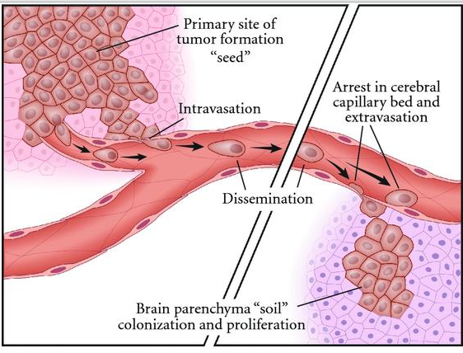
Rahmathulla G. et al. The molecular biology of brain metastasis. J Oncol.
2012:723541
Notes:
The metastatic tumor cells detach from the primary site and penetrate the adjacent parenchyma to reach the blood vessels. On reaching the vessels, the cells invade and enter the circulation (intravasation) and then disseminate within the vascular system (left half of figure). These cells eventually adhere to secondary sites “soil” to then extravasate out of the blood vessels and form colonies of metastatic cells (right half of figure)

Slide 6
PATHOPHYSIOLOGY: Seed and Soil Hypothesis
Seed: Genetic change in a cancer cell that supports growth in brain
Intravasation into blood and lymphatics
Enters systemic Circulation
Arrest in CNS capillary bed
Extravasation into brain parenchyma to form mets
Dormancy: If the soil is not propitious, the tumor cells may die or lie dormant for months or even years.
Tumor Growth in Soil/ Biochemical environment of the brain favorable for growth.

Slide 7
Role of Blood Brain Barrier
BBB is minimal hindrance to tumor cell extravasation
Acts as sanctuary
  Micro-mets lie dormant behind the BBB and are sheltered from chemotherapeutic agents
  However, growing tumor disrupts the BBB making chemotherapy effective

Slide 8
Clinical Features
Location based neurological deficits
  Destruction or displacement of brain tissue by expanding tumor
Signs/Symptoms of Increased ICP
  Peritumoral edema
  Vascular compromise
Headache
Seizures

Slide 9
Screening
Indication for routine brain scans in asymptomatic cancer patients:
  Lung cancer
  Metastatic melanoma
  Advanced Germ Cell Cancer—choriocarcinoma
All pts. with cancer obtain imaging studies if symptomatic

Slide 10
CNS Involvement
? of increase in cancer failure in CNS
  Improved therapies w/ limited CNS penetration
  Observed w/ trastuzumab therapy in breast ca.
  Prostate cancer with improved therapies an increase in leptomeningeal dz
CNS prophylactic treatment improves outcomes in ALL, Burkitt’s lymphoma, and SCLC
Sul J, Posner JB 2007 Cancer Treat Res 136

Slide 11
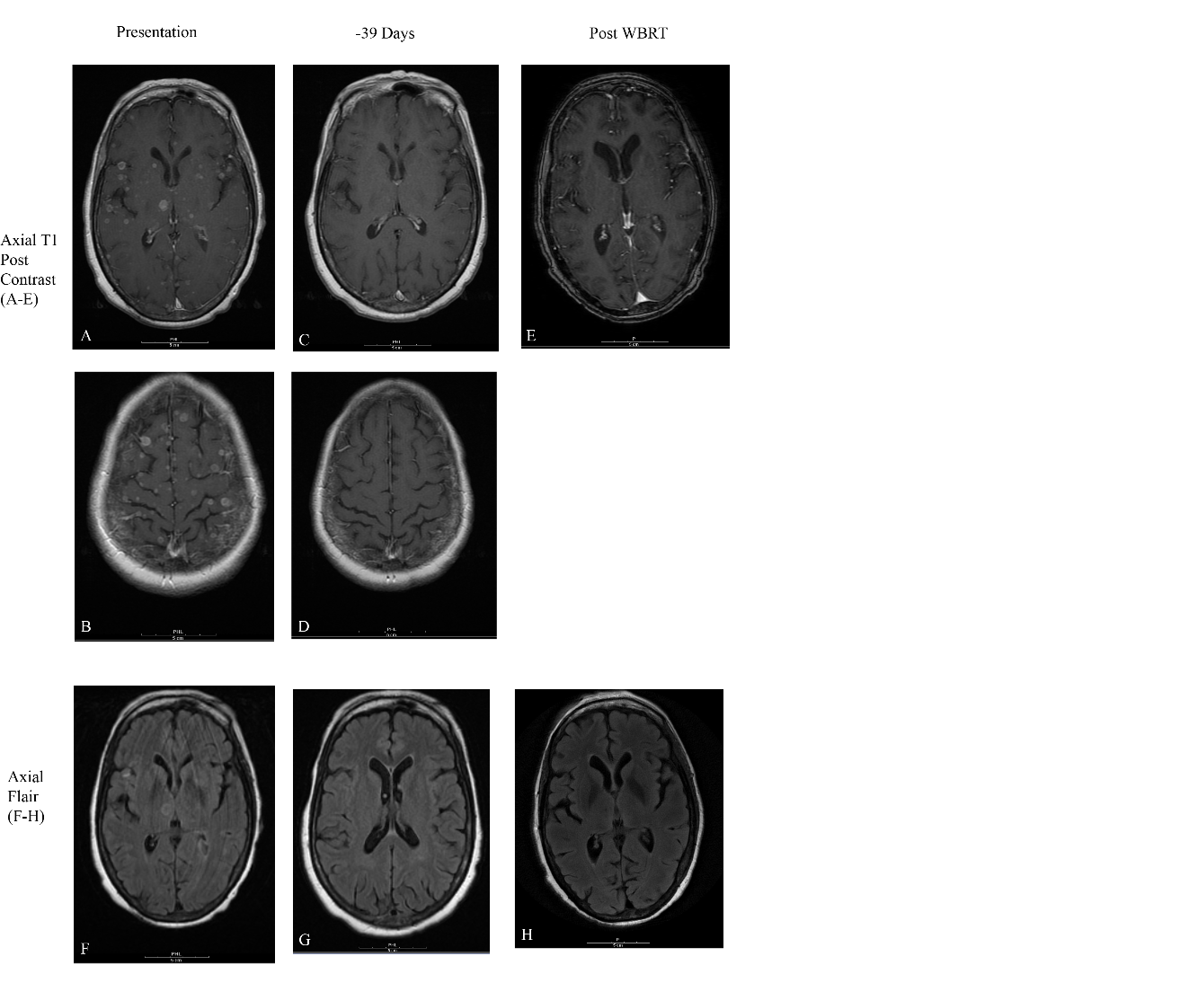

Slide 12
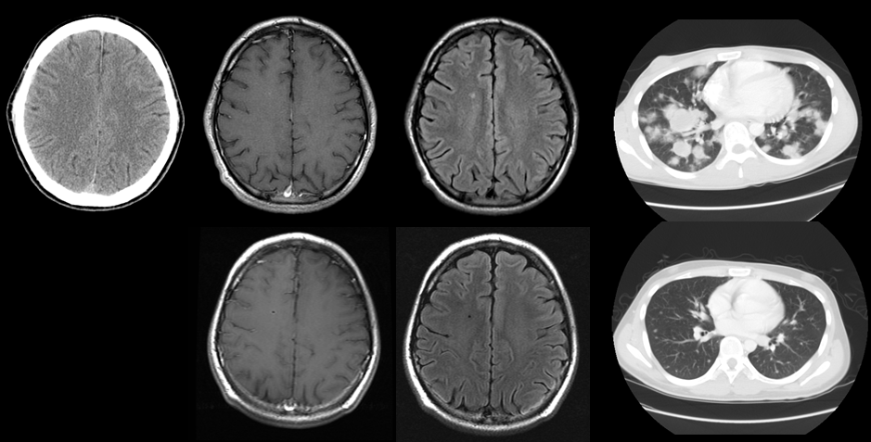
Incidental CNS involvement of testicular germ cell cancer: a growing trend?
Shaikh H, Villano JL. Radiother Oncol. 2009 Dec;93
A
B
C
D
E
F
G

Slide 13
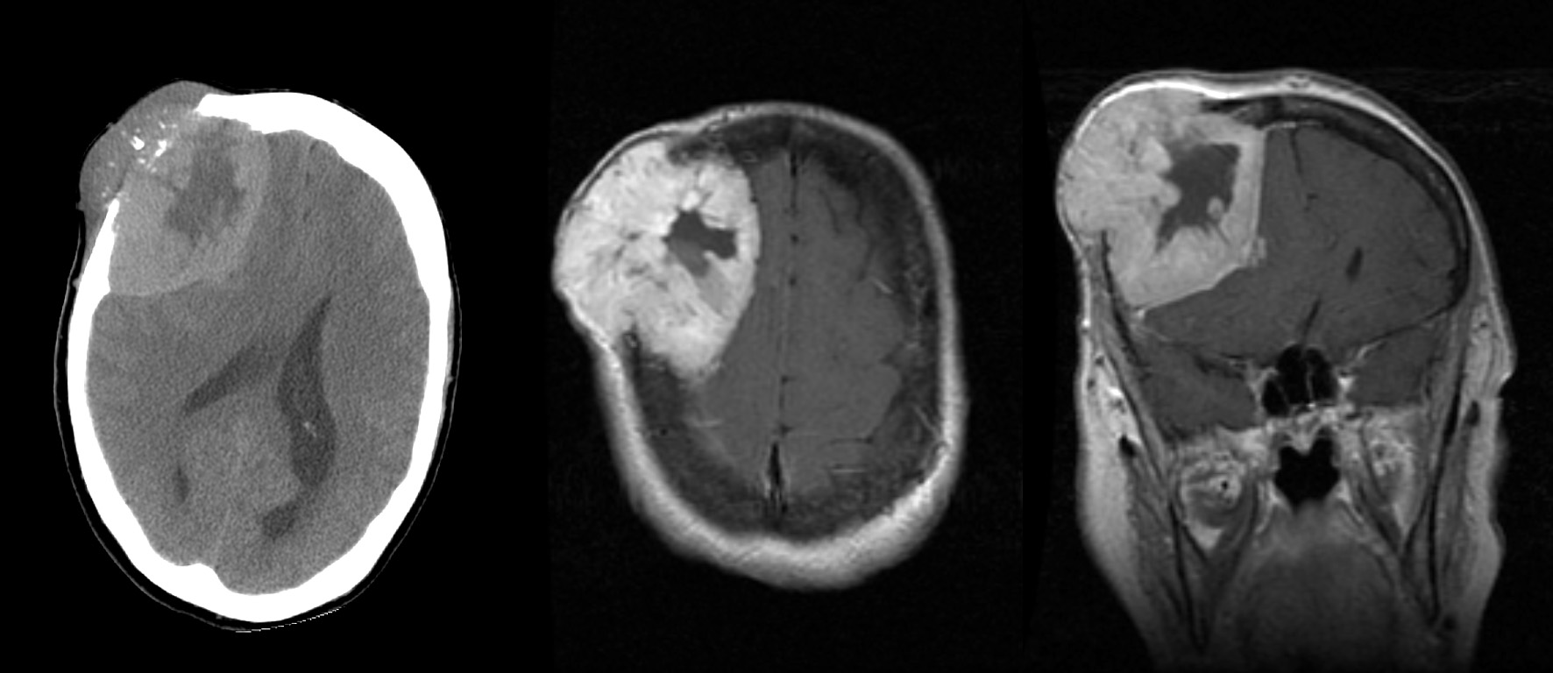
58 y/o woman with follicular thyroid cancer, initial presentation

Slide 14
57 y/o with known hx. of Squamous NSCLC
FINDINGS: The lesion has a low density, possibly cystic, component. There is no significant mass effect or edema associated with this mass.
IMPRESSION: Mildly enhancing lesion in the para sagittal right frontal lobe which appears to be partially calcified. Metastatic disease should be excluded.

Slide 15
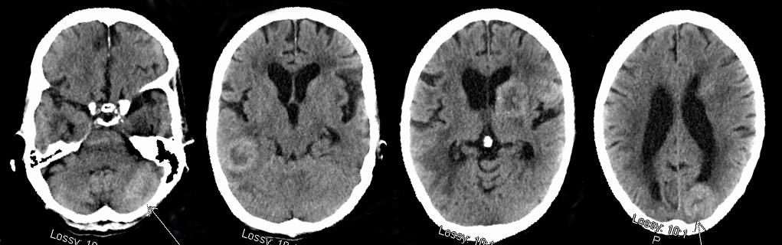
66 year old woman with history of localized adenocarcinoma lung cancer dx 12/2010.
She lives alone. Family noticed she had a decline in mental status, unable to care of herself with incontinence of urine and stool.

Slide 16
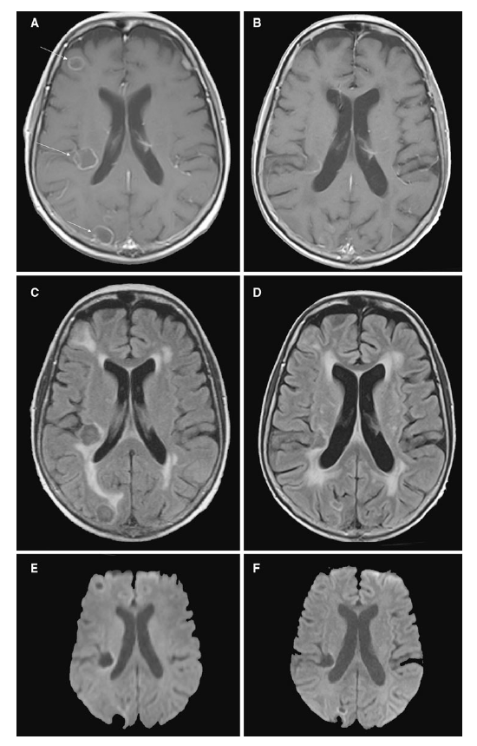

Slide 17
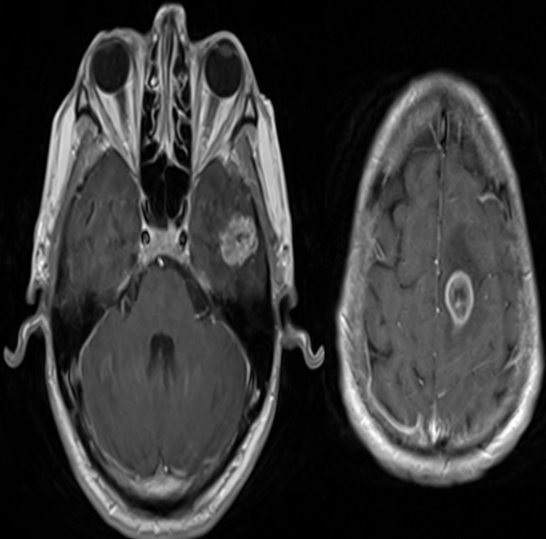

Slide 18
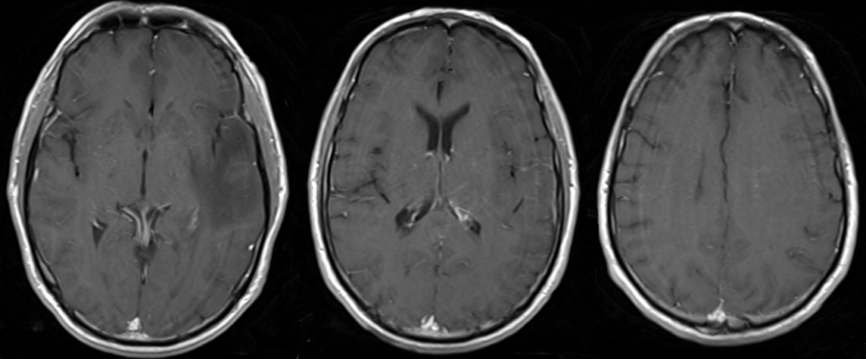

Slide 19
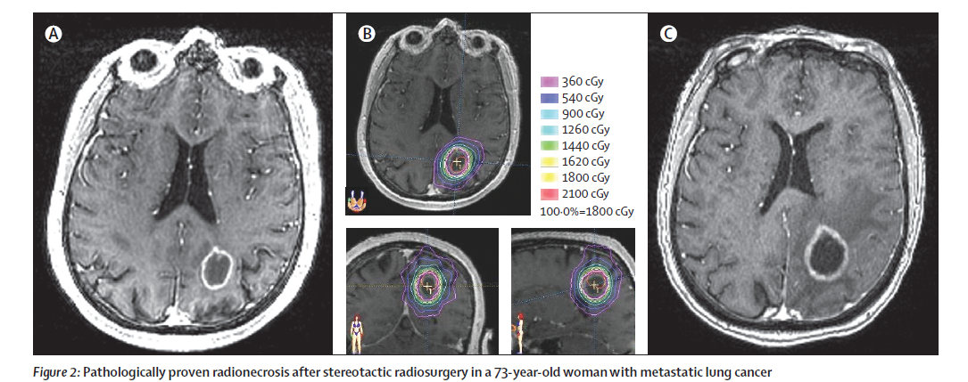
RANO Group, Lin, et al. Lancet Oncol. 2013

Slide 20
Treatment and Prophylaxis
PCI: Administering WBRT to patients at high risk of BM
Whole Brain Radiation Therapy (WBRT)
Stereotactic Radiosurgery +/-WBRT
Surgery + WBRT/SRS
Chemotherapy +/- WBRT

Slide 21
Prognosis
Early Studies report survival of 1 month without treatment
Pre-treatment Prognostic Factors
Performance Status
Age
Number of Mets
Extracranial Mets +/-
Primary Cancer Site

Slide 22
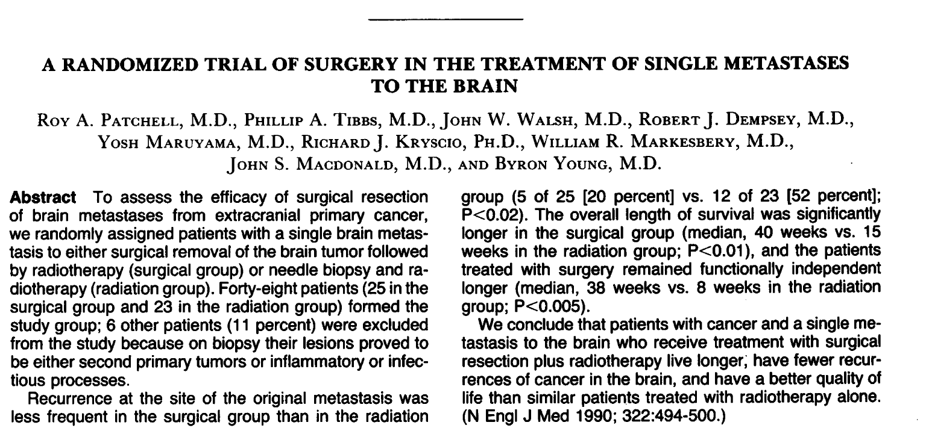

Slide 23
Patchell, NEJM 1990
Randomized single brain mets
  Surgical removal—followed by RT
  Needle biopsy—followed by RT
25 in surgical and 23 in RT
Improved overall survival 40 wks vs. 15 wks. in surgical group
Less recurrence at site and had functional independence longer in surgical group

Slide 24
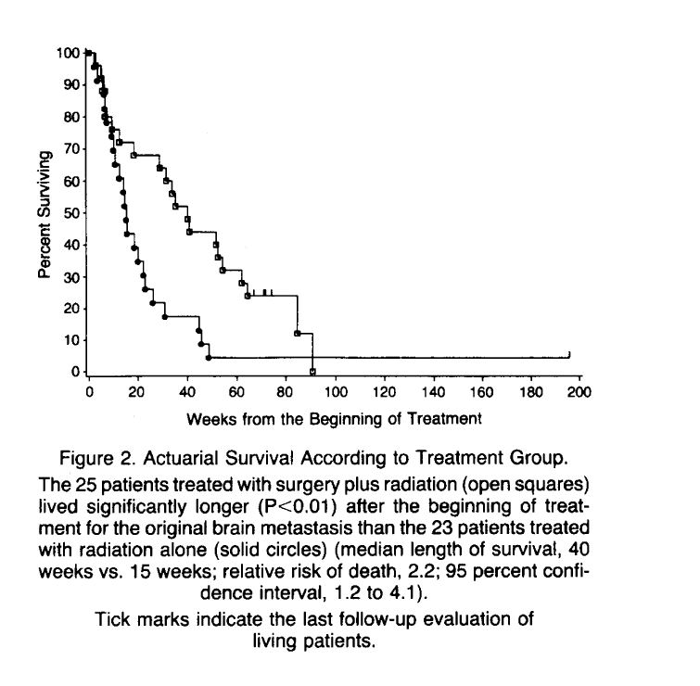

Slide 25
Patchell, R. et al. JAMA. 1998
Single met. surgery + RT (36 Gy) vs Surgery alone
95 pts who had single met.
  Primary end point - dz recurrence in brain; secondary were OS, cause of death, and preservation of independence
Combined arm had less recurrent dz at any site in brain, and less likely to die of neurologic causes
No diff. in OS (48 wks vs 43 wks )

Slide 26
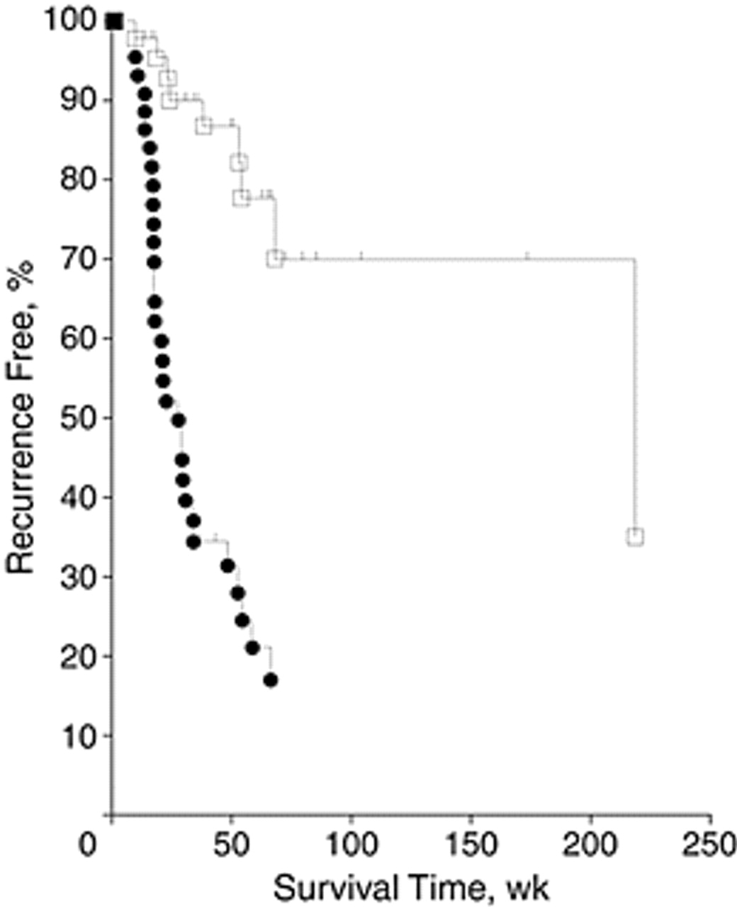
--The length of time to recurrence of tumor anywhere in the brain was significantly (P<.001) longer in patients in the radiotherapy group (white squares) than in the observation group (black circles), median 220 weeks vs 26 weeks (relative risk of any brain recurrence, 4.94; 95% confidence interval, 2.36-10.35)
Patchell, R. A. et al. JAMA 1998;280:1485-1489.
Copyright restrictions may apply.

Slide 27
RTOG 9508 Phase III trial
1-3 mets. randomized to WBRT vs WBRT + SRS boost
  stratified by # of mets and status of extracranial disease
167 assigned WBRT + SRS and 164 WBRT
Survival adv. in combined tx for pts w/ single met. (median survival time 6·5 vs 4·9 months, p=0·0393)
Andrews, DW et al Lancet 2004; 363

Slide 28
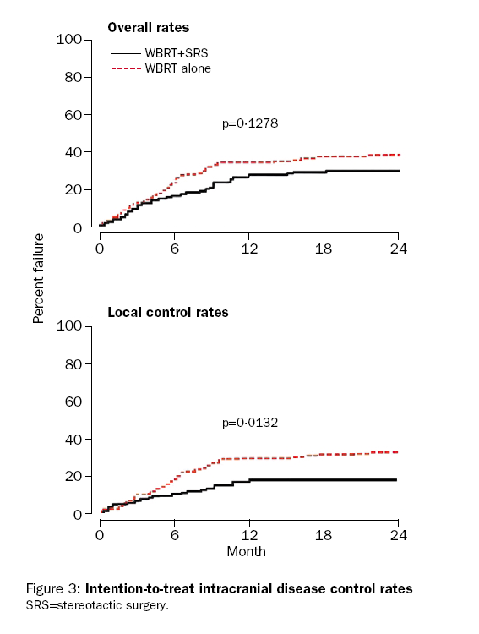
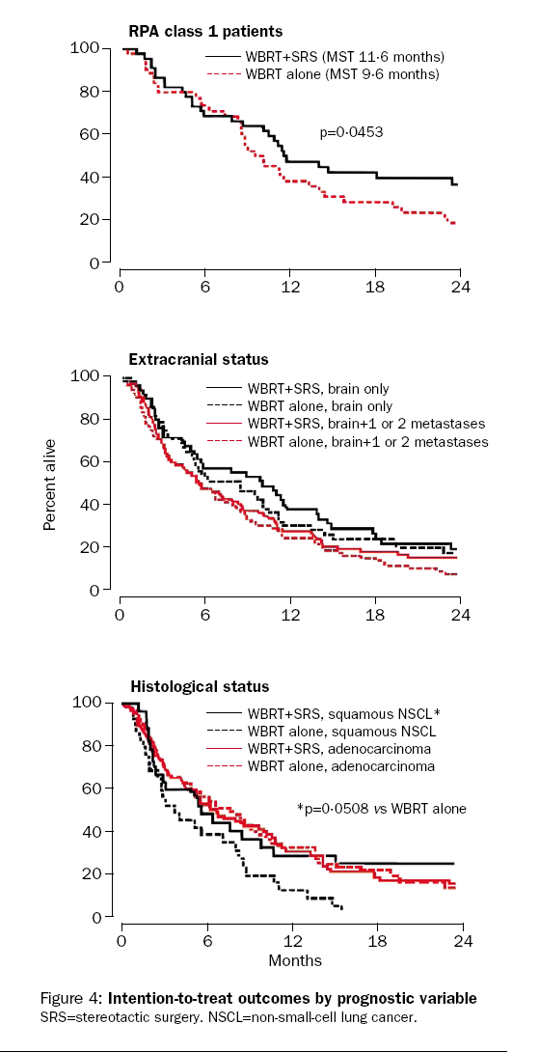

Slide 29
Aoyama, et al. JAMA. 2006;295
WBRT to SRS beneficial effects on mortality or neurologic function vs SRS
132 patients w/ 1-4 met, < 3 cm in diameter
No diff. in OS
  12-mo. brain dz recurrence rate 46.8% WBRT + SRS vs 76.4% SRS (P<.001)

Slide 30
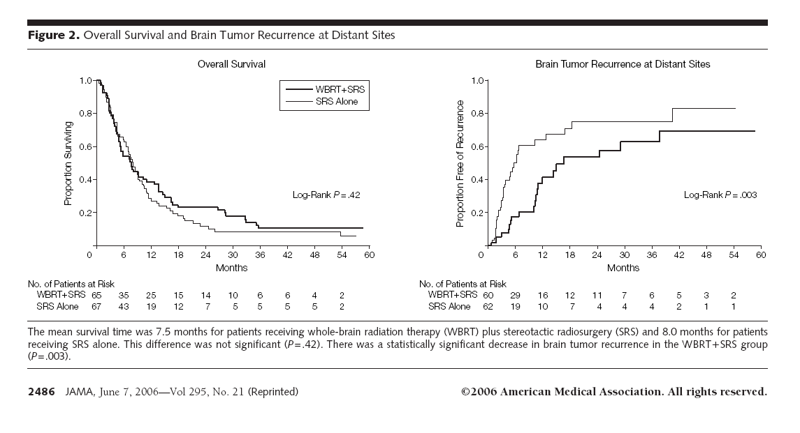

Slide 31
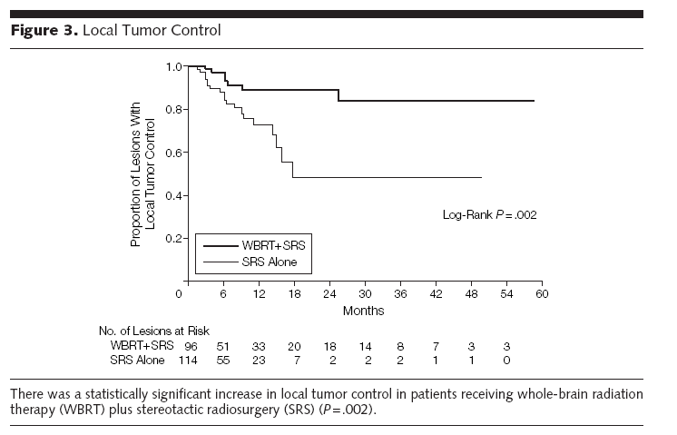

Slide 32
RTOG’s RPA
1200 patients from 3 consecutive RTOG trials for pts. with brain mets.
Class 1: patients with KPS ≥ 70, < 65 y/o, with controlled primary and no extracranial metastases (median: 7.1 months)
Class 3: KPS < 70 (median: 2.3 mo.)
Class 2- all others (median of 4.2 mo.)
Gaspar, L. et al., Int J Radiat Oncol Biol Phys. 1997;37

Slide 33
Karnofsky Scoring
100% - Normal
90% - Able to carry on normal activity; minor signs or symptoms of disease
80% - Normal activity with effort; some signs or symptoms of disease
70% - Cares for self; unable to carry on normal activity or to do active work
60% - Requires occasional assistance, but is able to care for most of his personal needs
50% - Requires considerable assistance and frequent medical care

Slide 34
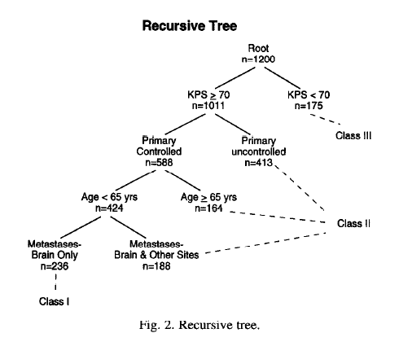
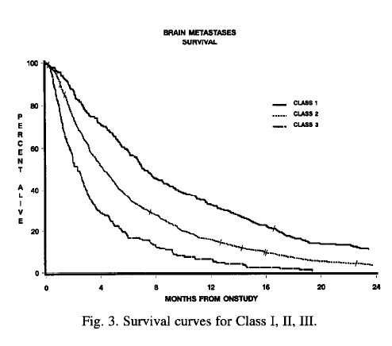

Slide 35
Graded Prognostic Assessment (GPA)
Guides treatment choices and research outcomes.
Prognostic Criteria | Score
 | 0 | 0.5 | 1
Age | >60 | 50-59 | <50
KPS | <70 | 70-80 | 90-100
No. of CNS Metastases | >3 | 2-3 | 1
Extracranial Metastases | Present | - | None
GPA 0-1 | GPA 1.5-2.5 | GPA 3
Int. J. Radiation Oncology Biol. Phys., Vol. 70, No. 2, pp. 510–514, 2008

Slide 36
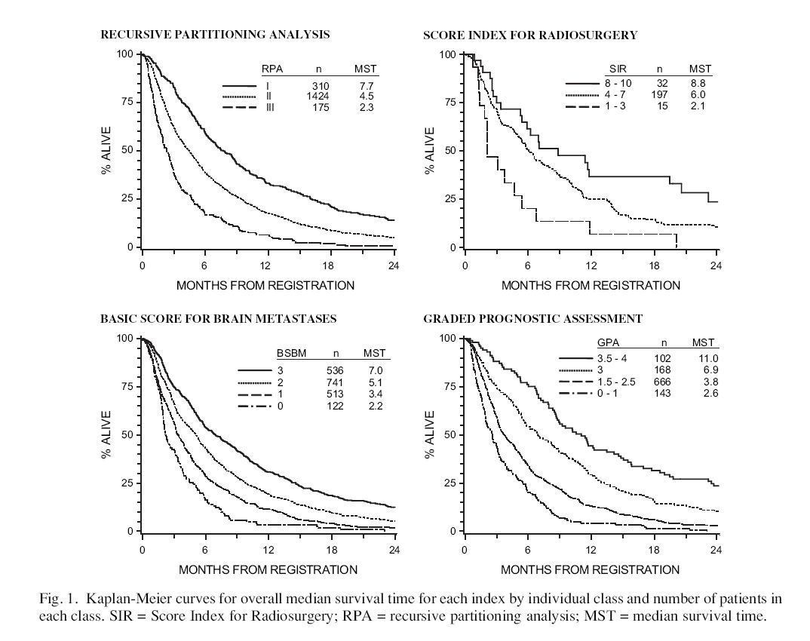

Slide 37
Diagnosis specific GPA
Specific diagnosis | Prognostic factors | Score
 |  | 0 | 0.5 | 1
Lung Cancer | Age | >60 | 50-60 | <50
 | KPS | <70 | 70-80 | 90-100
 | Extracranial Metastasis | + |  | -
 | Number of Mets | >3 | 2-3 | 1
 |  | 0 | 1 | 2
Melanoma Renal Cell Cancer | KPS | <70 | 70-80 | 90-100
 | Number of Mets | >3 | 2-3 | 1
 |  | 0 | 1 | 2 | 3 | 4
Breast GI | KPS | <70 | 70 | 80 | 90 | 100
DS-GPA classes 0-1 | 1.5-2.5 | 3 | 3.5-4
Int. J. Radiation Oncology Biol. Phys., Vol. 77, No. 3, pp. 655–661, 2010

Slide 38
Challenges in Obtaining Current Statistics
Autopsy studies
  First large scale data
  Not necessarily clinically relevant
Hospital/Institution based
  Significant source of data
Clinical Trial based
  Restricted to subjects enrolled in large trials
Population-based studies
  Limited investigations

Slide 39
Studies that Define Statistics:
Autopsy Studies
  Posner and Chernik studied 3219 patients w/ cancer at MSKCC from 1970 to 1976
  24% had intracranial mets.
  Other series had 18-24%
  Autopsy cases for melanoma demonstrate nearly 90% have brain metastases.
  Limitations
  Low autopsy rates <5%
  Currently limited autopsies performed

Slide 40
Hospital Studies
Source of data
  Death certificate
  Hospital records
  Discharge diagnosis
Limitations
  Regional variation in clinical aggressiveness to obtain diagnosis
  Lack of accuracy in hospital discharge dx and in death certificates

Slide 41
Population Based Studies
The Standard for primary tumors
Limitations:
Coding Errors
Non Uniform reporting
Regional referral pattern
Regional access to healthcare
Other Challenges
Asymptomatic cases are undiagnosed
Palliative Care/Hospice cases can be missed

Slide 42
Epidemiology
Incidence: 7-14/100,000 population
  Exact results unknown
20% to 40% patients with systemic cancer develop CNS metastasis during the course of their disease.
Factors affecting incidence
Cancer stage: Higher in advanced stages
Age: Higher in older age groups
Race: Higher in Whites
Gender: Higher in females
Cancer histology

Slide 43
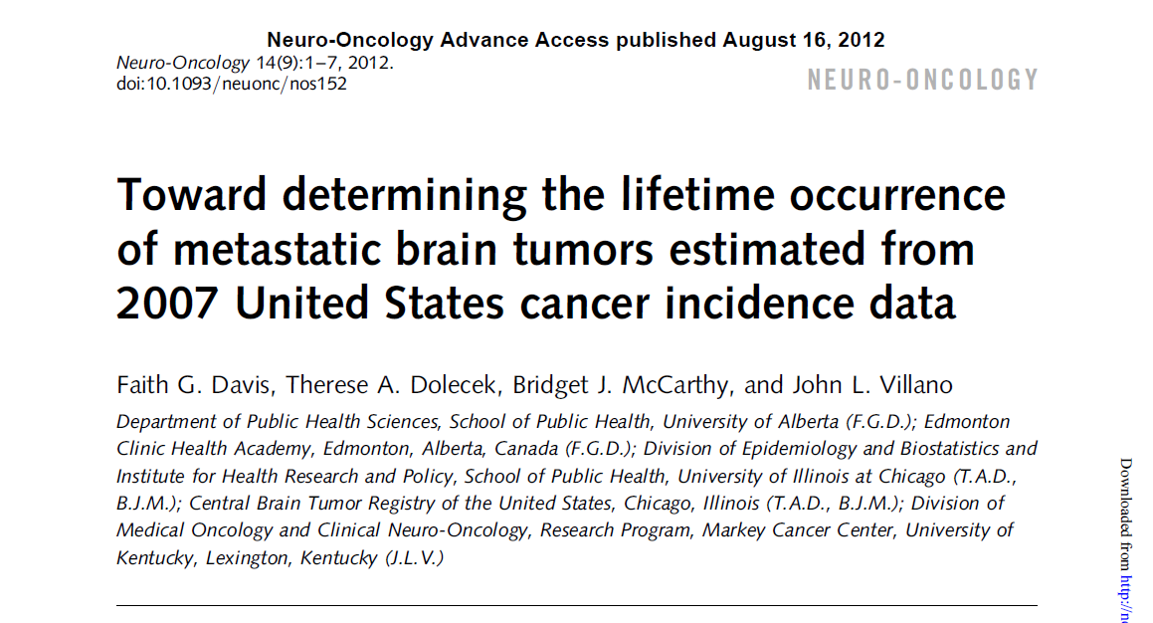

Slide 44
Estimated BM Incidence in 2007
Site | BM Incidence | % of total BM
Total | 70,000
Lung and Bronchus | 41,784 | 60%
Breast | 10,658 | 15%
Melanoma | 4119 | 6%
Renal Cell Cancer | 3470 | 5%
Colorectal | 3359 | 5%
NHL | 2530 | 4%
Davis/Villano Neuro-oncol, 2012; 14(9): 1171-7

Slide 45
Incidence Proportion by Cancer Site
Definition: Proportion of cases of a cancer site known to develop brain metastasis (BM Incidecex100/Site Incidence)
Site | IP of BM(%)
Lung and Bronchus | 20%
Renal | 7%
Melanoma | 7%
Breast | 5%
NHL | 4%
Colorectal | 2%
Davis/Villano et al. Neuro-oncol, 2012 September; 14(9): 1171-1177.

Slide 46
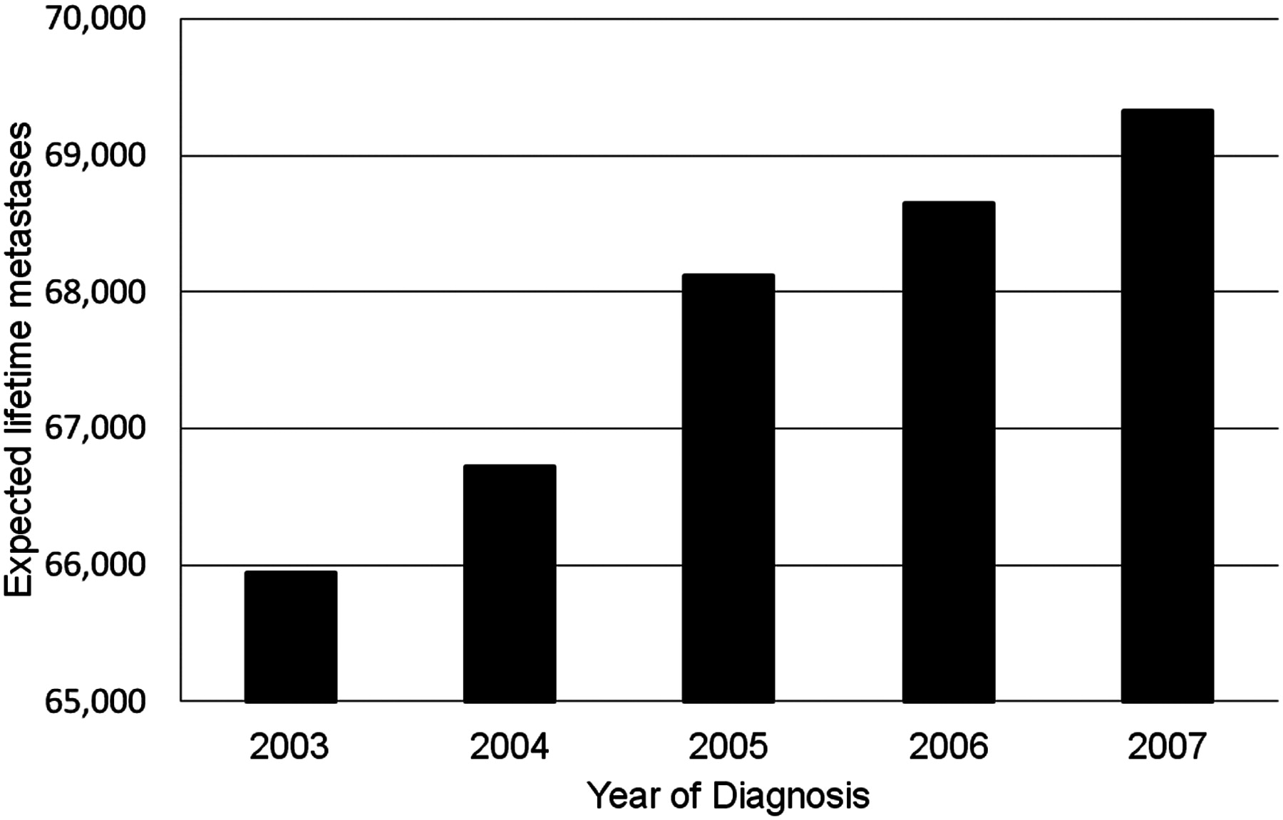
Estimated lifetime metastases of the brain for selected primary cancer sites, by individual year of diagnosis in the United States, 2003–2007
Davis /Villano. Neuro-oncol, 2012 September; 14(9): 1171-1177.

Slide 47
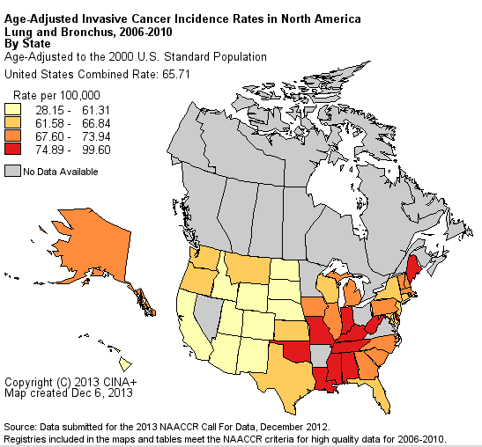
Incidence of BM at initial presentation in Kentucky
Kentucky Age adjusted IR: 99.6/100,000 population

Slide 48
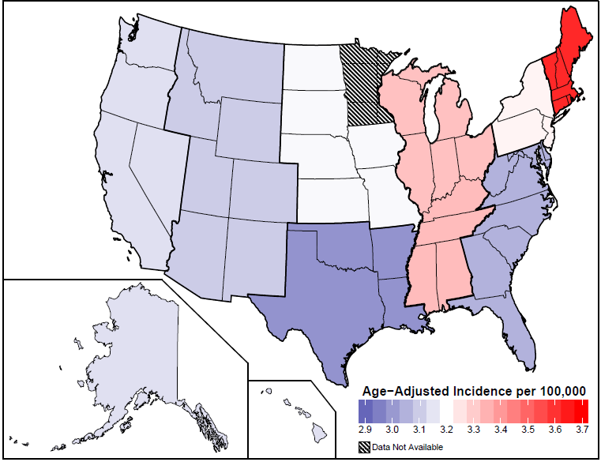
Age Adjusted Incidence Rates of Glioblastoma by Region in US,
CBTRUS Statistical Report, SEER 2006-2010. Rates are per 100,000
Thakkar et al., under review at CEBP

Slide 49
Since 2010 NCI and SEER require mandatory data collection for secondary metastatic sites including brain.
We report the first population-based study with numerical evidence of BM at initial presentation.
We capture incidence of BM at initial presentation in different cancer sites from captured KCR and ACR for years 2010 and 2011.
Comparisons were made between Kentucky and Alberta for the stage and site of organ involvement of lung cancer.

Slide 50
Kentucky BM Data at Initial Presentation, 2010-2011
Villano et al. 2013. Under review in Neuro-Oncology

Slide 51
Alberta BM Data at Initial Presentation, 2010-2011

Slide 52
Villano et al. 2013. Under review in Neuro-Oncology

Slide 53
Lung/Bronchus Cases of BM at Initial Presentation, Alberta 1995-2011
Villano et al. 2013. Under review in Neuro-Oncology

Slide 58
Site of Metastases in Stage IV Lung Cancer in Kentucky and Alberta for 2010 and 2011
Year | Brain-n (%) | Contra-lateral Lung-n (%) | Liver-n (%) | Osseous-n (%)
Kentucky
2010 | 484 (21.1) | 563 (24.5) | 554 (24.1) | 729 (31.7)
2011 | 475 (22.6) | 537 (25.5) | 482 (22.9) | 676 (32.1)
Alberta
2010 | 211 (21) | 191 (19) | 260 (26) | 363 (37)
2011 | 191 (23) | 161 (19) | 247 (29) | 318 (38)
Villano et al. 2014, in press Neuro-Oncology

Slide 59
Conclusions
BM from lung cancer dominates the incidence at initial diagnosis, comprises of 80% of the total BM cases in Kentucky
The similarity of our data reflects current epidemiology of lung cancer organ involvement at initial presentation and the overall aggressive nature of lung cancer
Mandatory recording has significantly increased the incidence of BM in Kentucky
Registry data are an important source for evaluating clinical and disease histories

Slide 60
43 y/o woman presented with hoarseness in Sept. 2012 adeno. NSCLC and w/u identified CNS met. received WBRT

Slide 61
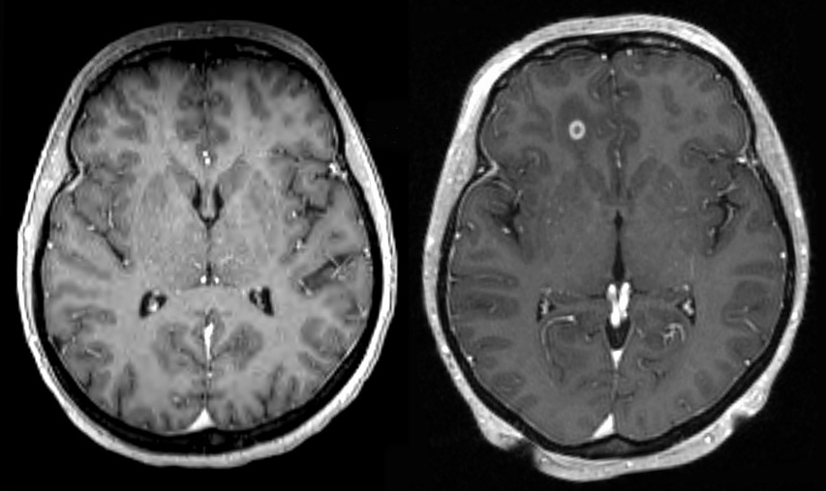
Jan. 24, 2013
Feb. 11, 2013
Received Gamma Knife Tx.

Slide 62
April 10, 2013
Received Gamma Knife Tx.
June 13, 2013
Jan. 29, 2014

Slide 63
Summary
Obtaining accurate incidence of BM remains a challenge
  Changing rates of primary cancers, trends in populations at risk, effectiveness of treatments on survival, and access to treatments
  Registry data from KCR and ACR demonstrated similar data at initial cancer presentation; lung ca. dominated
Treatment Remains a Challenge
  Level I evidence for single brain met, conducted at UK
Investigational therapies are being evaluated at UK including tumor treating fields and anti-angiogenic

Slide 64


Edvard Munch’s The Scream,
1893
Joaquín Sorolla y Bastida’s Two Sisters, 1909
Notes:
artist Edvard Munch between 1893 and 1910. Der Schrei der Natur (The Scream of Nature) is the title Munch gave to these works, all of which show a figure with an agonized expression against a landscape with a tumultuous orange sky. Arthur Lubow has described The Scream as "an icon of modern art, a Mona Lisa for our time

Slide 65
Acknowledgements
Oncology
  Jigisha Thakkar, MD
  Kara Reynolds, RN
Neurosurgery
  Thomas Pittman, MD
  Diana Shappley, RN
Neuropathology
  Craig Horbinski, MD, PhD
Clinical Research
  Tonya Gardner, CCRC
Rad. Therapy
  William St. Clair, MD, PhD
  Ronald McGarry, MD, PhD
Epidemiology
  Bridget McCarthy, PhD (UIC)
  Therese Dolecek, PhD (UIC)
  Faith Davis, PhD (Univ. Alberta)
  Chris Normandeau, MSc. (Alberta Health Svcs)
  Eric B. Durbin, PhD
  Thomas C. Tucker, PhD, MPH

