Slide 1
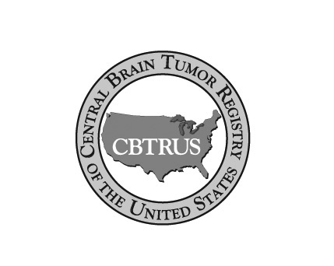
Counting Brain Tumors The Mission of CBTRUS
28th Annual Advanced Cancer Registrars’ Workshop
Presented by
The Kentucky Cancer registry
September 11-12, 2014
Carol kruchko, CBTRUS President

Slide 2
CBTRUS Mission
To provide a resource for gathering and disseminating current epidemiologic data on all primary brain tumors for the purposes of accurately describing their incidence and survival patters, evaluating diagnosis and treatment, facilitating etiologic studies, establishing awareness of the disease, and, ultimately, for the prevention of all brain tumors.

Slide 3
Overview
Profile & history
Role in cancer collection and reporting
Statistical Report highlights
Contribution

Slide 4
CBTRUS - Profile
501 3 (c) not-for-profit corporation
Board of Directors
Board of Advisors
Site-specific specialized cancer registry
- Brain Tumor Incidence, Survival, Prevalence, Trends, Mortality, Lifetime Risk
- CDC/NPCR Partner
Research conducted at Case Western Reserve University in Cleveland, Ohio
Headquarters in Hinsdale, Illinois

Slide 5
How CBTRUS Started-The Stories I Could Tell
Personal Impetus
Right Timing
- Public Advocacy & Power
- AACCR forming
- Access to Stakeholders
- Neuropathologist – Director of IARC
Clear Case
- Clinical & research support
- Some cancer registries already collecting
Human Power
- American Brain Tumor Association
- Pediatric Brain Tumor Foundation

Slide 6
CBTRUS Focus
Collect and disseminate data on all primary brain and CNS tumors
Utilize data for manuscripts focused on descriptive epidemiology of brain tumors
Influence the collection of high quality data on all primary brain tumors
Provide information to specific requests

Slide 7
Serving Two Communities
Brain Tumor Community
- Patients
- Brain Tumor Organizations
- Clinicians
- Researchers
- Industry
Cancer Surveillance Community
- Cancer Registries
Hospital
Central registries
Organizations in United States
Global cancer and brain tumor registries
World Health Organization

Slide 8
Challenges
Cancer Registration Rules
- Collection limited to primary brain tumors
- Coding guides all cancer
- Collection to reporting time delay
Clinical Wants
- More specificity in collection
- More data elements available
- Real time reports
Answering Patients’ Questions

Slide 9
The CBTRUS Role in Cancer Registration
Publication of Statistical Reports on All Primary Brain Tumors with histology-specific incidence
- Peer-reviewed journal supplement of Neuro-Oncology
- Most cited publication of Neuro-Oncology in 2012 & 2013
Promote dialogue between cancer registry and clinical and research communities
- Sponsored Consensus Conference 1 resulting in standard definition to guide brain tumor definition
- Sponsored Consensus Conference 2 to document clinical input on registration rules
- Working with neuropathologists to advocate for collection of molecular markers of certain brain tumor histologies
- Work with standard setter on collection rules
Multiple Primaries Committee (SEER)
Data Assessment Committee (NAACCR)
Utilization of population-based data to provide descriptive epidemiology studies

Slide 10
Impact on Cancer Registrars
Increase in education to learn rules and regulations guiding collection
Increase in case finding to include primary brain & CNS tumors with ICD-O-3 histology codes according to brain tumor site definition in Public Law and with behavior codes /0 and /1
Increase in contribution to public health surveillance of all primary brain tumors, to influencing brain tumor research, and to patient support resources

Slide 11
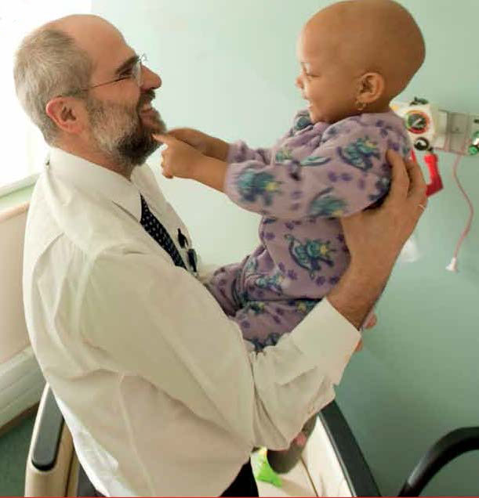
Counting Every Brain & CNS Tumor Thank You Tumor Registrars

Slide 12
CBTRUS Efforts to Enhance Data
Conducts Edits Review on data from CDC/NPCR and NCI/SEER used to prepare CBTRUS Statistical Reports and reviews results with neuropathologists
Provides assessment of CBTRUS Edits Review to surveillance stakeholders
Maintains up-to-date Histology Grouping Scheme in sync with WHO Classification
Provides Site/Histology Validation List based on SEER Site/Histology Validation List
- Excluded over 150 site/histology combinations considered implausible or invalid (<1% of all tumors in CBTRUS Dataset

Slide 13
Findings from CBTRUS Edits Review
Duplicate cases
Behavior miscodes
Site/histology mismatches
Recoding needed for certain histologies

Slide 14
CBTRUS Data Collection Process
Integrated in Centers for Disease Control and Prevention National Program of Cancer Registries Yearly Data Call (CDC/NPCR)
Combine CDC/NPCR with data from National Cancer Institute Surveillance, Epidemiology and End Results (SEER) program
Use site code for collection as per Consensus Conference 1
Population data by histology, histology groupings, gender, age, race and Hispanic ethnicity. 5-yr age groups obtained from US Census Bureau. Mortality and relative survival rates calculated using SEER data for the period 1995-2010

Slide 15
CBTRUS Data Reporting Specifications
International Classification of Diseases for Oncology (ICD-O-3)
CBTRUS Histology Grouping Scheme
Incidence Data reported by histology, histology groupings, gender, age, behavior, race and Hispanic ethnicity
49 states excluding Minnesota and District of Columbia, 2006-2010 data

Slide 16
Primary Brain Tumors in US by Behavior, CBTRUS 2006-2010 Total = 326, 711 cases
Total Primary Brain & CNS Tumors N = 326,711
Age-Adjusted Incidence Rate = 21.03 per 100,000

Slide 17
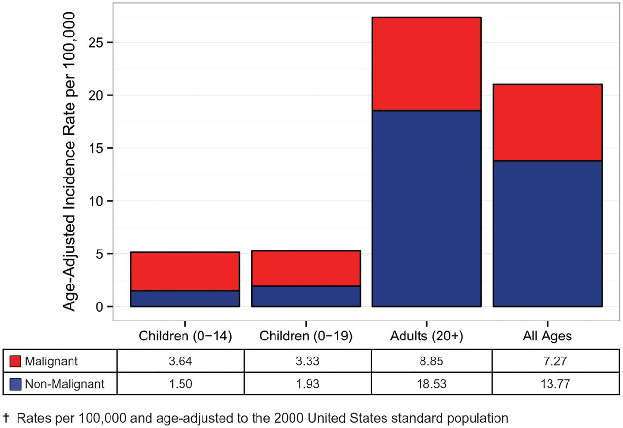
Annual Age-Adjusted Incidence Rates of Primary Brain & CNS by Age and Behavior, CBTRUS, 2006-2010

Slide 18
Annual Age-Adjusted Incidence Rates of Primary Brain & CNS by Year and Behavior, CBTRUS, 2006-2010
Malignant | 7.36 | 7.37 | 7.39 | 7.25 | 6.98
Non-Malignant | 13.31 | 13.46 | 14.02 | 14.50 | 13.53
Total | 20.67 | 20.83 | 21.41 | 21.75 | 20.52
✝ Rates per 100,000 and age-adjusted to the 2000 United States standard population

Slide 19
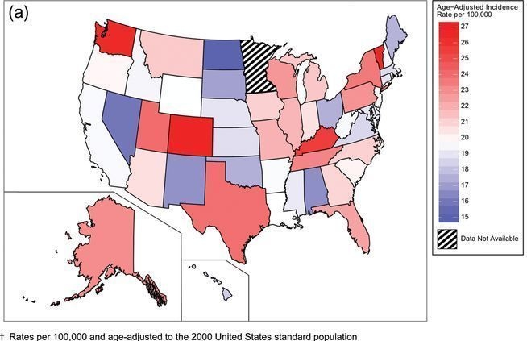
Average Annual-Age-Adjusted Incidence Rates of Primary Brain & CNS Tumors by Central Cancer Registry and Behavior, CBTRUS 2006-2010

Slide 20
Variation in Rate Ratios, Non-Malignant:Malignant CBTRUS, 2006-2010
Average annual age-adjusted incidence rates of malignant brain & CNS ranged from 5.03- 8.84
Average annual age-adjusted incidence rates of non-malignant brain & CNS ranged from 8.99-19.13
Variation in ratios in central cancer registries of non-malignant:malignant suggests that there is a greater consistency in reporting of malignant tumors

Slide 21
Percentages of Non−Malignant Brain & CNS Tumors by Type of Diagnostic Confirmation and Year of Diagnosis, CBTRUS 2006-2010

Slide 22
Most Common Primary Brain and CNS Tumors by Age Groups, CBTRUS 2006-2010
Age (yr) | Most Common Histology | Second Most Common Histology
0-4 | Embryonal Tumors | Pilocytic Astrocytoma
5-9 | Pilocytic Astrocytoma | Glioma Malignant, NOS
10-14 | Pilocytic Astrocytoma | Glioma Malignant, NOS
15-19 | Tumors of the Pituitary | Pilocytic Astrocytoma
20-34 | Tumors of the Pituitary | Meningioma
35-44 | Meningioma | Tumors of the Pituitary
45-54 | Meningioma | Tumors of the Pituitary
55-64 | Meningioma | Glioblastoma
65-74 | Meningioma | Glioblastoma
75-84 | Meningioma | Glioblastoma
85+ | Meningioma | Glioblastoma

Slide 23
Summary of Incidence Facts, 2006-2010
Incidence rate: 21.03 per 100,000 for all primary brain tumors
Incident count: 326,711 tumors diagnosed 2006-2010
- 112,458 malignant brain & CNS tumors
- 214,253 non-malignant
- 7% < 20 yrs (21,512); 93% > or = 20 yrs (305,199)
- 42% occurred in males
- 64% occurred in females
- 55% malignant in males; 45% malignant in females
- 36% non-malignant males; 64% non-malignant in females
- 62.9% histologically confirmed
- Meninges is most common site (36%) followed by front lobe (8.7%); brain stem tumors (7.4%)

Slide 24
CBTRUS Survival Facts, SEER 1995-2010
5-Year relative survival rate following a diagnosis of a primary malignant brain tumor is 33.8%, 32.6% for males and 35.3% for females
5-Year relative survival rate following a diagnosis of a primary malignant brain tumor by age at diagnosis:
- Age 0-19 years: 73%
- Age 20-44 years: 58%
- Age 45-54 years: 32%
- Age 55-64 years: 17%
- Age 65-74 years: 10%
- Age 75+ years: 6%

Slide 25
CBTRUS Prevalence
Prevalence rate for all primary brain & CNS tumors in the US estimated at 221.8 per 100,000 with 69.9 for males and 177.3 for females in 2010
More than 688,096 people living with a brain & CNS tumor in 2010 with estimated 138,054 persons living with a malignant tumor and more than 550,042 living with a non-malignant tumor

Slide 26
What about Trends?
Trends manuscript "Trends in central nervous system tumor incidence relative to other common cancers in adults, adolescents, and children in the United States, 2000-2010" accepted for publication by CANCER
CBTRUS Study published Trends for all primary brain tumors in 2006, 1985-1999 data
USC Study published Trends for childhood brain tumors in 2013, 1973-2009 data (0.10% annual change from 1987-2009)
Both these paper conclude that rates were influenced by classification changes and by diagnostic changes and in more recent years of each study rates appear to have stabilized.

Slide 27
Contribution Assessment
CBTRUS rates provide:
- Estimates for specific histologies
- Estimates for non-malignant tumors and histologies with mixed behavior
- Estimates for rare subtypes
Numbers such as these provide a resource for:
- Patients and families
- Clinicians
- Researchers
- Industry
- National and local health departments
- Health care planners
- Selected populations (e.g. pediatric, elderly)
Notes:
In Summary:
These data present an updated summary (1995-1999) of the incidence of all primary brain tumors in the United States.
-Because several tumor types have both benign & malignant variants, our data facilitates the understanding of the full spectrum of disease.
We hope that these data are useful to clinicians, researchers, and patient families.

Slide 28
Working Together to Advocate for Complete and Accurate Collection and Reporting of All Brain Tumors

Slide 29
Acknowledgements
Thank you to our Principal Investigator Jill Barnholtz-Sloan, Quinn Ostrom, Haley Gittleman and the rest of the CBTRUS team at Case Western Reserve University for the data presented in the slides.
The following organizations contributed to the maintenance of the
CBTRUS database in 2014: the Centers for Disease Control and
Prevention (CDC) under Cooperative Agreement 5U58DP00383,
The Sontag Foundation, the Pediatric Brain Tumor Foundation, along
with the Musella Foundation, Novocure, Inc., Voices Against Brain
Cancer, Elekta , as well as private and in kind donations. Contents are
solely the responsibility of the authors and do not necessarily represent
the official views of the CDC.

