Slide 1
LYMPHOMA & LEUKEMIA
a closer look

Slide 2
SEER HEMATOPOIETIC DATABASE
Understanding the disease
AMBIGUOUS TERMS
Choosing the right Histology & TOPO CODE
Navigation of the Hematopoietic and Lymphoid Neoplasm Database
New primary & Multiple primary calculator
ICD CODE LIST IN HEM DATA BASE
Transformations

Slide 3
Leukemia vs. Lymphoma
Leukemias and Lymphomas
One of the differences between leukemia and lymphoma is that leukemia most commonly presents in the bone marrow and/or blood while lymphoma most commonly manifests in lymph nodes, lymphoid tissue, or lymphoid organs. When only the bone marrow is involved, the diagnosis is usually leukemia. Although rare, a lymphoma may present only in the bone marrow. (See PH rules, Modules 6 and 7, for instructions on coding primary site for lymphomas.)

Slide 4
Both leukemia and lymphoma patients may have splenomegaly (enlargement of the spleen). Patients with leukemia may have leukemic infiltrate of the spleen. Splenomegaly does not mean that the leukemia originated in the spleen or that this neoplasm is lymphoma. The spleen filters and stores blood cells. The spleen involvement is usually secondary, much like metastases in solid tumors. The rare histologies that are primary in the spleen are identified in the Heme DB. The Primary Site will be listed as C42.2

Slide 5
Diagnostic Process for Leukemia
For most patients, the first suspicion or presentation of a hematopoietic neoplasm will be symptoms such as unexplained weight loss, weakness, chronic fatigue, easy bruising, etc. When the physician suspects leukemia, he/she usually orders a complete blood count (CBC) and/or a peripheral blood smear. The CBC will identify abnormalities of the platelets, hemoglobin, white blood cells or red blood cells. When an abnormality is identified in the blood cell analysis, a bone marrow (BM) biopsy is usually the next procedure. The CBC or bone marrow alone seldom provide a definitive diagnosis; however, the results usually provide provisional diagnoses such as: myeloproliferative neoplasms, myeloid neoplasms, myelodysplastic/myeloproliferative neoplasms, myelodysplastic syndromes, or leukemia. These non-specific diagnoses are differential or provisional. More testing is needed to identify the specific hematopoietic or lymphoid neoplasm. Many of the neoplasms in the 2008 WHO Classification require immunophenotyping or genetic information to identify the specific histology. The Heme DB contains information on the types of diagnostic tests that are used to identify the specific histology for the hematopoietic or lymphoid neoplasm being abstracted. See the “Definitive Diagnostic Method” section in the Heme DB.

Slide 6
Leukemia:
Blood consists of three types of cells and cell fragments floating in a liquid called plasma. These cellular components are:
Red Blood Cells ("erythrocytes," "RBCs") - oxygen-carrying cells
White Blood Cells ("leukocytes," "WBCs") - cells that help make up the body's immune system
Platelets ("thrombocytes") - fragments of cells that play an important role in formation of blood clots
The total number of white blood cells normally ranges from 4 million to 11 million cells per milliliter of blood. Leukemias are a group of diseases characterized by increased numbers of white cells in the blood and bone marrow.
In 2013, the American Cancer Society estimates that 48,610 new leukemia cases will be diagnosed and 23,720 people will die from the disease in the United States.

Slide 7
Information for Myeloproliferative Disorders only
Myeloproliferative disorders are a group of hematopoietic stem cell diseases which include:
• Acute myeloproliferative disorders (MPD)
• Acute myelogenous leukemia, myeloblastic leukemia, promyelocytic leukemia, myelomonocytic leukemia, monocytic leukemia, erythroid leukemia, megakaryocytic leukemia, eosinophilic leukemia, basophilic leukemia, acute biphenotypic leukemia with myeloid and lymphoid markers, leukemia, and acute leukemia with lymphoid markers evolving from a prior clonal hemopathy
• Subacute MPD
• Oligoblastic smoldering leukemia, refractory anemia with excess blasts (RAEB, myelomonocytic leukemia) Chronic MPD
• Polycythemia vera, agnogenic myeloid metaplasia, primary thrombocythemia, chronic myelogenous leukemia, chronic monocytic leukemia, and chronic neutrophilic leukemia

Slide 8
Multiple Myeloma:
Myeloma is a cancer that affects B cells, the immune cells responsible for the production of antibodies. Normal B cells develop in bone marrow. Myeloma therefore affects bones. Multiple myeloma arises when the cancer cells travel through the body and form tumors in several different bones. Affected bones may become brittle as the malignant cells proliferate and alter the chemical equilibrium in the marrow.
In 2013, the American Cancer Society estimates that 22,350 new multiple myeloma cases will be diagnosed and 10,710 cancer deaths due to multiple myeloma would occur. There are approximately 55,000 people affected in the United States. Multiple myeloma is the second most common hematologic malignancy in the United States, but it accounts for only about 1% of all cancers. Multiple myeloma is rarely diagnosed in individuals under the age of 45.

Slide 9
Multiple Myeloma: Treatment
The National Comprehensive Cancer Network (NCCN) lists the following treatments for multiple myeloma:
Chemotherapy: included the proteasome inhibitor bortezomib (Velcade®)
Combination chemotherapy
Autologous Stem Cell Transplantation

Slide 10
LYMPHOMA
Lymphoma is the most commonly occurring blood cancer in the U.S.
Lymphoma is a cancer of white blood cells that arises in the lymphatic system.
Types of Lymphoma
Hodgkin's lymphoma frequently develops from B-cells, but may also develop from T-cells.
The majority of lymphoma cases are non-Hodgkin lymphoma

Slide 11
Risk Factors
Non-Hodgkin lymphoma is more common in developed regions of the world and in men.
Infection with the Epstein Barr virus and other such viruses increases the risk of developing lymphoma.
Symptoms
Swollen lymph nodes, unexplained weight loss, fever, extreme night sweats, and severe "itchiness".
Symptoms vary with the location in which the cancer arises.
Detection and Diagnosis
Lymphatic tumors may be detected by an MRI, a bone scan, a CT scan, or a PET scan.

Slide 12
Pathology Report and Staging
A pathologist examines a tissue sample micro- and macroscopically in order to create a pathology report.
The Ann Arbor staging system is commonly used to categorize non-Hodgkin lymphoma into one of four stages.
Lymphoma Tumor Biology
Many genetic changes occur in cancer. Details can be found in the Mutation section.
BCL-6, p53, and HDM2 are all genes involved in the development of lymphoma.

Slide 13
Treatment
Specific treatment plans for lymphoma depend on the type and stage of disease. (Consult the NCCN guidelines)
Non-Hodgkin's lymphoma can be treated with surgery, radiation therapy, chemotherapy, stem cell transplantation, or targeted treatments.
Hodgkin's disease is treated with chemotherapy, radiation and bone marrow transplantation

Slide 14
Don’t forget to look for the proper terms!
NOTE: ALL AMBIGUOUS TERMS ARE LISTED IN THE HEM DATA BASE AND ARE DIFFERENT FROM THE SOLID TUMOR TERMS!
READ….READ…..READ!

Slide 15
Report the case when the diagnosis of a hematopoietic neoplasm is preceded by one of the following ambiguous terms:
• Apparently
• Appears
• Comparable with
• Compatible with
• Consistent with
• Favor(s)
• Malignant appearing
• Most likely
• Presumed
• Probable
• Suspect(ed)
• Suspicious (for)
• Typical (of)
Note 1: Use these terms when screening all reports other than cytology and tumor markers.
Note 2: Report cases that use only the words on the list or an equivalent word such as “favored” rather than “favor(s). Do not substitute synonyms such as “supposed” for “presumed” or “equal” for “comparable with”. Do not substitute “likely” for “most likely.” See SEER coding manual, Reportability section.
Note 3: Accept the reportable term and report the case when one part of the medical record uses a reportable ambiguous term such as “apparently” and another section of the medical record(s) uses a term that is not on the reportable list.
Note 4: Follow back is recommended for diagnoses based on ambiguous terminology to see if the diagnosis has been confirmed or proven to be incorrect (see note 5).
Note 5: Do not report the case when biopsy or physician’s statement confirms a non-reportable condition or proves the ambiguous diagnosis is wrong
Example: CT scan shows enlarged lymph nodes suspicious for lymphoma. Subsequent biopsies of the lymph nodes thought to be involved with a neoplasm are negative for malignancy. The pathology is more reliable than the scan; the negative biopsy proves that the ambiguous diagnosis was wrong. Do not report the case.

Slide 16
Information for Lymphoma Only Biopsies
The most accessible involved lymph node or site is usually biopsied when lymphoma is suspected. For example, if a CT or PET scan identified enlarged cervical and mediastinal lymph nodes, the physician would biopsy the cervical lymph nodes because that would be the least invasive procedure; i.e. the cervical nodes are more accessible than the mediastinal nodes. Do not assume that the more accessible site chosen for biopsy is the primary site. Follow the primary site rules and instructions when coding Primary Site.

Slide 17
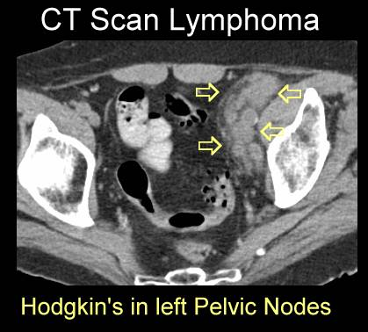

Slide 18
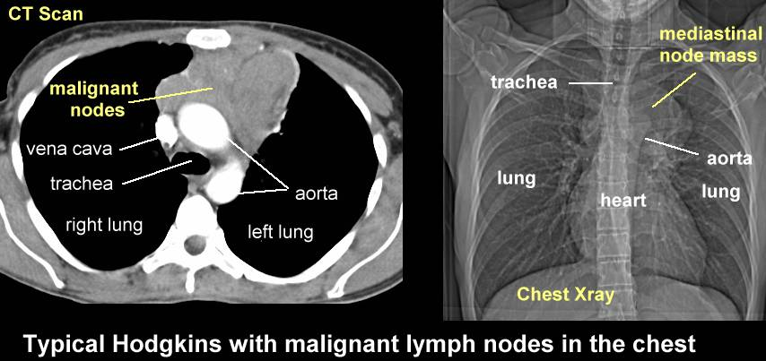

Slide 19

Enlarged Neck lymphnode

Slide 20
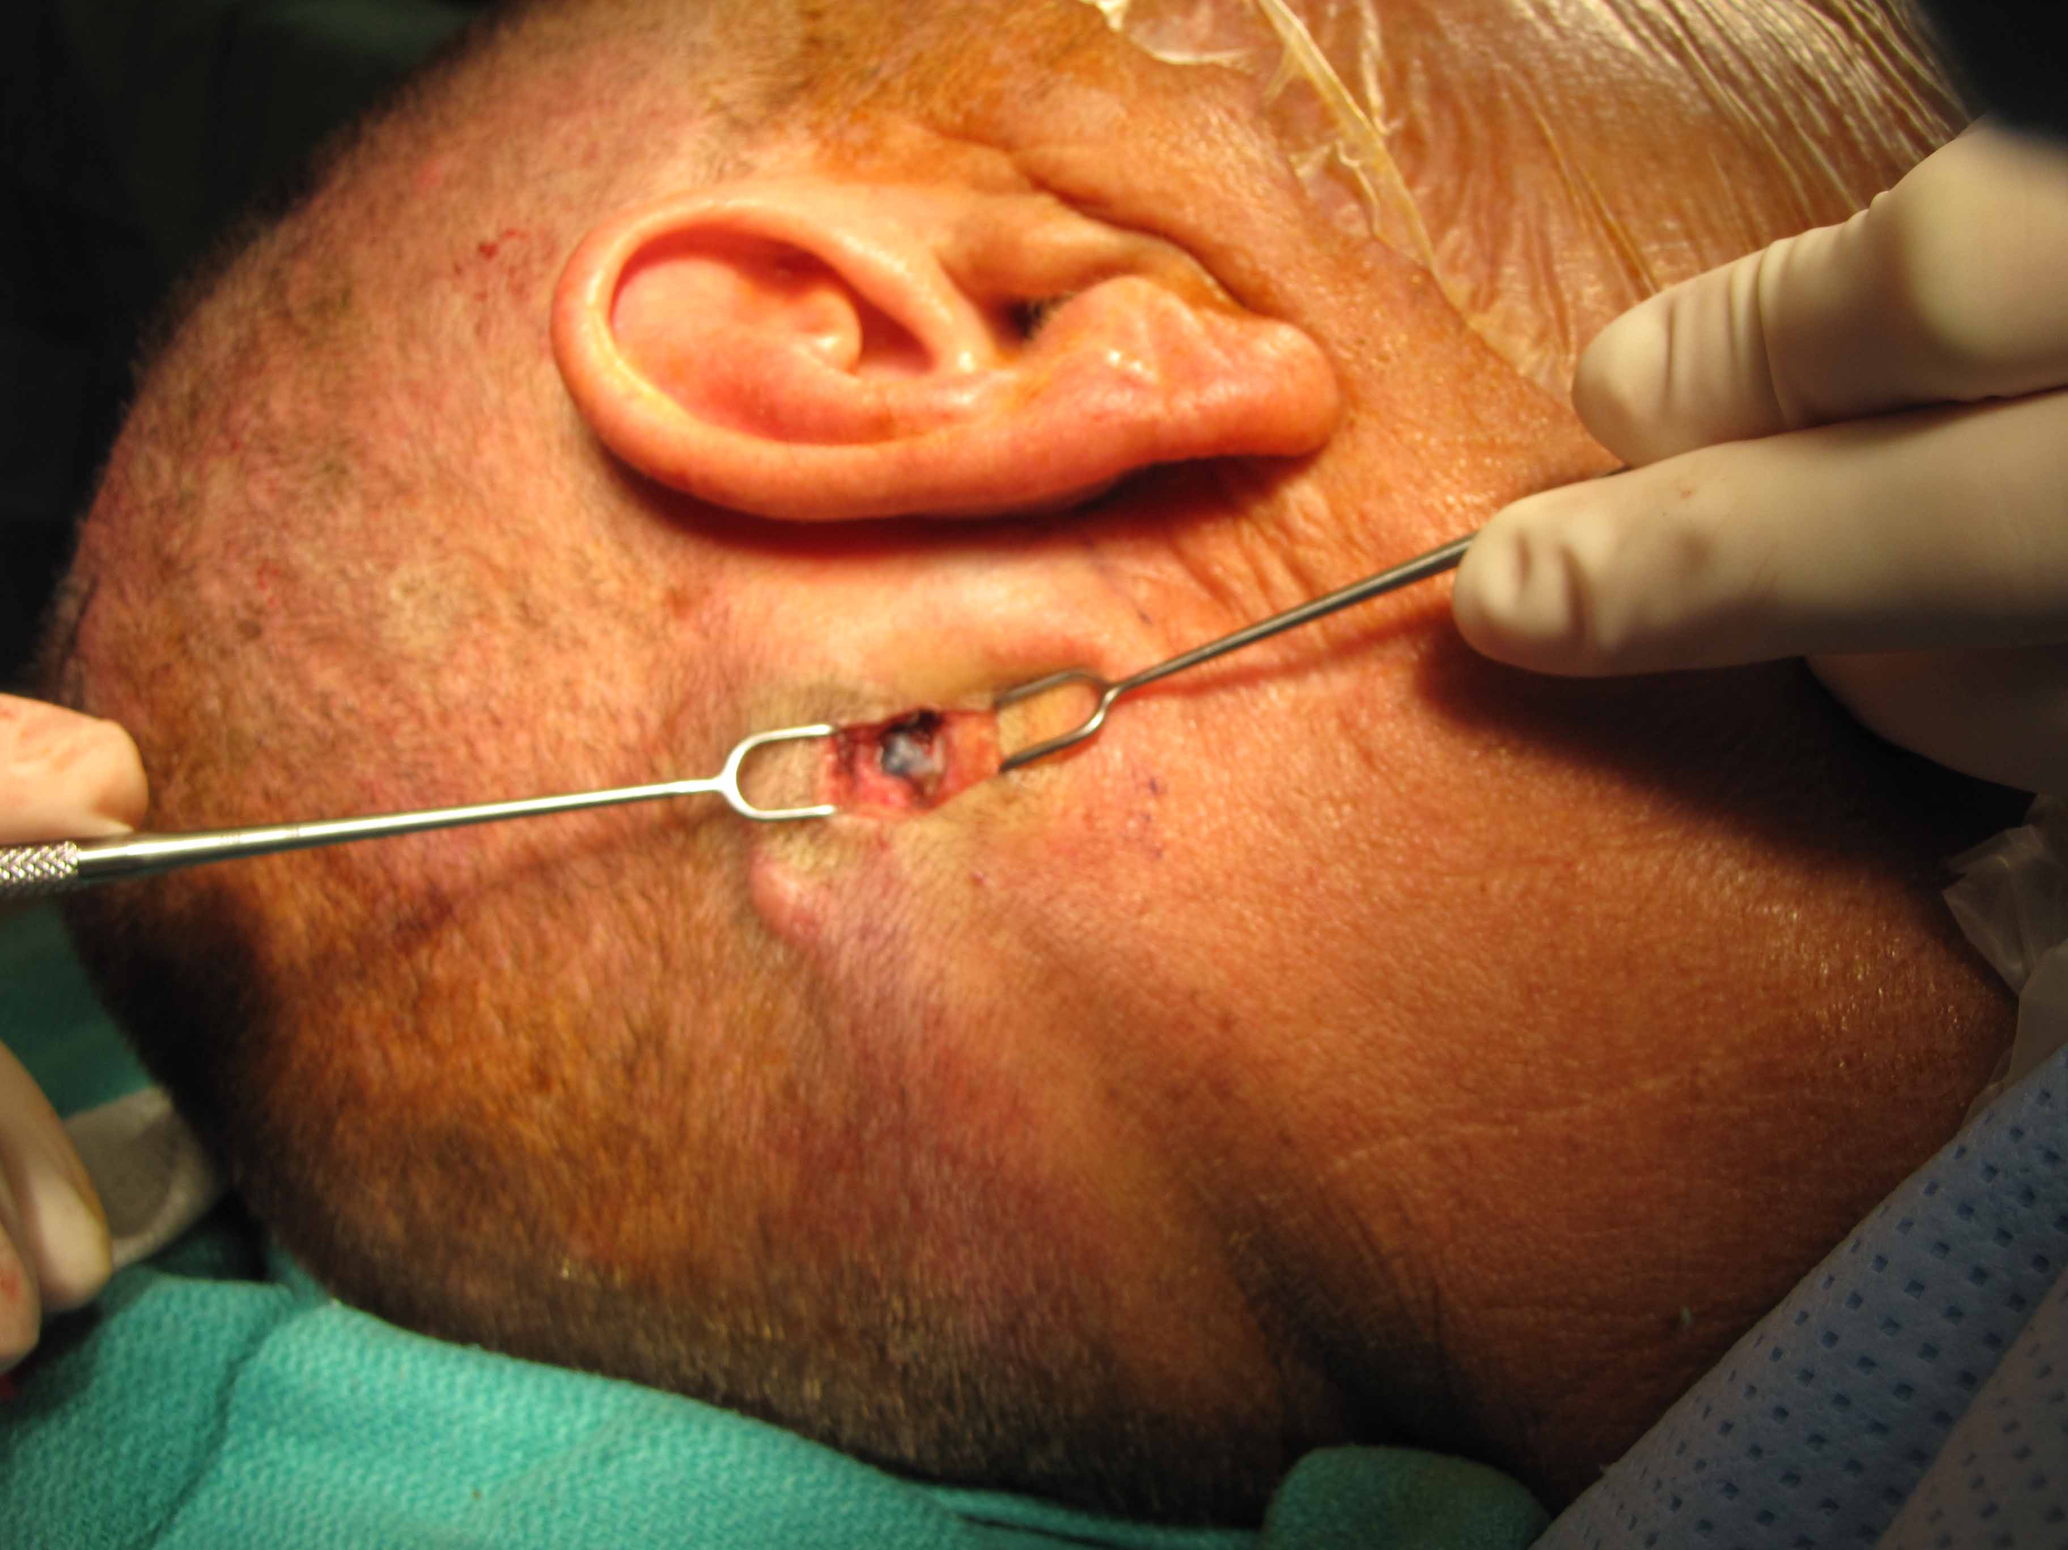
Lymphnode Excisional or Incisional Biopsy

Slide 21

Lymphnode fna

Slide 22
KNOW YOUR PRIMAY SITE
DO NOT JUST CODE THE SITE OF BIOPSY. BE SURE TO REVIEW ALL SCANS AND H&P NOTES. JUST BECAUSE A LYMPHNODE WAS BIOPSIED DOESN’T MEAN IT’S THE PRIMARY SITE IT JUST MEANS IT WAS THE EASIEST ONE TO ACCESS!

Slide 23
NHL PRESENTATION
LYMPHADENOPATHY
B SYMPTOMS: USE ONLY PHYSICIAN STATEMENT OF B SYPMTOMS FOR POSITIVE OR NEGATIVE OTHERWISE DO NOT ASSUME AND USE CODE UNK 999 IN SSF
ONLY USE PHYSICIAN STATEMENT OF HIV OTHERWISE USE UNK 999 IN SSF

Slide 24
Module 7:
Coding Primary Site for Lymphomas Only
Rule PH26 Code the primary site to bone marrow (C421) when lymphoma is present only in the bone marrow.
Note: All available physical exams, scans, and other work-up must be negative for lymph node, tissue, or organ involvement OR no other workup was done.
Example: Bone marrow biopsy is positive for diffuse B-cell lymphoma (DLBCL). No other work up performed. Code primary site to bone marrow. If further workup is done that identifies a primary site, reassign primary site

Slide 25
CLL/sll
Chronic lymphocytic leukemia
These types can be further divided into subtypes.
When classifying the type of leukemia, the first steps are to determine if the cancer is:
1) Lymphocytic or myelogenous leukemia
2) Acute or chronic leukemia
Cancer can occur in either the lymphoid or myeloid white blood cells.
Lymphocytic leukemia: Cancer develops in the lymphocytes (lymphoid cells)
Myelogenous leukemia: Cancer develops in the granulocytes or monocytes (myeloid cells)
Leukemia is also either acute or chronic.
Acute leukemia: The new or immature cancer cells, called blasts, remain very immature and cannot perform their functions. The blasts increase in number rapidly, and the disease progresses quickly.
Chronic leukemia: There are some blast cells present, but they are more mature and are able to perform some of their functions. The cells grow more slowly, and the number increases less quickly, so the disease progresses gradually. Chronic leukemia may affect the skin, central nervous system, digestive tract, kidneys, and testicles.

Slide 26
Navigation of the Hematopoietic and Lymphoid Neoplasm Database
ALWAYS CONSULT
SEER Hem data base
HISTO
Enter exact histo from path/cyto report
READ DESCRIPTION
Always read alternate names to confirm you have the right histology

Slide 28
Identify the working (preliminary) histology code(s).
Search the Heme DB using a unique word in the diagnosis, for example “precursor” if the diagnosis is precursor acute lymphoblastic leukemia.
Or you can search on the complete name (diagnosis). For example, “acute myelomonocytic leukemia”. The number of matched terms that are displayed will be much smaller than just searching on “leukemia”.
The search engine will display every entry with all of the words “acute” “myelomonocytic“ and “leukemia.” The results displayed (“diseases match all terms”) will have all three words in the histology name. The words may be appearing in any part of the entry (alternate names, abstractor notes, transformations, etc.)
The search engine can also display the number of diseases having at least one of the search words by choosing “diseases match any term.”
You can also search on abbreviations such as AMML for acute myelomonocytic leukemia, DLBCL for diffuse large B-cell lymphoma, or AML for acute myeloid leukemia.
When multiple results are displayed, click on the desired term (e.g. acute myelomonocytic leukemia) to display the record.

Slide 29
New primary?
Multiple Primaries Calculator

Slide 30
The Multiple Primaries Calculator shows whether two morphology codes
are for the same primary or a new primary.
Note: This MP Calculator is only to be used when at least one of the diagnosis years for the two codes is 2010 or later. If both diagnosis years are prior to 2010, use the link for the ICD-O-3 Hematopoietic Primaries Table (link provided in the note for the calculator).
To compare two codes:
1. Select the Show Multiple Primaries Calculator (#3 in Figure 1) on the link. The calculator (see Figure 3) will open.
2. Enter Morphology Code 1 (#1 on Figure 3) and Morphology Code 2 (#2 on Figure 3).
3. Click the Calculate (#3 on Figure 3) button.
4. The result will be shown either as New Primary or Same Primary.

Slide 31
Using the ICD Code Lists

Slide 32
1. Click the ICD-O-3 Code Lists link (#1 on Figure 1) at the top right of the web page. The ICD-O-3 code list opens with the ICD-O-3.
2. A dropdown menu (#1 on Figure 4) allows you to select different configurations that include ICD-9 and ICD-10 code lists.
3. On all of the ICD code list configurations, the ICD codes link to the information about them in the Hematopoietic and Lymphoid Database.
4. The Print button (#2 on Figure 4) on the top right opens a print dialog allowing you to print the open code list.
5. The Export button (#3 on Figure 4) on the top right opens an export dialog that allows you to export the list in a .csv file. The file can be saved or opened in Microsoft Excel and other applications where .csv files can be viewed.

Slide 34
TRANSFORMATIONS
STEP 1
STEP 2
STEP 3
IF YOUR PT ALREADY HAS A HEMATO PRIMARY CHECK THE HDB FOR THE 1ST HISTOLOGY/M/CODE
SCROLL DOWN TO :
TRANSFORMATIONS TO
TRANSFORMATIONS FROM
SAME PRIMARIES
READ ALL INFO TO SEE IF THIS IS TRULY A NEW PRIMARY.
HDB WILL ALSO GIVE YOU A LIST OF “SAME PRIMARY” M/CODES AND HISTOLOGY

Slide 35

Questions?

Slide 36


Slide 37


