Slide 1
Kentucky Cancer Registry
Thyroid Cancer Overview
Dr Wendell Miers
Kentucky Diabetes Endocrinology Center
Lexington, KY
September 11, 2014

Slide 2


Slide 3
OVERVIEW
Thyroid gland/Nodules
Diagnosis of Thyroid Cancer
Types of Thyroid Cancer
Staging
Treatment
Surveillance

Slide 4
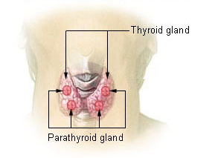
THYROID ANATOMY

Slide 5
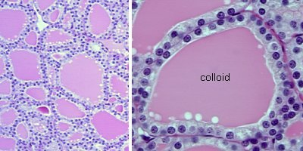
THYROID HISTOLOGY

Slide 6
THYROID NODULES
Thyroid nodules are fairly common - upwards of 20% of the population will have thyroid nodules
Incidence of nodules increases with age
Risk of cancer in a thyroid nodule ~5%
Larger size of nodule (>2cm) increases risk of thyroid cancer
History of head and neck radiation increases risk of cancer

Slide 7
DIAGNOSIS OF THYROID CANCER
Typically presents as painless thyroid nodule
Discovered by patient, health care provider on routine exam, or as incidental finding on imaging study
Can occur at any age but risk of cancer in a nodule is higher in children and adults age <30 or >60
Fine needle aspiration usually next step in diagnosis

Slide 8


Slide 9
Types of Thyroid Cancer
DIFFERENTIATED THYROID CANCER
  Papillary thyroid cancer
  Follicular thyroid cancer
ANAPLASTIC THYROID CANCER
MEDULLARY THYROID CANCER
LYMPHOMA INVOLVING THE THYROID
METASTATIC CANCER TO THE THYROID

Slide 10
PAPILLARY THYROID CANCER
Most common type of thyroid cancer – 75 to 80% of thyroid cancers
Excellent prognosis – most patients don’t die from this – mortality rate in 1 series was 6% at 16 years
Incidence increasing – has tripled since 1975 – from 4.9 to 14.3 per 100,000
Increase likely due to increase in diagnosis (? overdiagnosis) as mortality rate has remained stable – 0.5 deaths per 100,000

Slide 11
PAPILLARY THYROID CANCER
Subtype: follicular variant of papillary thyroid cancer – accounts for 10% of papillary cancers – same prognosis as papillary
Subtype: tall cell variant – accounts for 1% of papillary cancers – more aggressive variant – larger tumors and often invasive – higher risk for distant metastases

Slide 12
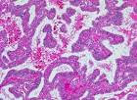
PAPILLARY THYROID CANCER HISTOLOGY

Slide 13
FOLLICULAR THYROID CANCER
Second most common type – accounts for about 10% of thyroid cancer
Diagnosed on histopathology by invasion of tumor capsule or vascular invasion
May contain RAS oncogene (40%)
Less common lymph node involvement
Distant metastases can occur in lung or bone – hematogenous spread

Slide 14
FOLLICULAR THYROID CANCER
Prognosis for differentiated thyroid cancer – 10 year survival rate over 95% if age <40; 80% age 40 to 59
Other prognostic factors for follicular cancer: minimally invasive vs widely invasive on pathology; vascular invasion; distant metastases
Subtype: Hurthle cell cancer – worse prognosis – less responsive to radioactive iodine – 10 year disease free interval 41% vs 75% for follicular cancer

Slide 15
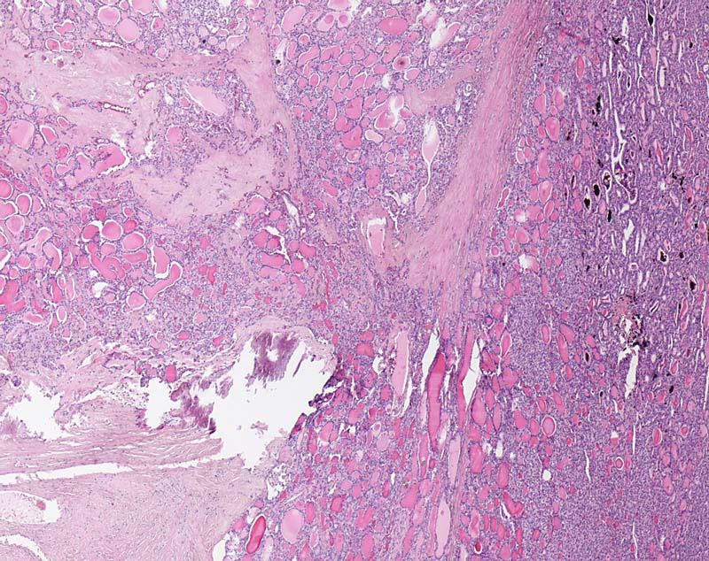
FOLLICULAR THYROID CANCER HISTOLOGY

Slide 16
ANAPLASTIC THYROID CANCER
Uncommon type of cancer – annual incidence 1 to 2 per million persons – mean age at diagnosis 65 years
Undifferentiated tumor of follicular epithelium
Rapidly growing and extremely aggressive – disease specific mortality of almost 100%
Very poor prognosis – initial management includes end of life issues and plan for comfort care measures; median survival 3 to 7 months
Treatment options include surgery, external beam radiation and chemotherapy

Slide 17
MEDULLARY THYROID CANCER
Tumor of C-cells (parafollicular cells) – neuroendocrine tumor
Accounts for about 4% of thyroid cancers
May be part of Multiple Endocrine Neoplasia syndrome
Calcitonin can be used as tumor marker
Therapy is total thyroidectomy with central neck lymph node dissection; XRT for residual disease
10 year survival with biochemical cure post-op is 98%; without biochemical cure 70%

Slide 18
OTHER CANCERS INVOLVING THE THYROID
Thyroid lymphoma – uncommon cause of thyroid enlargement – <2 % of thyroid malignancies - may be presenting symptom of lymphoma though – typically presents as rapidly enlarging goiter
Typically NHL – B-cell lineage
Treated with chemotherapy and/or external beam radiation
Other cancers metastatic to the thyroid gland – very rare; treatment is specific to the type of cancer

Slide 19
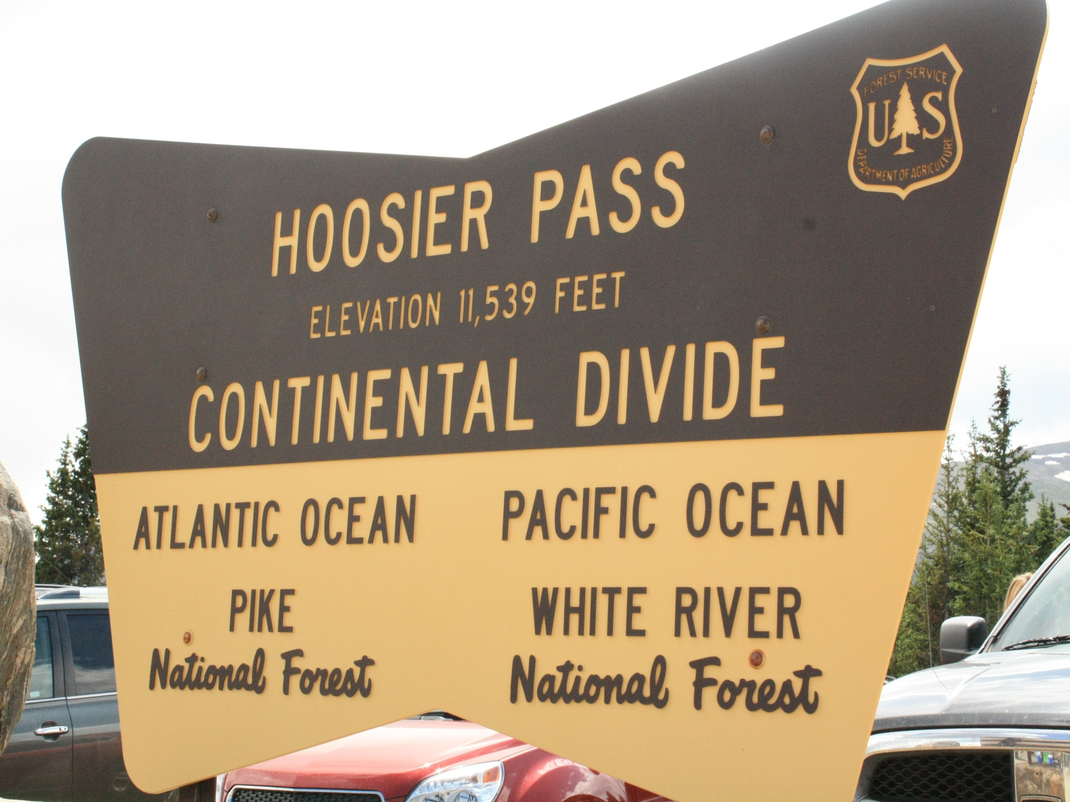

Slide 20
STAGING FOR DIFFERENTIATED THYROID CANCER
Initial staging can estimate disease-specific mortality
Can help tailor treatments – need for I131 and degree of TSH suppression
Can help determine intensity of follow up based on risk for recurrence or mortality

Slide 21
STAGING PREDICTS MORTALITY
At the University of Chicago, the 20-year survival rate was nearly 100 percent among the 82 percent of patients who were classified as stage I versus a five-year survival of only 25 percent among the 5 percent of patients classified as stage IV . The results were similar when this system was applied at the Mayo Clinic.
However, staging can’t predict risk of recurrence in an individual patient

Slide 22
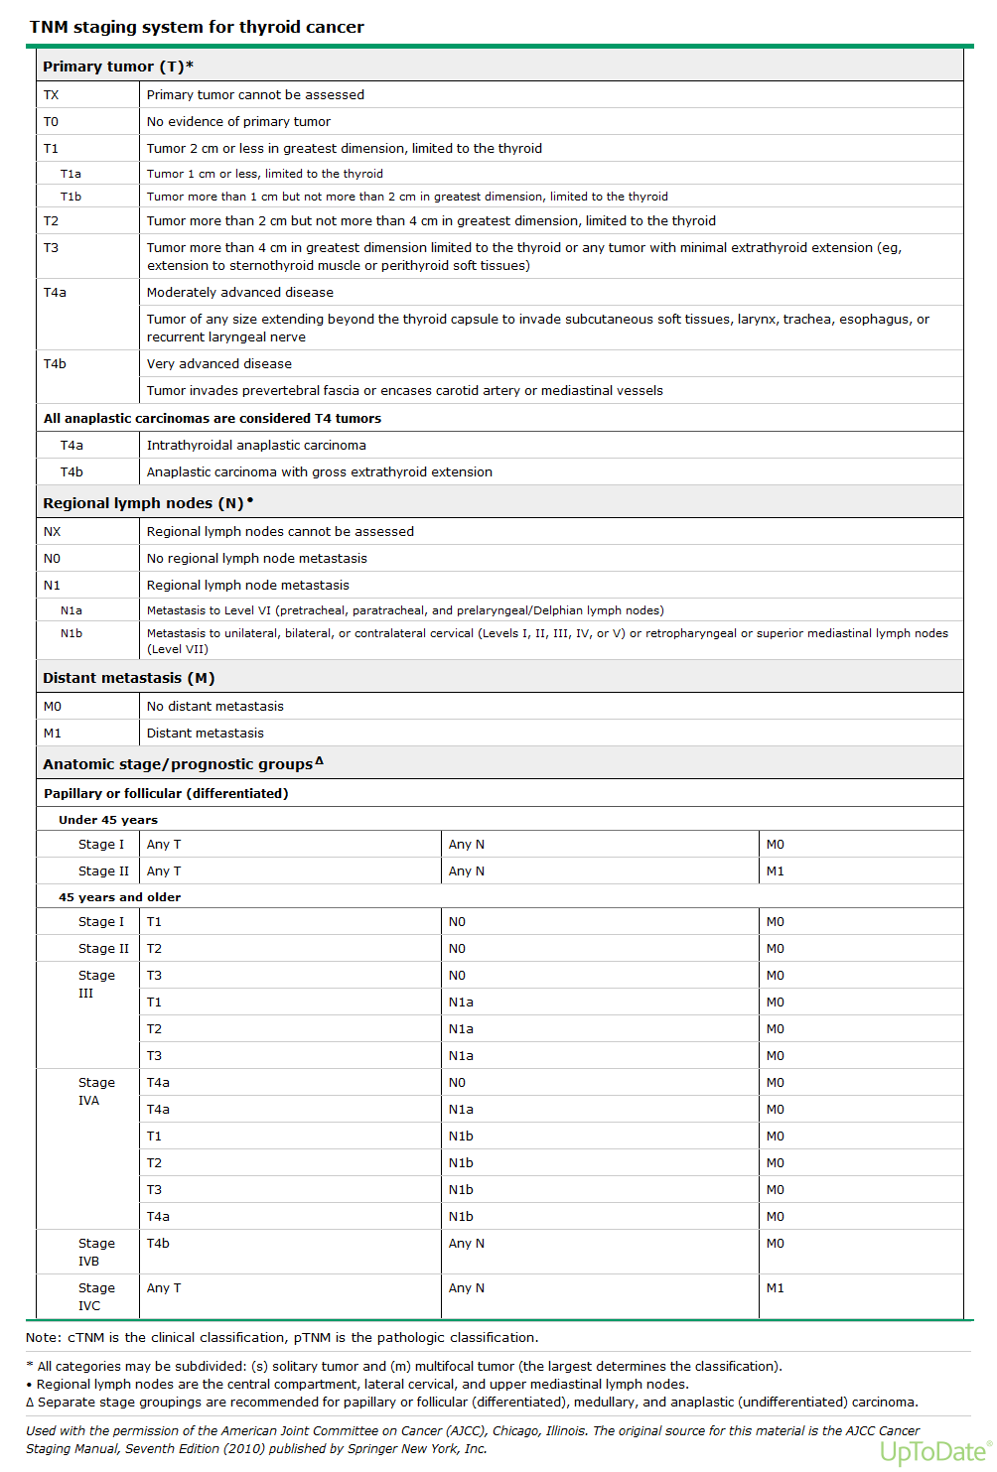

Slide 23
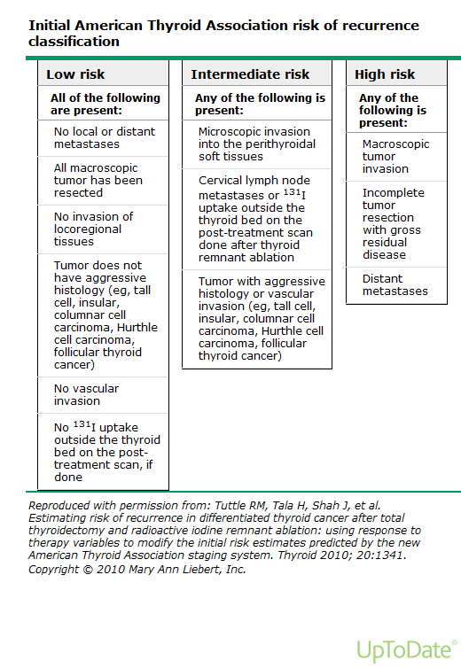

Slide 24


Slide 25
TREATMENT OF THYROID CANCER
SURGERY
RADIOACTIVE IODINE
SUPPRESSION WITH LEVOTHYROXINE
EXTERNAL BEAM RADIOTHERAPY

Slide 26
TREATMENT FOR THYROID CANCER:
SURGERY
Initial treatment is total thyroidectomy +/- central neck lymph node dissection
  May consider hemithyroidectomy if single focus of papillary cancer < 1cm
  More extensive resection for patients with evidence of invasion of neck structures
  Surgical risks include hypoparathyroidism and recurrent laryngeal nerve damage; usually overnight stay after surgery to monitor calcium

Slide 27
TREATMENT FOR THYROID CANCER:
RADIOACTIVE IODINE
I131 treatment has several uses: ablation of residual thyroid tissue and any microscopic residual cancer; imaging for possible metastatic disease; and treatment of known residual or metastatic disease
Should be considered in patients with known residual disease or at intermediate or high risk for recurrence

Slide 28
TREATMENT FOR THYROID CANCER:
RADIOACTIVE IODINE
Iodine is taken up by thyroid (and differentiated thyroid cancer) cells – I131 emits short length beta radiation and thereby kills cells
Iodine uptake is facilitated by low iodine diet and by increased TSH
2 options to increase TSH – withdrawal from thyroid hormone or synthetic TSH injections (Thyrogen)

Slide 29
TREATMENT FOR THYROID CANCER:
RADIOACTIVE IODINE
Concerns with I131 treatment:
  Isolation of patients after high dose I131
  Shouldn’t be given to pregnant or nursing women
  Risk for sialadenitis
  Women shouldn’t attempt pregnancy for at least 6 months after I131 treatment
  Small absolute increase in risk of second malignancy after I131 (leukemia or salivary gland cancer)

Slide 30
TREATMENT FOR THYROID CANCER:
THYROID HORMONE SUPPRESSION
After thyroidectomy, all patients will require levothyroxine therapy
Using doses of levothyroxine to suppress TSH may minimize potential thyroid cancer growth
For patients at low risk of recurrence, attempt to maintain TSH between 0.1 and 0.5mU/L
For patients at higher risk, attempt to maintain TSH <0.1mU/L

Slide 31
TREATMENT OF THYROID CANCER:
EXTERNAL BEAM RADIOTHERAPY
Used for metastatic disease
May be used for disease that isn’t radioiodine avid

Slide 32


Slide 33
SURVEILLANCE FOR RECURRENCE
DYNAMIC STAGING
Excellent response: no clinical, biochemical or structural evidence of disease
Biochemical incomplete response: abnormal thyroglobulin values in the absence of localizable disease
Structural incomplete response: persistent or newly identified locoregional or distant metastases
Indeterminate response: non-specific biochemical or structural findings that cannot be confidently classified as either benign or malignant

Slide 34
SURVEILLANCE FOR RECURRENCE
BIOCHEMICAL SURVEILLANCE: serum thyroglobulin – stimulated vs. unstimulated
IMAGING MODALITIES:
Neck ultrasound
Radioactive iodine whole body scanning
PET/CT

Slide 35
IMAGING FOR SURVEILLANCE
NECK U/S
  Advantages:
  less expensive
  looks at area at highest risk for recurrence
  Disadvantages:
  higher false positive rate
  not able to identify metastatic disease

Slide 36
IMAGING FOR SURVEILLANCE
RADIOACTIVE IODINE WHOLE BODY SCANNING
  Advantages:
  Specific for thyroid cancer
  Able to identify distant metastases
  Disadvantages:
  Expensive
  Prep
  Non-iodine avid disease

Slide 37
IMAGING FOR SURVEILLANCE
PET/CT
  Advantage:
  Can be used for non-iodine avid disease
  Disadvantages:
  Expensive
  Not specific for thyroid cancer/false positive rate

Slide 38
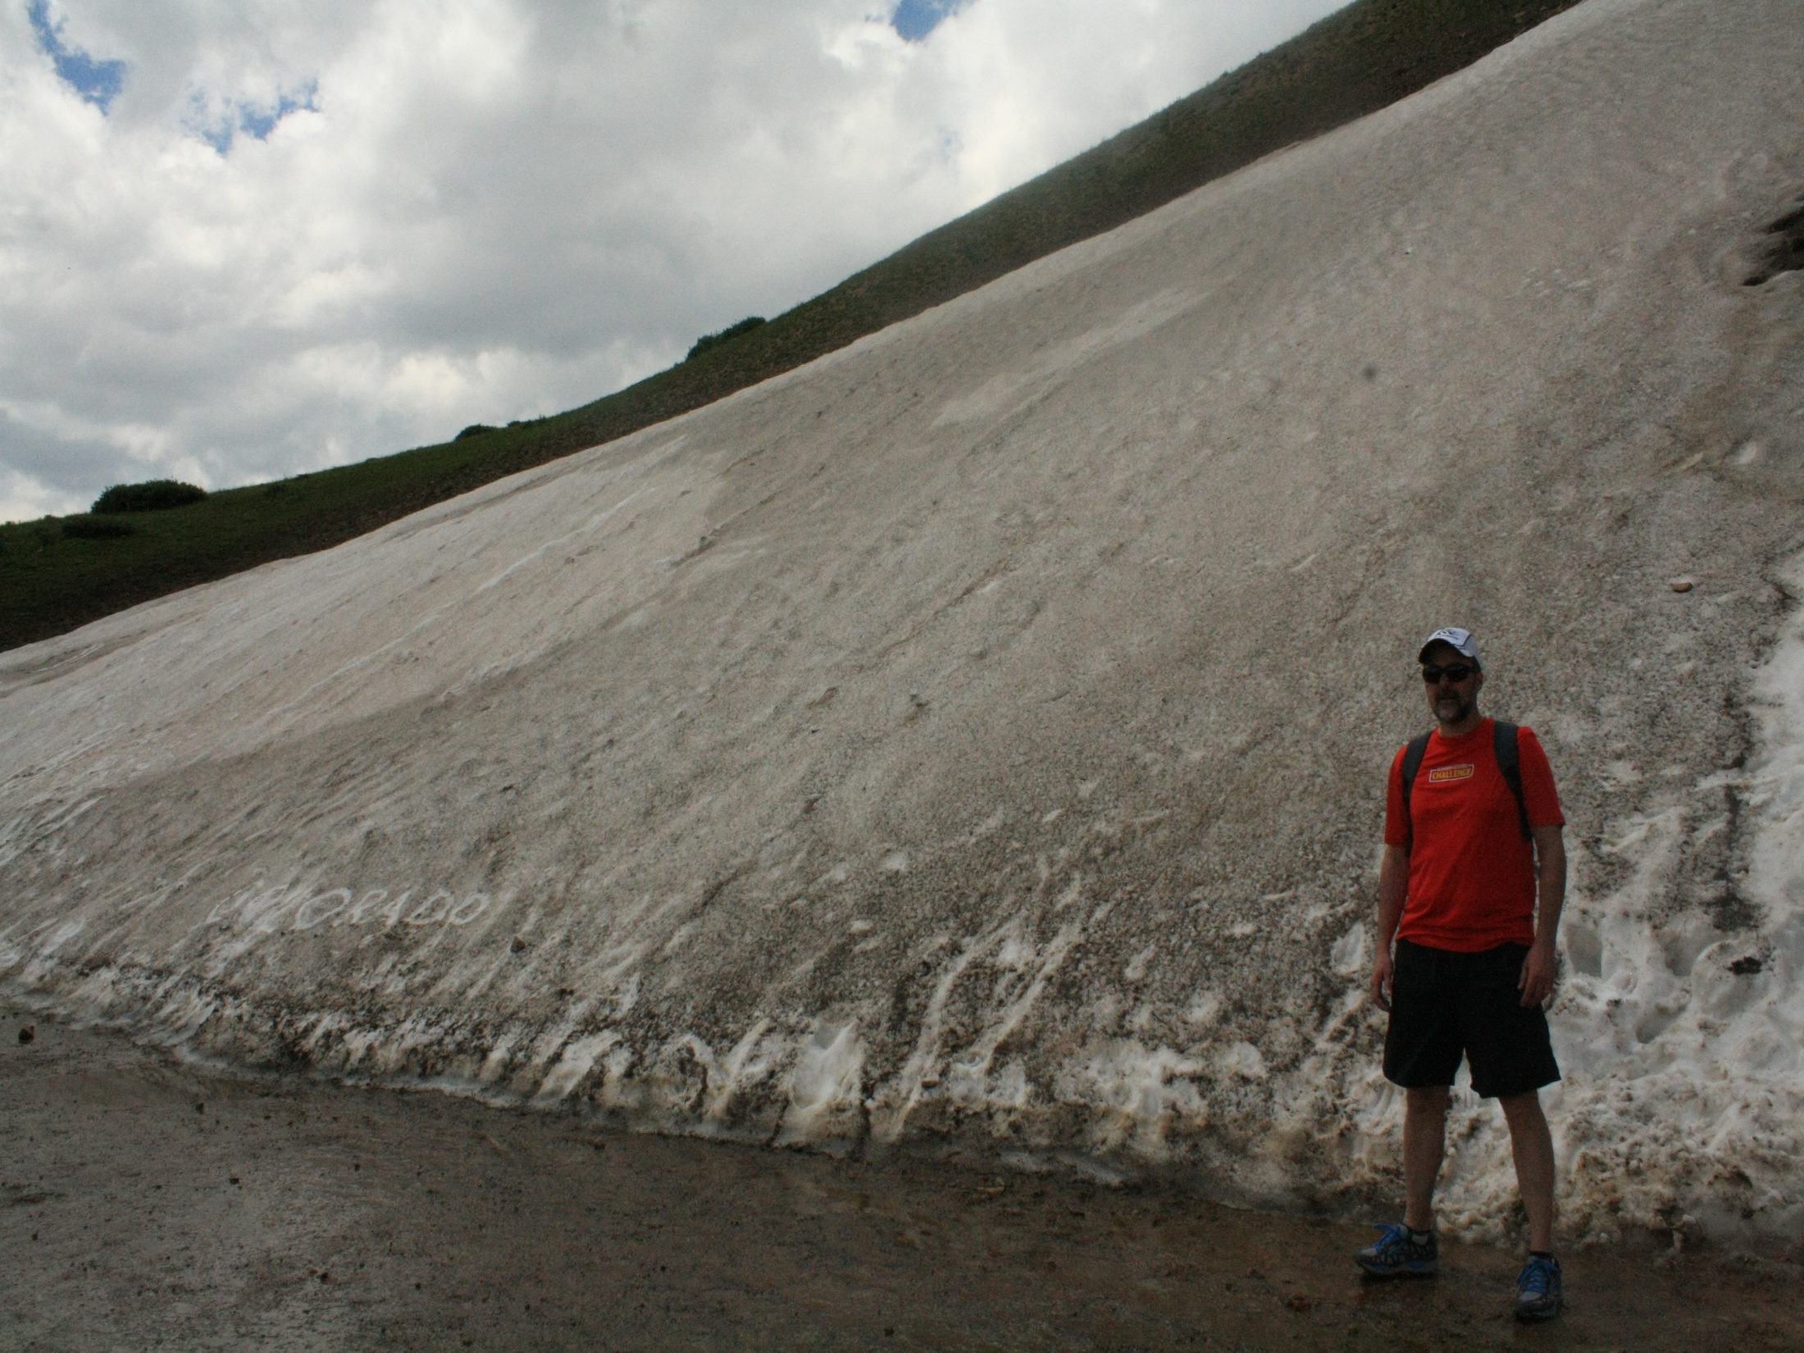

Slide 39
SOURCES
www.uptodate.com
Current Thyroid Cancer Trends in the United States; Davies, Louise and Welch, Gilbert, JAMA Otolaryngology-Head & Neck Surgery; April 2014; Volume 140, Number 4, pp 317-322
Revised American Thyroid Association Management Guidelines for Patients with Thyroid Nodules and Differentiated Thyroid Cancer (2009)
The American Thyroid Association (ATA) Guidelines Taskforce on Thyroid Nodules and Differentiated Thyroid Cancer D.S. Cooper, (Chair), G.M. Doherty, B.R. Haugen, R.T. Kloos, S.L. Lee, S.J. Mandel, E.L. Mazzaferri, B. McIver, F. Pacini, M. Schlumberger, S.I. Sherman, D.L. Steward, and R.M. Tuttle

