Slide 1
Breast Radiotherapy and Fractionation and Zombies.
Anthony E. Dragun, M.D.
Associate Professor
Vice Chair and Residency Program Director
U of L SOM, Dept. of Radiation Oncology
KCR 29th Annual Advanced Cancer Registrars’ Workshop
10 September 2015

Slide 2
Learning Objectives
What are the causes and consequences of lack of access to radiation services?
What is the level of evidence for hypofractionation and who is a candidate?
What is the future of breast radiotherapy in a changing healthcare environment?

Slide 3

Disclosures: None

Slide 4
Background
Yarnold J. et al. Int. J. Radiation Oncology Biol. Phys., Vol. 79, No. 1, pp. 1–9, 2011
Relationship between Total Dose (TD) and Biological Effective Dose (BED) depends on dose per fraction.
  Concepual understanding for over 100 years.
  As Fraction size ↑ total dose must ↓ to maintain equal…
    Antitumoral effect
    Normal tissue detriment
Ellis Isoeffect Formula (Hypothesis)
  (Ellis F. Clin Radiol 1969; 20:1-7)
  50Gy/25fx = 45Gy/15fx for skin reactions
  “skin epithelium reflects the condition of underlying stroma”
  “apart from bone and brain…the normal tissue tolerance could be based on skin tolerance”

Slide 5
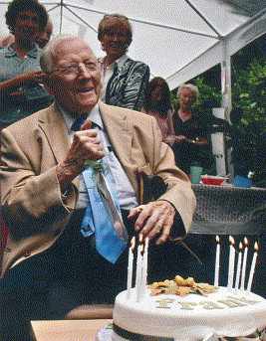
Background (cont.)
Frank Ellis (22 August 1905 – 3 February 2006)
  Born in Sheffield, England
  Educated at King Edward VII School and the University of Sheffield.
  1943 he became the first director of the Radiotherapy Department at the Royal London Hospital.
  1950 he established the Radiotherapy Department at the Churchill Hospital, Oxford.
  Retired in 1970 and held visiting professorial appointments at the University of Southern California and at the Memorial Sloan-Kettering.
"Frank Ellis". Obituaries (The Guardian). Retrieved 2008-05-09.

Slide 6
Background (cont.)
Yarnold, J. (2010) The Breast 19:176-9
Ellis’ proposal was a hypothesis meant to be tested clinically
  Radiation Oncologists applied the formula uncritically in late 70s -early 80s
  Late effects of subcutaneous fibrosis/brachialplexopathy/telangectasia, etc. were more sensitive than acute skin reactions to fraction size
  “Hyopfractionation” fell out of favor due to anecdotal bad experiences
Ellis’ formula insufficient for matching late effects
  Assuming typical α/β value of 3.0 for late normal tissue response with linear-quadratic (LQ) model: 45Gy/3Gy/fx ⇝ 54Gy/2Gy/fx
    For tissues like brachial plexus (α/β ~2.0), BED = 56.3Gy
  Reductions in TD Necessary for 15 fraction regimens
    42.8Gy/2.85Gy ⇝ 50Gy/2Gy
    40Gy/2.67Gy ⇝ 45.5Gy/2Gy
      Brachial plexus ~ 47Gy/2Gy
  Ellis formula for isoeffective doses led to overdosing of tissues where late effects are dose limiting

Slide 7

Conventional Fractionation…
1960s-Forever????

Slide 8
The “Modern Era” of Hypofractionation (HF)
Fraction sizes of 1-6Gy, LQ model offers a “more reliable guide”
How is tumor control effected?
  Traditional teaching: most human tumors—esp. SCCa—are relatively insensitive to fraction size (α/β~10)
    If correct for breast cancer, sharp reductions in TD for late effects may underdose the cancer.
    However, more human trials data show some malignancies to be more sensitive to fraction size (melanoma, RCC, prostate, breast?)
    Underlying cellular mechanisms remain unclear…

Slide 9
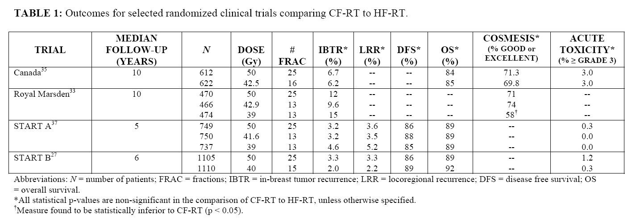
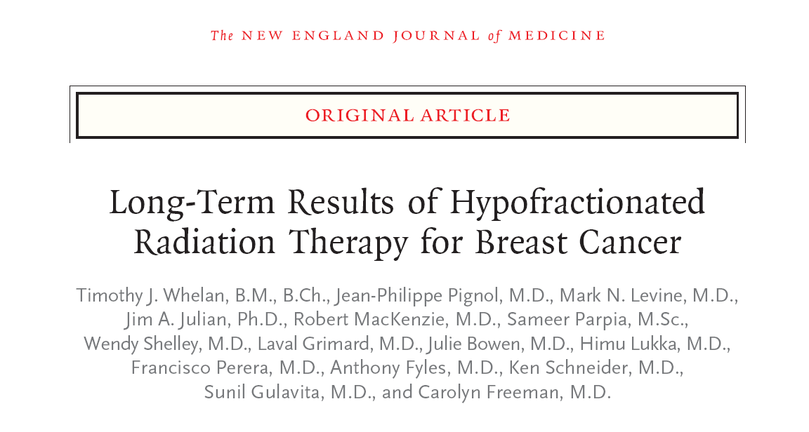
Breast HF Clinical Trials
  >7000 patients comparing HF to CF (50Gy/25)

Slide 10
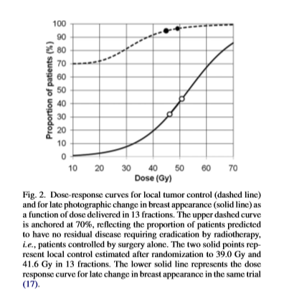
HF: “Data Drilldown”
Royal Marsden (RMH)/START A
  Two dose levels of 13 Fractions over 5 weeks to 50Gy/25
  Combined 278 LR failures
    α/β value for tumor control = 4.6Gy (95% CI: 1.1-8.1)
    α/β value for changes in late breast photographic appearance (cosmesis) = 3.4Gy (95% CI: 2.3-4.5)
Yarnold, et al IJROBP (2011) 79:1

Slide 11
HF: “Data Drilldown”
Canada/START B
  Two dose levels of 15 or 16 fractions over ~3 weeks to 50Gy/25
    Assumes an α/β ratio of 3.0Gy for equivilant tumor control and no influence of shortening treatment time
    Canada: identical rates of cosmesis @ >11y
    START B: lower rate of cosmetic change in 15 fraction arm
      Unsurprising: 40Gy/2.67Gy ⇝ 45.5Gy/2Gy (if α/β =3.0Gy)
      HF = “gentler” on late-reacting tissues
      “Gentler” on cancer?
        No! only 65 LR failures with no differences in each arm. (3.3% CF vs. 2.2% HF)

Slide 12


Slide 13
Criticisms of HF: Tumor Control
Yarnold, et al. NEJM 362:19
Canada: unplanned subgroup analysis
  Is HF bad for high tumor grade?
Meta-analysis of RMH, START A, START B
  Hazard Ratios for LR by grade (p=0.12)
    GRADE 1-2: 1.28 (95% CI: 0.87-1.88)
    GRADE 3: 0.83 (95% CI: 0.56-1.23)
  Adjusted α/β ratios:
    GRADE 1-2: 3.6Gy
    GRADE 3: 2.2Gy
  “results suggest that response to radiotherapy fraction size is not affected by tumor grade”

Slide 14
Criticisms of HF: Application
Yarnold, IJROBP (2011)79:1; Yarnold, 2012 SABCS, Plenary Session
40Gy in 15 fractions/3 weeks is now recommended by the National Institute for Clinical Excellence (NICE) as standard of care for adjuvant breast radiotherapy in the UK
  No clinical rationale for excluding underrepresented subgroups
  Breast-conservation or Post-mastectomy
  DCIS, systemic chemotherapy or premenopausal
  Regional nodal irradiation or not

Slide 15
Criticisms of HF: Normal Tissue Complications
Cosmetic outcome:
  Photographic change: most commonly atrophy (shrinkage)
    Edema, retraction, telangectasia also contribute
  Complex phenotype: pathogenesis?
    Early induration: fat necrosis
    Late induration: fibrosis
    Photographic appearance may not quantify injury to pectoralis muscle, chest wall
      Patient self-assessment must accompany photographic assessment to obtain whole picture

Slide 16
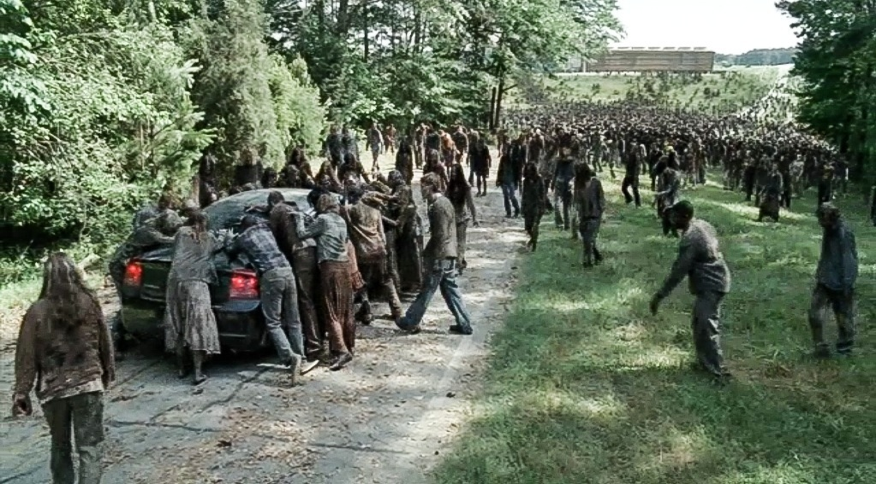

Slide 17
Criticisms of HF: Normal Tissue Complications
Lung injury?
  Lung dose delivered by tangential fields exceeds tolerance no matter the fractionation schedule
    Volume of lung irradiated in modern era makes pneumonitis rare
Heart injury?
  Priority is to protect the organ irregardless of dose
    There is no “safe” dose to the heart, no matter the fractionation
  Chan et al. (IJROBP 2014), (1990-98, British Columbia, Left sided RT)
    CF: N=485: 21% 15y cardiac morbidity (hospitalization)
    HF: N=2221: 21% 15y cardiac morbidity

Slide 18
Criticisms of HF: Breast Size
Randomized trials limited breast size for inclusion (“separation”)
Dorn et al. (2012 IJROBP) U. Chicago
  N=80, BMI 29.2, Median Vol (~1300cc)
  42.5Gy/16
  Sep >25cm not significant
  Vol >2500cc ↑ rate of acute skin toxicity (moist desquamation)-27.2% vs. 6.3%
Hannan et al. (2012 IJROBP) UTSW/Columbia
  Sep >25cm; Vol >1500cc ↑ rate of acute skin toxicity (moist desquamation)-28% vs. 12%
  Prone positioning may limit toxicity
Goldsmith et al. (2011 RadOnc) UK
  Change in cosmesis in large breast patients can be related to dose inhomogeneity

Slide 19
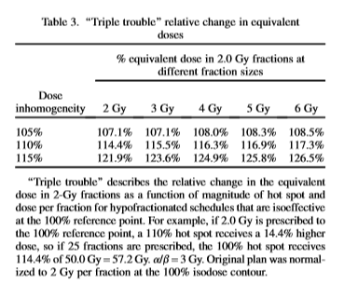
Criticisms of HF: Dosimetry
“Double Trouble” (Withers, 1992)
  Significance of a hot spot that not only receives a higher dose, but also a higher dose/fraction
  Hot spots will be penalized even more severely if using HF: “triple trouble” (Yarnold)

Slide 20
HF: Past/Present Dosimetric Failures
Historical experience of HF:
  Inadequate downward adjustment of total dose
  Poor dosimetry/ high skin doses
  Low energy beams, non-standard reference points
  Delivery of medial/lateral tangents on alternate days
  Failure to detect gross off-axis dose inhomogeneities
Limiting hotspots, protecting homogeneity are vital.

Slide 21


Slide 22
HF: Pushing the Limits…
Once or twice-weekly large fractions
Courdi et al. (2006, RO) France
  N=115 (1987-1999), Elderly (med 78y); NO SURGERY
  6.5Gy X5 fractions, once-weekly
    Boost (1, 2 or 3 fractions of 6.5Gy)
  5y PFS = 78%
  Late effects: G1 (24%); G2 (21%); G3 (6%)
Kirova et al. (2009, IJROBP) France
  N=50, Elderly AFTER SURGERY
  6.5Gy X5, once weekly
  7y PFS: 91%; G1-2 induration=33%
6.5Gy X 5 = 62Gy in 31 Fx (α/β = 3)

Slide 23

HF: Pushing the Limits…
UK Pilot Study
  Martin et al. (2008, Clin Onc.)
    N=30; > 50y; pT1-2, N0, No Chemo
    30Gy/5fx, 15 days
    Acute Tox: 13% moist desquamation
    2y cosmesis: 77%=no change from baseline (photo)
    3y PFS: 100%
UK FAST Trial (2011, RO)
  N=915; 2004-2007; >50y, pT1-2, N0

Slide 24
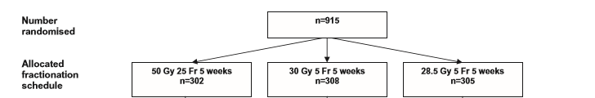
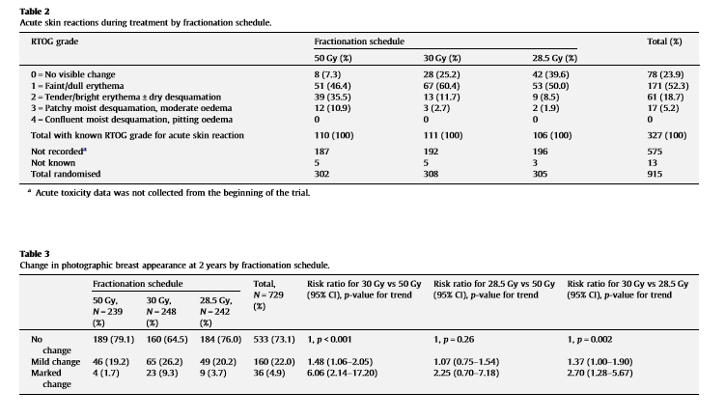
UK FAST Trial

Slide 25
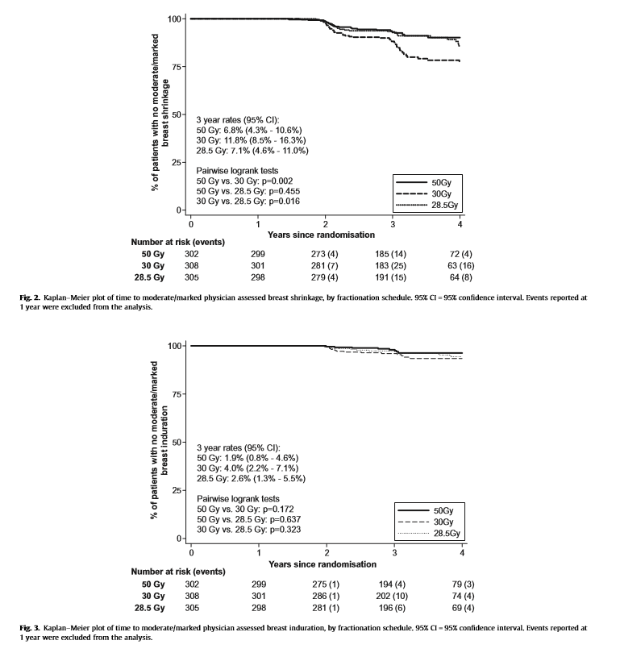
UK FAST Trial

Slide 26
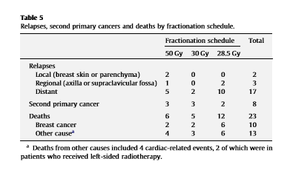
UK FAST Trial

Slide 27


A Phase II trial of once-weekly hypofractionated breast irradiation (WHBI): first report of acute toxicity, feasibility and patient satisfaction.
Anthony E. Dragun, M.D.¹, Amy R. Quillo, M.D. ², Elizabeth C. Riley, M.D. ³,
Glenda G. Callender, M.D. ², Teresa L. Roberts, R.N. ¹, Barbara Kruse, O.C.N. ³, Dharamvir Jain, M.D. ³, Shesh N. Rai, Ph.D. ⁴, Kelly M. McMasters, M.D., Ph.D. ²,
and William J. Spanos, M.D. ¹
Departments of ¹Radiation Oncology, ²Surgical Oncology, ³Medical Oncology, and ⁴Biostatistics and Epidemiology, University of Louisville School of Medicine, James Graham Brown Cancer Center, Louisville, KY, USA.
Dragun et al. (2013) IJROBP 85:3

Slide 28
Background
Kentucky is “underserved” with regard to breast cancer services
  High mastectomy rate for BCS-eligible patients¹
    45.5% (range: 38.8-53.1% from 1998-2007)
  Low proportion of BCS patients receive XRT²
    66.2% (range: 60.9-70.1% from 1998-2007)
Favorable early experience (Europe/UK)
    30-32.5Gy in 5 fractions delivered 1-2 X weekly (mainly in elderly)³⁻⁵
    UK “FAST” Trial (N=915, >50y, Node -)⁶
      50Gy/25fx (daily) v. 30Gy/5fx (weekly) v. 28.5Gy/5fx (weekly)

Slide 29
Purpose/Methods
Offer pragmatic once-weekly whole-breast regimen (post BCS)
  Add to existing literature/improve access
  Avoid controversies regarding APBI
Phase II Trial Design (Opened 12/2010)
  Age >21y with 0, I or II breast cancer up to 3 + LN
    Partial mastectomy with – margins; ± SLNB
  Target definitions = standard arm of NSABP B39/RTOG 0413
  30Gy/5 (80); 28.5Gy/5 once-weekly ± boost
  Accrual goal = 160 (~4y); Currently at 110 (4/2012)
  No restrictions on breast size
  Planned interim analysis (N=42)
    15% accrual (acute toxicity/feasibility/QOL)*

Slide 30
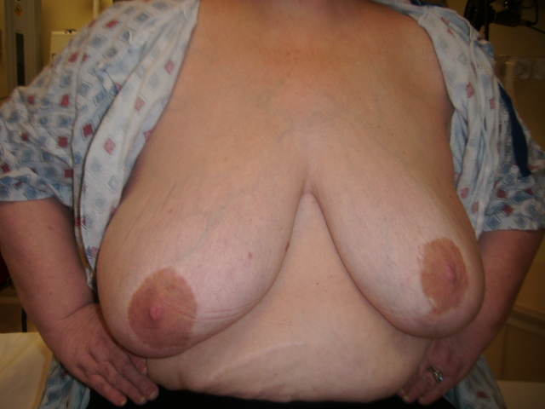
Demographics
Table 1: Patient Demographics (N = 42).
Age at Diagnosis
Median | 62
Range | 31-80
Race
White | 30 | 71.4%
Black | 12 | 28.6%
Body Mass Index (BMI)
Median | 30.2
Range | 18.3-45.9
Chest Size (in)
Median | 38
Range | 34-44
Cup Size
A | 1 | 2.4%
B | 10 | 23.8%
C | 18 | 42.9%
D | 12 | 28.6%
DD | 1 | 2.4%
Laterality
Left | 18 | 42.9%
Right | 24 | 57.1%
Smoking History
Yes | 23 | 54.8%
No | 19 | 45.2%
Diabetes History
Yes | 12 | 28.6%
No | 30 | 71.4%
Transportation
Self | 23 | 54.8%
Others | 15 | 35.7%
Public | 4 | 9.5%

Slide 31
Details of Disease/Therapy
Table 2: Disease characteristics and surgical details for all cases (N = 42).
Histology
DCIS | 13 | 31.0%
IDC | 27 | 64.3%
ILC | 2 | 4.8%
T-Stage
Tis | 13 | 31.0%
T1 | 20 | 47.6%
T2 | 9 | 21.4%
N-Stage
N0/NX | 36 | 85.7%
N1 | 6 | 14.3%
Histologic Grade
1 | 9 | 21.4%
2 | 15 | 35.7%
3 | 18 | 42.9%
ER/PR Status
ER+/PR+ | 31 | 73.8%
ER+ or PR+ | 2 | 4.8%
ER-/PR- | 9 | 21.4%
HER2
Positive | 5 | 11.9%
Negative | 29 | 69.0%
N/A | 8 | 19.0%
Table 3: Details of therapy for all cases (N = 42).
Lymph Node Surgery
None | 5 | 11.9%
SLNB | 33 | 78.6%
Axillary Dissection | 4 | 9.5%
Re-excision
Yes | 12 | 28.6%
No | 30 | 71.4%
Cytotoxic Chemotherapy
Yes | 14 | 33.3%
No | 28 | 66.7%
Hormonal Therapy
Yes | 31 | 73.8%
No | 11 | 26.2%
Radiation Dosimetry
DMAX
Median | 107.0%
Range | 104.6-110.0%
V95%
Median | 98.5%
Range | 90.0-99.6%
V105%
Median | 5.30%
Range | 0.0-28.30%
Tumor Bed Boost
Yes | 8 | 19.0%
No | 34 | 81.0%

Slide 32
Results: Acute Toxicity (CTCAE v.3.0)
* Grade 1 extremity pain (N=1); Grade 2 infection (N=1)

Slide 33
Results: QOL

Slide 34
Results: Cost
KY/TN Regional Medicare Pricing
  Total Cost (Technical/Professional)
  No boost
  Omits cost of purchase/placement/removal of brachy catheters
  Approximations, extracted Aug, 2011
Conventional XRT | HypoFractionated XRT | APBI (Multicatheter Balloon Brachytherapy) | APBI (3D CRT) | WHBI
50 Gy/25 FX | 42.5 Gy/16 FX | 34 Gy/10 FX | 38.5 Gy/10 FX | 30 Gy/5 FX
$6,884 | $3,937 | $11,447 | $3,952 | $2,901

Slide 35
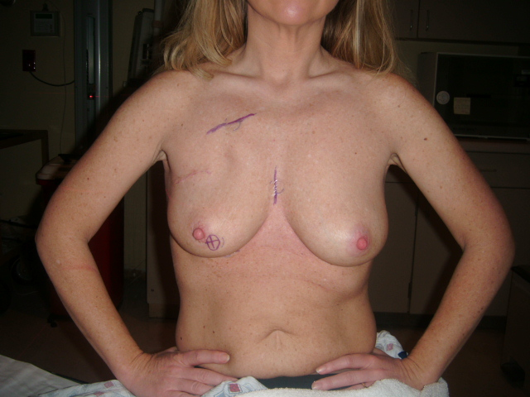
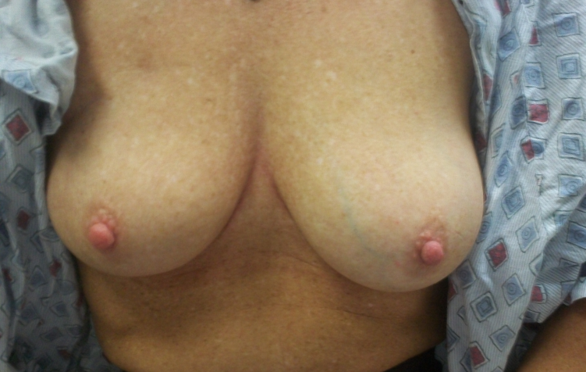
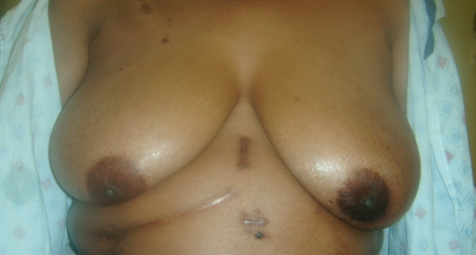
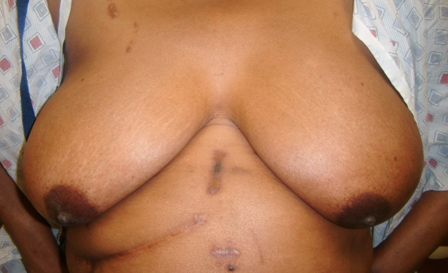
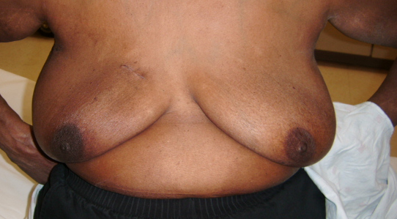
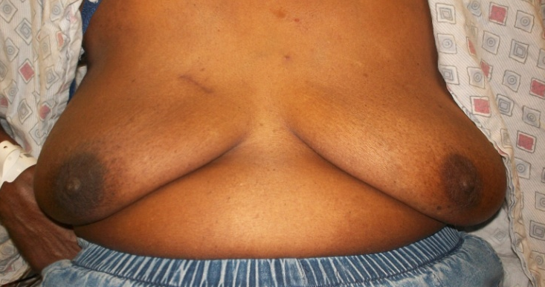
Next Report: Cosmesis (N=80 with >12 mos f/u; ASTRO 2015)
BASELINE
36 MONTHS

Slide 36
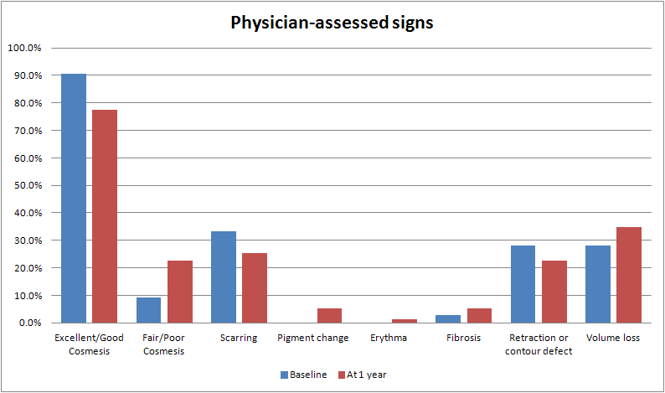

Slide 37
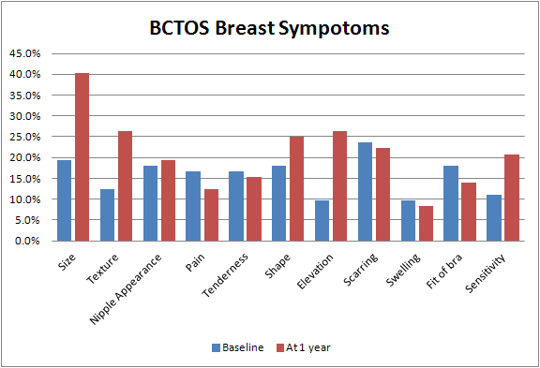

Slide 38
Conclusions:
Growing body of literature “Pushing Limits” of hypofractionation for breast radiotherapy⁷
WHBI is feasible, cost effective, widely applicable
  Improves access to care, especially for underserved patients
  Avoids controversies associated with partial breast techniques
Limitations:
  Small numbers, early data
Future directions:
  Continued accrual/data maturation and reporting
  Applications for regional nodal irradiation and/or PMRT

Slide 39
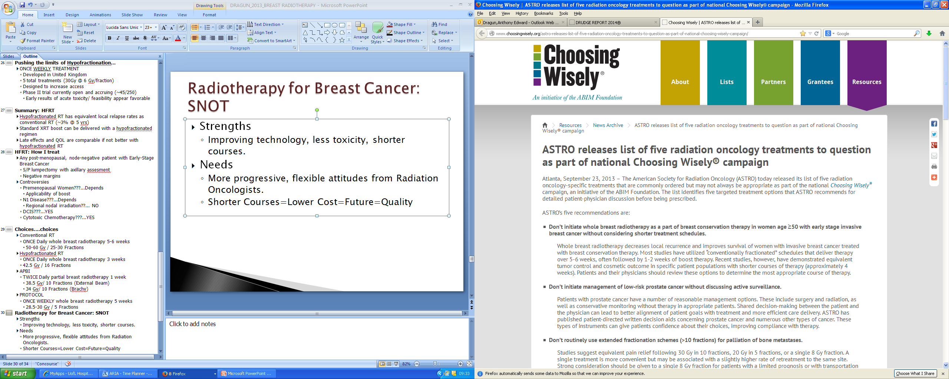
Radiotherapy for Breast Cancer: SNOT
Strengths
  Improving technology, less toxicity, shorter courses.
Needs
  More progressive, flexible attitudes from Radiation Oncologists.
  Shorter Courses=Lower Cost=Improved Access=Quality

Slide 40
Radiotherapy for Breast Cancer: SNOT
Opportunities
  Up to 1/3 patients are “falling through the cracks”
    Coordination of care, up-front consultations
  Shorter courses are marketable (competition)
  American College of Surgeons’ (ACS) Commission on Cancer (CoC)
    Quality metrics for breast conservation and receipt of radiotherapy
Threats
  Push on multiple fronts to lessen the role of radiotherapy in up-front/adjuvent setting
    “Elderly” (>70y) patients: Tam alone?
    DCIS: Oncotype?
    Increasing use of elective mastectomy with reconstruction (Jolie/Applegate Effect)

Slide 41
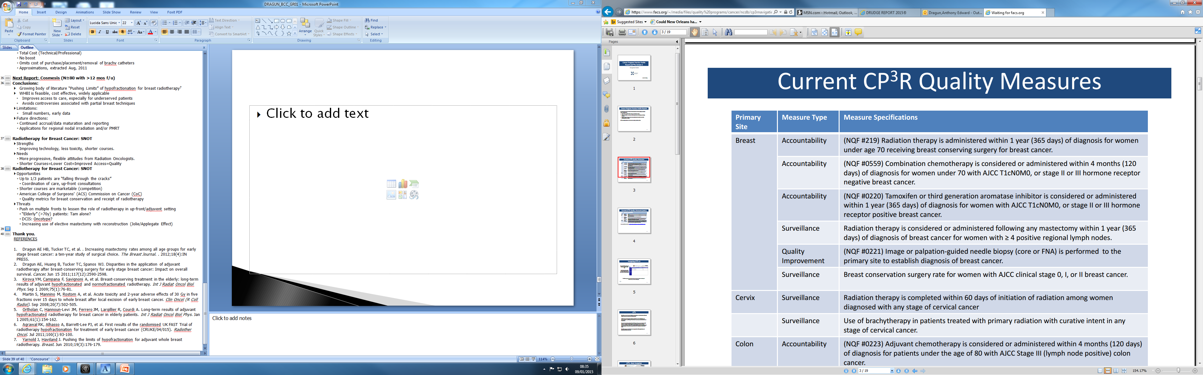

Slide 42
Implications for CTRs
DCIS: “Overtreatment”
  Less radiation is appropriate for all (HFRT)
  No radiation is appropriate for some
    WHO?
      Prognostic indices, nomograms, genomic testing
LESS Radiation (HFRT) is new standard for MOST Early Stage Cancers
  Marker of QUALITY (ASTRO)
  Cost efficacy
  Implications for QUANTIFYING XRT in registries

Slide 43

Thank you.
REFERENCES
1. Dragun AE HB, Tucker TC, et al. . Increasing mastectomy rates among all age groups for early stage breast cancer: a ten-year study of surgical choice. The Breast Journal. . 2012;18(4):IN PRESS.
2. Dragun AE, Huang B, Tucker TC, Spanos WJ. Disparities in the application of adjuvant radiotherapy after breast-conserving surgery for early stage breast cancer: Impact on overall survival. Cancer. Jun 15 2011;117(12):2590-2598.
3. Kirova YM, Campana F, Savignoni A, et al. Breast-conserving treatment in the elderly: long-term results of adjuvant hypofractionated and normofractionated radiotherapy. Int J Radiat Oncol Biol Phys. Sep 1 2009;75(1):76-81.
4. Martin S, Mannino M, Rostom A, et al. Acute toxicity and 2-year adverse effects of 30 Gy in five fractions over 15 days to whole breast after local excision of early breast cancer. Clin Oncol (R Coll Radiol). Sep 2008;20(7):502-505.
5. Ortholan C, Hannoun-Levi JM, Ferrero JM, Largillier R, Courdi A. Long-term results of adjuvant hypofractionated radiotherapy for breast cancer in elderly patients. Int J Radiat Oncol Biol Phys. Jan 1 2005;61(1):154-162.
6. Agrawal RK, Alhasso A, Barrett-Lee PJ, et al. First results of the randomised UK FAST Trial of radiotherapy hypofractionation for treatment of early breast cancer (CRUKE/04/015). Radiother Oncol. Jul 2011;100(1):93-100.
7. Yarnold J, Haviland J. Pushing the limits of hypofractionation for adjuvant whole breast radiotherapy. Breast. Jun 2010;19(3):176-179.

