Slide 1
ajcc TNM Staging: chapter 1, and
Summary stage
Tonya Brandenburg, MHA, CTR
QA Manager Abstracting and Coding
Kentucky Cancer Registry

Slide 2
What are we discussing?
What is AJCC Staging
Purpose of staging
General rules for clinical and pathological TNM staging
Anatomic stage/prognostic grouping rules
Using Blanks and X’s when information is unknown
Summary stage

Slide 3
AJCC staging
AJCC stands for American Joint Committee on Cancer
Established in 1959 to formulate and publish systems of classification of cancer
Comprised of nineteen member organizations
Notes:
-Some members: American Cancer Society, American College of Surgeons (ACoS), American Society of Clinical Oncology (ASCO), CDC, College of American Pathologists (CAP)

Slide 4
AJCC staging
Classifies the extent of disease at diagnosis based on extent of the primary tumor, involvement of regional LNs, and presence or absence of distant mets
Currently on 7th edition (for cases diagnosed January 1, 2010 forward)
Required by ACoS approved facilities; optional for others
For specified histologies
Notes:
-Also referred to as TNM staging
-First manual published in 1977
-Should be assigned by the physician, if possible; if not, done by registrar
-show of hands for ACoS approved hospitals?
-CoC standards require 90% MD staging
-colon TNM staging is only for carcinomas, NOT lymphomas, NETs, or sarcomas; the colon chapter lists the range of eligible histology codes

Slide 5
Purpose of Staging
Stage of disease
  Helps establish prognosis
  Is used to determine appropriate treatment, based on the experience and outcomes of previous patients
Stage of disease
  Is used in evaluating the results of treatments and clinical trials
  Provides a common framework for comparison of patients across treatment centers
  Serves as a basis for clinical and translational research

Slide 6
T N M Classification
T describes the primary tumor, and is defined by size or contiguous extension
  T0, Tis, T1 – T4, TX
N denotes the presence or absence of cancer in regional draining lymph nodes
  N0, N1 – N3, NX
M denotes the presence or absence of distant spread or metastases
  M0, M1
Notes:
T specifically designed for each primary site–
Roles of size and contiguous spread depend on site characteristics
Primary Tumor (T) valid values:
T0 No evidence of primary tumor; Tis Carcinoma in situ; T1, T2, T3, T4 Increasing size and/or local extension of primary tumor
TX Primary tumor cannot be assessed (minimize use of TX) I will discuss the use of X later.
N involvement is also categorized specifically for each site based on Number of positive nodes and/or Involvement of specific regional nodal groups
Regional Lymph Nodes valid values are : N0 No regional lymph node metastases; N1, N2, N3 Increasing number or extent of regional lymph node involvement, and NX Regional lymph nodes cannot be assessed.
M values are also specifically designed for some sites, which will have subcategories for detailed areas of involvement, such as cM0 (i+) or M1a

Slide 7
General rules
All cases should have microscopic confirmation, even for clinical classification
Cases without microscopic confirmation can be staged, but survival should be analyzed separately
Notes:
Stage can be wrongly presumed based on presumed site and histology.
For the rare cases without confirmation you can stage based on presumed site and histology.

Slide 8
Timing rules
Clinical Stage
Pathological Stage
Diagnosis and workup obtained before definitive treatment or within 4 months, whichever is shorter
  Definitive treatment includes:
    Surgical resection
    Systemic treatment (C,H,I)
    Radiation
    Active surveillance
    Palliative care
Diagnosis, workup, definitive surgical resection operative findings, and path report of resected specimen
Or within 4 months of diagnosis, whichever is longer
No systemic or rad prior to resection
Surgical resection must meet site specific criteria
Notes:
Must meet criteria for that specific chapter

Slide 9
Disease progression and staging
Both clinical and pathological staging say to use only the information before progression to assign the stage
If there is evidence of progression before the start of any treatment, do not use that information for staging

Slide 10
“downstaging”
Assign the lower category or stage group if:
  there is information, but it is unclear or
  not sufficient to definitively choose between 2 classifications
Do not use the lowest category or group, if information is not available or unknown
Notes:
Examples: Imaging is unclear if one node (N1) or two nodes (N2) are involved – Use N1
Colonoscopy doesn’t provide info on T category for colon – Use TX (info is unknown)
Lung clinical stage group for T2a NX M0 – Use clinical stage group unknown

Slide 11
Staging and Neoadjuvant therapy
Neoadjuvant therapy is systemic therapy or radiation therapy given before surgical resection.
Staging assigned after neoadjuvant therapy is indicated by a ‘y’ descriptor
  yc - clinical stage after systemic or radiation therapy but prior to surgical resection; this is not currently captured by cancer registries
  yp – pathologic stage after systemic or radiation therapy AND surgical resection; this is currently reported in the pathologic stage elements, with the ‘y’ descriptor

Slide 12
Required non-anatomic prognostic factors
Some AJCC chapters require non-anatomic factors for assigning stage
  Clearly defined in each chapter
  These are collected separately from T, N, and M and are used to assign stage groups
Notes:
Clearly defined in each chapter
Ex: Thyroid uses age and histology, esophagus and esophogastric junction uses histology, and soft tissue sarcoma uses grade

Slide 13
Clinical t, N, and M
How can we determine a clinical TNM stage?
  Use all information from any of the following obtained BEFORE treatment:
    Physical examination
    Imaging
    Endoscopy and Biopsy
    Surgical exploration without resection
    Resection of a single node/sentinel node(s) with a clinical T
    Lab test or biological markers
    Any other relevant examinations

Slide 14
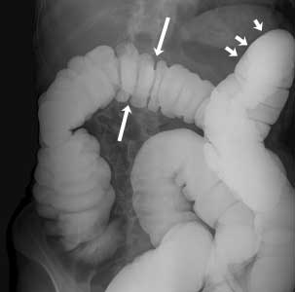
Clinical staging
Incorporates info from physical exam, endoscopy, imaging, biopsies, and surgical exploration without resection
Clinical staging is required by ACoS
Expressed as cT, cN, cM
Notes:
-Incisional biopsy, that does not completely resect the tumor; for example, bx during colonoscopy
-Clinical staging is used to select the treatment, based on national guidelines
-All patients can be staged clinically, whereas not all patients have a surgical resection for pathologic staging
-Rectal and rectosigmoid cancers are usually staged clinically, since they frequently receive chemo/XRT prior to or instead of surgical resection

Slide 15
Clinical clarifications
Clinical classification composed of:
  cT
  cN
  cM or pM
cM0
  No symptoms or signs of mets
  There is no MX category, so it must be M0 or M1 or left blank
  Only H&P needed to assign cM0
cM1
  Seen on physical exam or imaging
  Seen during scopes or operations, but not bx
Notes:
Extensive imaging NOT required to assign cT, cN or cM
Surgical exploration:
Can include biopsy
Cannot continue on to surgical resection in same procedure
Biopsy for T category:
If tissue establishes highest possible T category, CAN use for pT
Also use for cT
Biopsy of nodes is cN:
Single node or sentinel nodes as diagnostic workup, and
In absence of pathologic evaluation of primary tumor
Extensive imaging NOT required to assign cT, cN or cM
Only H&P needed to assign cM0
Patient must have had H&P, you don’t necessarily have to have seen the H&P

Slide 16
pathological t, N, and M
How can we determine a pathological TNM stage?
  Use all of the clinical staging information in addition to information obtained in:
    Operative findings (surgeon’s statement of findings)
    Pathology report (Only 1/3 of the information)
Notes:
Sometimes what the surgeon states can lead to a better staging
Pathology report (Only 1/3 of the information)
The remaining 2/3 information is in the operative findings and the clinical staging information. Path report may overrule clinically suspected involvement, but path report is NOT final stage – must be supplemented by other information.
-Pathologic stage is used mainly for survival and prognostic data
-Colon cancers are usually staged pathologically, in order to determine the depth of tumor invasion into the colon wall
-Pathologic staging requires removal of the primary tumor and regional LNs

Slide 17
pathological clarifications
Pathological classification composed of;
  pT
  pN
  cM or pM
pT – in general, resection of primary tumor is required
  Based on tumor size of extent of contiguous spread
  Record size to the nearest whole millimeter
  Ex: 4.5cm = 45, 3.43cm = 34, 6.8mm = 7
Biopsy which allows evaluation of highest T category is adequate to stage, pT can be assigned without resection
Notes:
Pay attention to units of measurement for tumor size. May be reported in millimeters or centimeters. Round up or down as appropriate, if tenths of millimeters are reported.

Slide 18
pathological clarifications
pN Regional node assessment for path classification
Number of nodes resected
  Requires pathologic assessment of at least ONE node
  Minimum number for sufficient sampling is explained in each chapter; however, if fewer than minimum number sampled, you can still assign pN
  Usually need pT to code pN
    Microscopic eval of highest N category can be used to assign pN, even if T is cT
Notes:
Regional node assessment for path classification requires a path exam of at least one node
Number of nodes – there are an expected number of nodes needed to stage pN
Ex. cT3, pN1
Do NOT need pathologic confirmation of highest N category
If LN surgery is performed, classify N category as pathologic even if minimum number is not examined
pT generally necessary for pN
Microscopic evaluation of highest N category
May use pN regardless whether T is pT or cT

Slide 19
pathological clarifications continued
pM can only be M1 (or 1a, 1b, 1c) or blank
pM0 does NOT exist
pM1 special considerations
  Requires positive biopsy of metastatic site
  May be used WITH cT and cN to assign pStage Group
  Staged as both
    Clinical stage IV – cT cN pM1
    Pathologic stage IV – cT cN pM1

Slide 20
Stage groupings
Allows grouping of patients with similar prognosis into fewer categories
Useful for data analysis and treatment guideline development
Stage groups summarize the stage information in a manner that is easily communicated and reproducible
Clinical Stage Group
  cT
  cN
  cM or pM
Pathologic Stage Group
  pT
  pN
  cM or pM
Notes:
There are separate clinical and pathological stage groups for each case. If you have a TX or NX the stage will be unstageable for that category, unless it is a stage that allows for any T, any N.
For groups that use non-anatomic factors, if the factor is missing, stage the case using the lowest category for that factor. For example, for prostate cancer, if the Gleason score is unavailable, assume < or = to 6.
If there are multiple tumors of the same histology in one organ, stage the tumor with the highest T category.

Slide 21
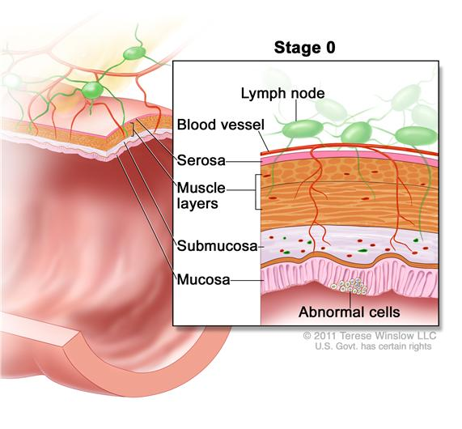
Definitions of TNM
Tis – carcinoma in situ; intraepithelial or invasion of lamina propria
Notes:
-tumors may arise in flat mucosa (‘frank’) or a polyp

Slide 22
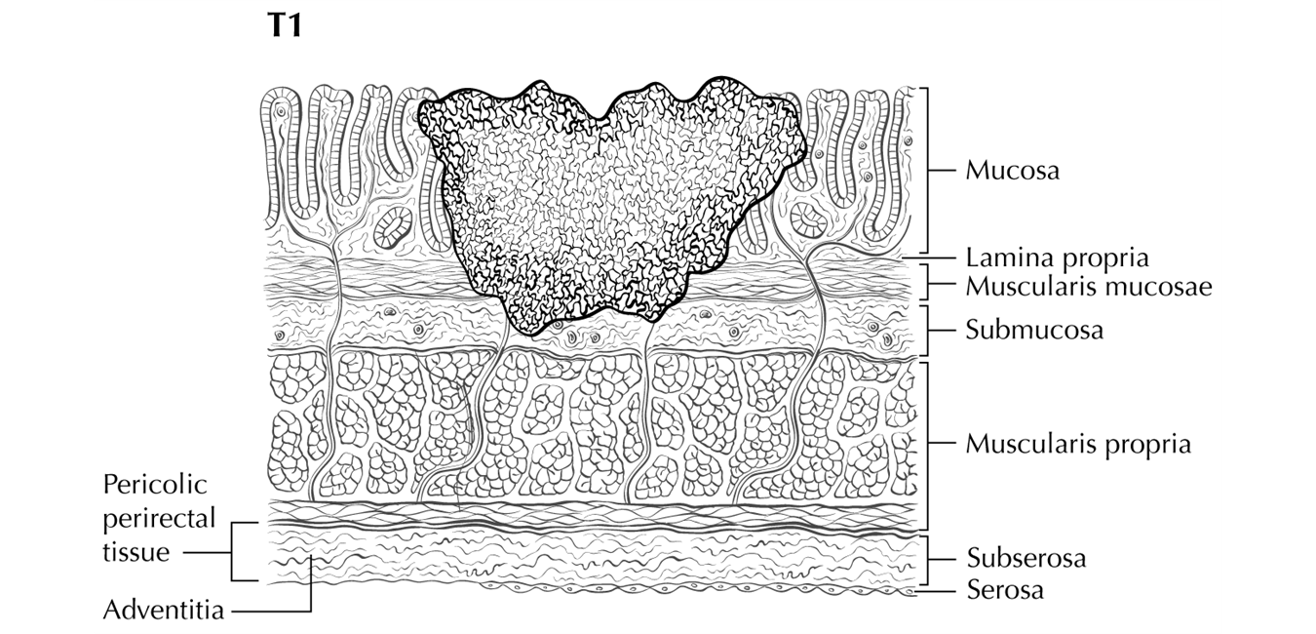
Definitions of TNM
T1 – tumor invades submucosa

Slide 23
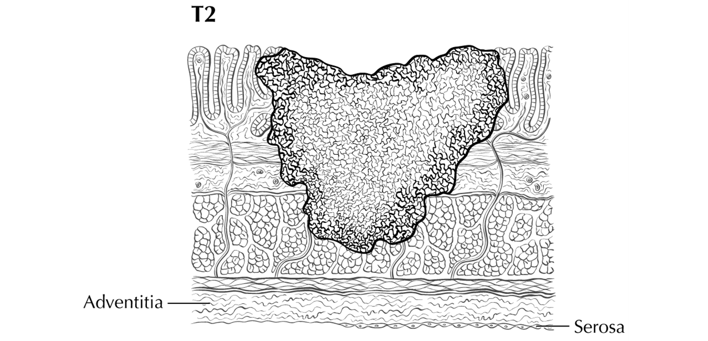
Definitions of TNM
T2 – tumor invades muscularis propria

Slide 24
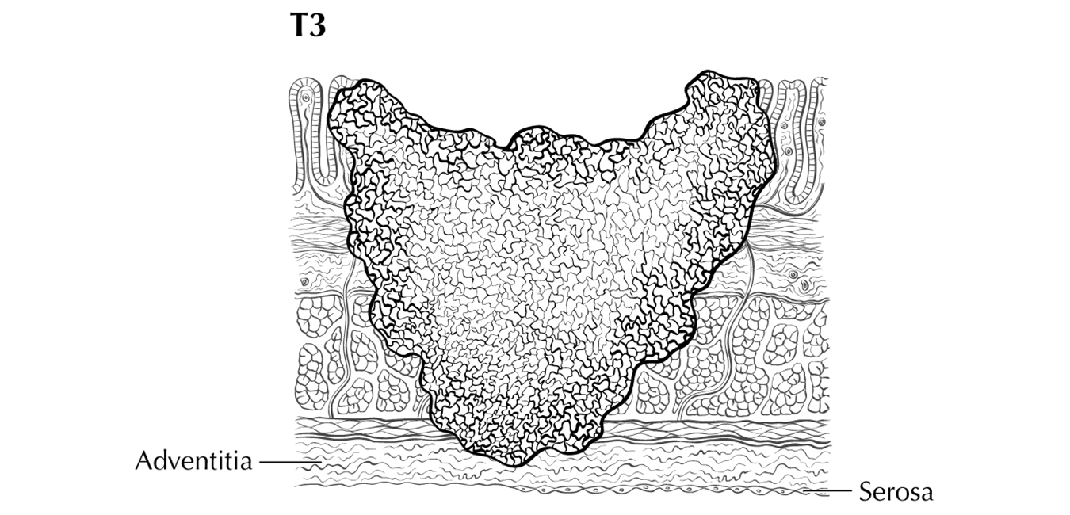
Definitions of TNM
T3 – tumor invades through the muscularis propria into pericolorectal tissues
Notes:
-”pericolic fat” may refer to the fat inside the colon wall in the subserosa, or outside the colon wall; either is a T3

Slide 25
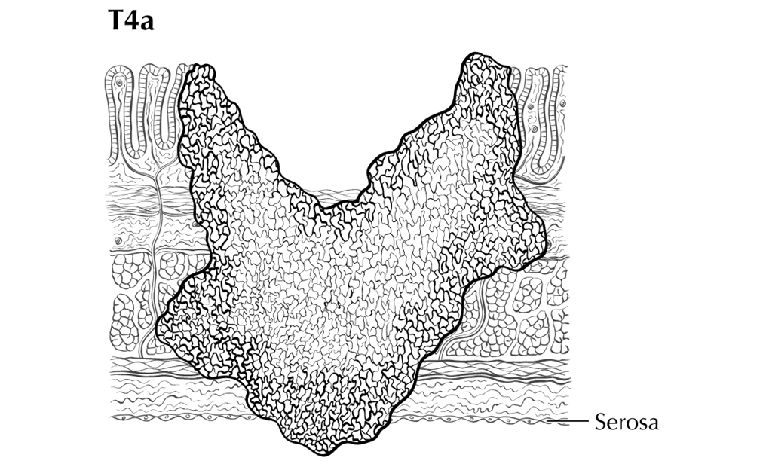
Definitions of TNM
T4a – tumor penetrates to the surface of the visceral peritoneum

Slide 26
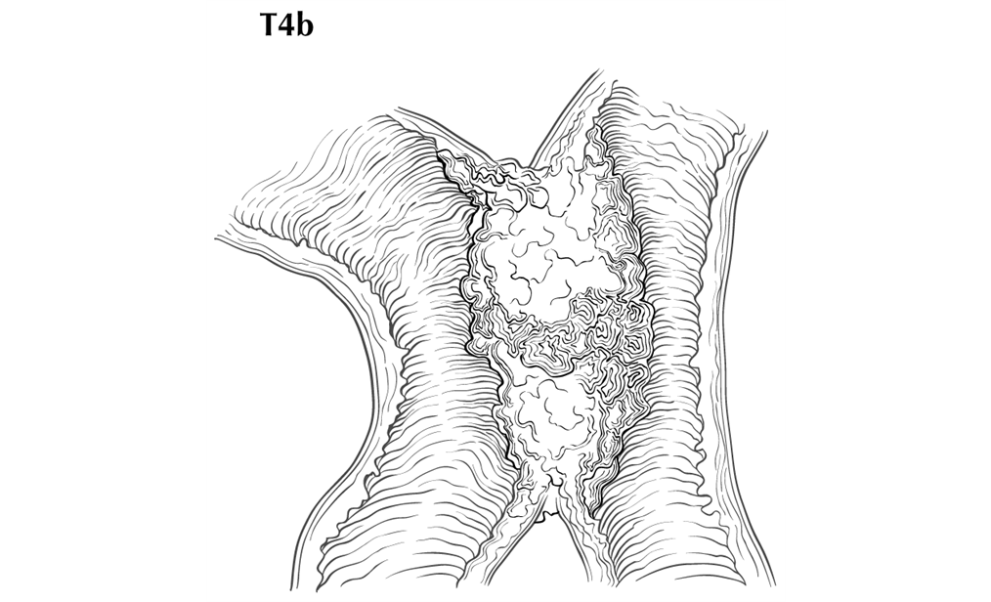
Definitions of TNM
T4b – tumor directly invades or is adherent to other organs or structures
Notes:
-Other organs includes other segments of the colon
-Involvement of the liver surface or capsule by direct extension is T4b; tumors within the parenchyma of the liver are discontinuous mets
-if tumor is grossly adherent to another organ or structure, but no tumor is microscopically present in the adhesion, downstage to T1-T4a

Slide 27
Definitions of TNM
The ‘N’ category designates the presence or absence of tumor in the regional LNs; increasing numerical involvement based on size, fixation, or invasion of the capsule that surrounds the LN, OR on number/location of involved LNs
NX – regional LNs cannot be assessed
N0 – no regional LN metastasis
Notes:
-For colon, the number of regional LNs is important prognostically
-Regional LNs vary by the segment of the colon where the tumor is located; the AJCC manual contains a list of which nodes are regional for each colon segment

Slide 28
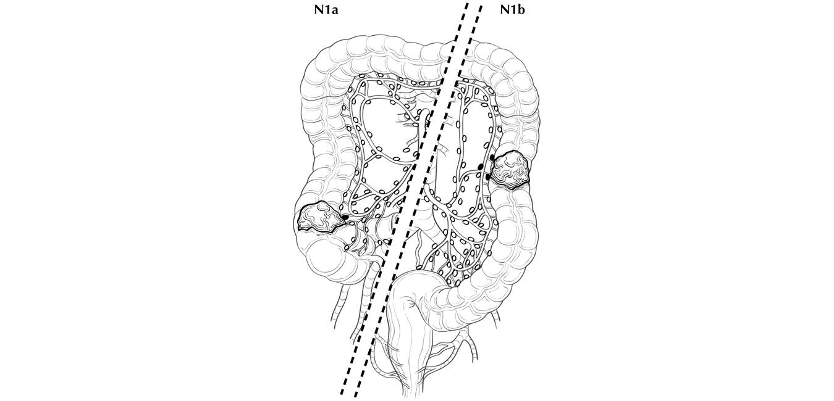
Definitions of TNM
N1 – mets in 1-3 regional LNs
N1a – mets in one regional LN
N1b – mets in 2-3 regional LNs

Slide 29
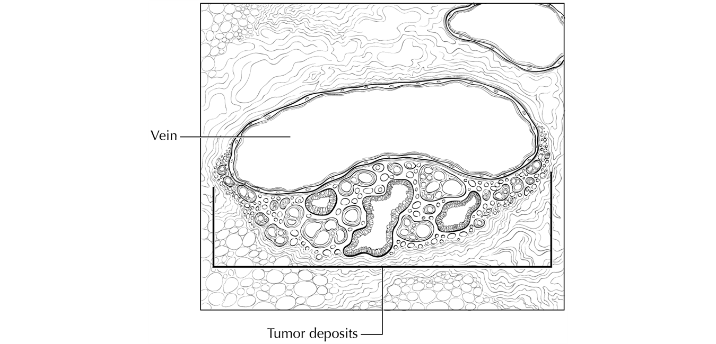
Definitions of TNM
N1c – tumor deposits in the subserosa, mesentery, or nonperitonealized pericolic tissues without regional nodal metastasis
Notes:
-A satellite peritumoral nodule in the pericolic adipose tissue without histologic evidence of a residual LN may represent discontinuous spread, venous invasion with extravascular spread, or a totally replaced LN.

Slide 30
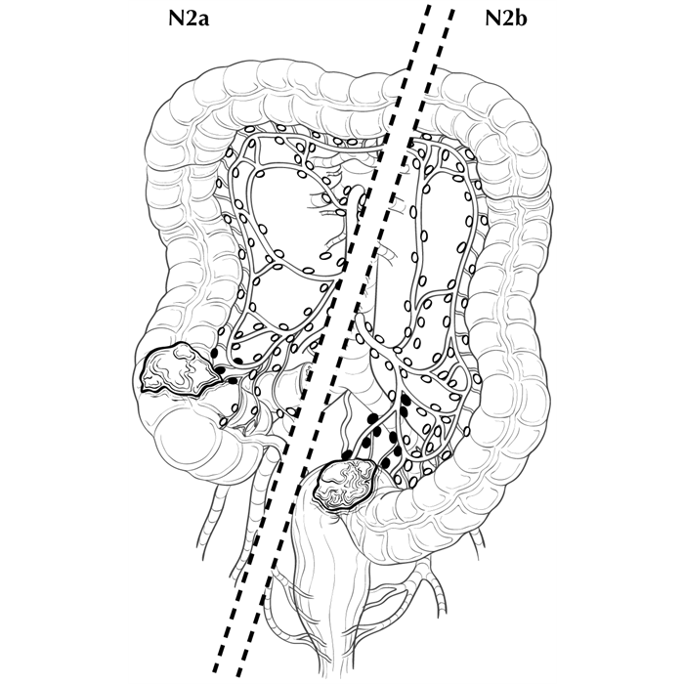
Definitions of TNM
N2 – mets in four or more regional LNs
N2a – mets in 4-6 regional LNs
N2b – mets in seven or more regional LNs
Notes:
-Use the more specific code when you know it (i.e., N2a or N2 NOS)

Slide 31
Definitions of TNM
-M component identifies the presence or absence of distant mets
M0 – no distant metastasis
M1 – distant metastasis NOS
M1a – mets confined to one organ or site
M1b – mets to more than one organ/site or the peritoneum
Notes:
-M1a-- for example, liver, lung, or non-regional LN
-You cannot have a pM0; only pM1

Slide 32
Definitions of TNM
The T, N, and M values are combined to form the stage group
The ‘y’ prefix is used to indicate cases that were staged after neoadjuvant therapy
‘yc’ is used when a clinical stage is assigned after neoadjuvant therapy, and ‘yp’ is used for cases when pathologic stage is assigned based on surgical resection following adjuvant therapy
Notes:
-Each chapter has a table allowing you to assign stage group
-Some stage groups may include factors other than T, N, and M, such as grade
-yp can be used in conjunction with the clinical stage to assess response to systemic tx/XRT
-tumor registries do not capture yc stage

Slide 33
TNM stage group
Stage 0 – Tis N0 M0
Stage I – T1 N0 M0
T2 N0 M0
T3 N0 M0
Stage IIA – T3 N0 M0
Stage IIB – T4a N0 M0
Stage IIC – T4b N0 M0
Notes:
-Cases with similar prognoses are grouped together
-Stage 0 reflects minimal involvement, usually in situ

Slide 34
TNM stage group
Stage IIIA – T1-2 N1/N1c M0
T1 N2a M0
Stage IIIB – T3-T4a N1/N1c M0
T2-T3 N2a M0
T1-T2 N2b M0
Stage IIIC – T4a N2a M0
T3-T4a N2b M0
T4b N1-N2 M0
Notes:
-Subdivisions are based on survival rates

Slide 35
TNM Stage Group
Stage IVA – Any T Any N M1a
Stage IVB – Any T Any N M1b
Notes:
-Unknown stage group (clinical or pathologic) is 99

Slide 36
Derived AJCC stage
Cpdms.net generates a derived TNM stage based on Collaborative Stage
Derives both 6th and 7th edition stages, for continuity
The field “Best Stage Group” is the derived 7th edition stage
Useful in data analysis
Notes:
-Combination of clinical and pathologic stage
-Can also be utilized for QA, making comparison between physician/registrar assigned AJCC and derived AJCC

Slide 37
When to use blanks and x’s
Blanks should be used if:
  There is no info in the chart to assign an AJCC value
  If the patient isn’t eligible for pathological staging
  If AJCC criteria for this stage classification is not met
X should be used if:
  Criteria for this stage classification is met
  T cannot be assessed
  N cannot be assessed
  Cannot use X in the M category; MX is not a valid value
Notes:
The critical difference, to be considered first, is whether or not the criteria for AJCC staging has been met, and this is chapter specific.

Slide 38
Does patient meet criteria for that stage classification?
Yes – patient meets classification criteria
No – patient does NOT meet classification criteria
  If physician could not assess T and/or N for the patient, and definitive information for T and N not in chart
  Use TX and/or NX (Use of X is rare)
  If there is no information about diagnostic workup or resection pathology in chart
  Use blank
    Indicates registrar could not find information in chart
  Do not use X
  Do NOT use X
    Indicates patient eligible for staging
    Implies physician did not assess or have info on patient’s T and/or N
  Must use blanks
    Indicates patient did not meet classification criteria
Notes:
Does patient meet criteria for that stage classification?
Yes – patient meets classification criteria
If physician could not assess T and/or N for the patient, and
Definitive information for T and N not in chart
Use TX and/or NX
Yes – patient meets classification criteria
No information about diagnostic workup or resection pathology in chart
Do not use X
Implies physician did not assess or have info on patient’s T and/or N
Use blank
Indicates registrar could not find information in chart
No – patient does NOT meet classification criteria
Do NOT use X
Indicates patient eligible for staging
Implies physician did not assess or have info on patient’s T and/or N
Must use blanks
Indicates patient did not meet classification criteria

Slide 39
CoC codes vs. AJCC values
CoC Codes (in FORDS 2015)
AJCC instructions
Blanks allowed in T, N, M but
Blanks are NOT allowed in
  c Stage Group
  p Stage Group
Blanks means no info or criteria for AJCC staging are not met
X is valid value; use per AJCC
Use 99 in Stage Group, if unknown
Use 88 if N/A for AJCC staging
Blanks are valid in any T, N, M and stage group field, if appropriate
X is valid value; use per AJCC instructions
Codes 99 and 88 are not defined or used by AJCC

Slide 40
Summary stage
How far the cancer has spread past the point of origin
Use all info in the medical record (the same info used to assign TNM)
Use information through completion of surgery in first course treatment or within 4 months without disease progression, whichever is shorter
If review of the records documents distant mets, you can avoid reviewing records to identify local or regional dz.
Path reports that contain a statement of invasion, nodal involvement or mets spread cannot be staged as in-situ even if the pathology of the tumor states it.
If there are nodes involved, the stage must be at least regional.
If there are nodes involved but the chain is not named in the pathology report, assume the nodes are regional.

Slide 41
Summary Stage Codes
0 In-Situ
1 Localized disease only
2 Regional disease by direct extension only
3 Regional disease w/only regional lymph nodes involved
4 Regional disease by both direct extension and regional lymph node involvement
5 Regional disease that is not specified as direct extension or extension to regional LN
7 Distant sites or distant lymph node involvement
8 Not applicable (Used for benign or borderline tumors that are reportable)
9 Unknown if there is extension or metastatic disease (unstaged, unspecified, DCO cases)

Slide 42
Questions?
???

