Slide 1
Cancer Registry Coding Changes for 2014
Presented by the
Kentucky Cancer Registry
February, 2014

Slide 2
List of 2014 changes
Conversion from CSv02.04 to CSv02.05
Discontinue Grade Path Value/System; move to Historic tab
Tumor Grade coding instructions revised
Some ICD-O-3 updates implemented (preferred terms and synonyms)
Casefinding List based on ICD-10 codes added to CPDMS Manual
Hematopoietic Database and Manual revised for 2014

Slide 3
Presentation Agenda
CSv02.05 changes 1 hour Frances
Tumor Grade 15 mins. Emily
ICD-O-3 changes 15 mins Emily
Hematopoietic changes 30 mins. Frances

Slide 4
Collaborative Stage v02.05
Involves a data conversion of all cases back to 2004
Must be used for initial data entry for all cases with a diagnosis date of Jan. 1, 2014 or later
May be used for data entry of any cases with earlier diagnosis dates
Some data items have been discontinued
Grade Path System and Grade Path Value
Some Site Specific Factors, which were never required
Some coding instructions have been clarified
Some corrections to the mapping algorithm for AJCC and Summary Stage values have been implemented

Slide 5
New look for CS web site

Slide 6
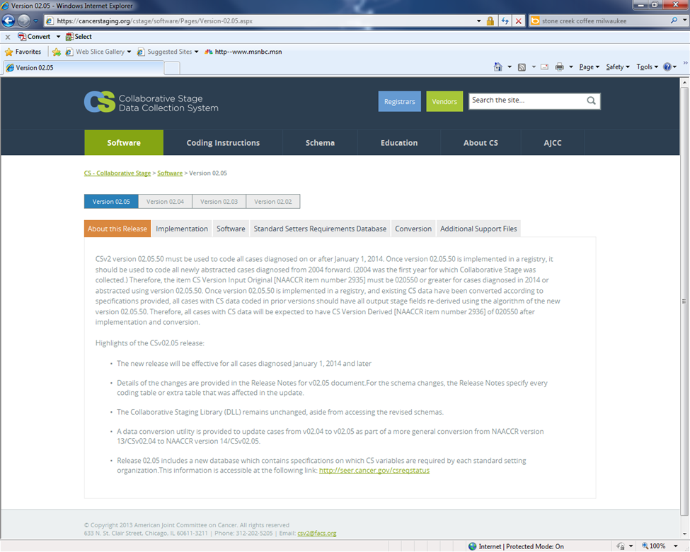
Click on Software tab

Slide 7
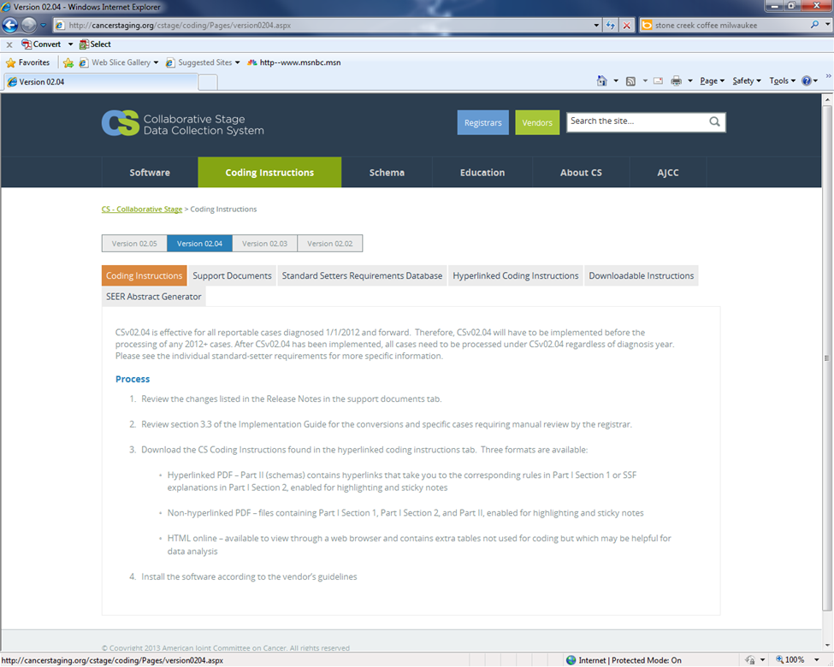
Click on Coding Instructions

Slide 8
Coding Instructions tab
Extra tables which are not used for coding but that may be helpful for data analyses are also included.
Contains links to
- a list of changes in v02.05 called Release Notes
- a list of requirements by each Standard Setter (CoC, SEER, NPCR)
- CS Coding Instructions - For this release, only the HTML Help format is available for downloading:
A desktop icon that reads CS Manual Online Help, when double clicked, will open the CS Coding Instructions software program. The program contains all schemas plus general and site specific instructions. Extra tables which are not used for coding but that may be helpful for data analyses are also included.

Slide 9
CS Data Conversion – some manual review and re-coding will be required …
…in these schemas:
Bile Ducts Intrahepatic and Bile Ducts Perihilar
Bladder
Head and Neck schemas
Nasopharynx

Slide 10
Bile Ducts Intrahepatic and Perihilar
Review SSF 10 (Tumor Growth Pattern) if coded 000 or 999
Explanation
Prior instructions for coding SSF10 for BileDuctsIntrahepat indicated that the
information should be coded based upon findings noted in the pathology report.
Instructions have been modified to indicate that information can be obtained from radiology and surgery reports as well as from pathology reports.
Review all cases coded in the BileDuctsIntrahepat schema with an SSF 10 code of
000 or 999 to determine if a code of 010 should be assigned, which could change
the derived T and stage values.
BileDuctsPerihilar should also be reviewed but it will not affect the derived T and stage values

Slide 11
Bladder
Review cases with CS Lymph Nodes coded 400 or 450 and recode SSF2 (Size of Metastasis in Lymph Nodes)
Explanation
Prior instructions for coding SSF2 included coding the largest size of any regional node listed under CS Lymph Nodes. SSF 2 instructions have been modified to indicate common iliac nodes are excluded when determining size of metastasis in lymph nodes.
Recode SSF 2 based on the size of lymph node metastasis in iliac (internal, external, NOS), obturator, pelvic, perivesical, sacral or regional nodes, NOS only. Do not include common iliac nodes.

Slide 12
Head and Neck schemas
Review SSF1 if coded 988
Explanation
Any head and neck cases with code 988 in SSF1 should be reviewed and recoded so that stage can be derived after conversion to v0205.
KCR may not have any of these cases.

Slide 13
Nasopharynx
Review cases with CS Lymph Nodes coded 130, 230, and 430
Explanation
If any Level IV nodes were coded using these codes, then CS Lymph Nodes needs to be recoded. All level IV nodes should be recoded to code 650.

Slide 14
Reviewable Cases and New Edits
When CPDMS.net is updated to CSv02.05, a list of the reviewable cases from each hospital’s database will be placed on FES, along with instructions regarding the type of review that is needed, based on the primary site.
Additional cases may fail edit checks now implemented with the 2014 changes. You may encounter these as you edit old cases. You should run the report for COC Edits to identify and fix these new errors.

Slide 15
Clarifications in the
General Instructions:
Highlights

Slide 16
Neoadjuvant Therapy
Neoadjuvant therapy affects coding of
– Tumor Size and Extension
Must be from the same time frame: clinical or y pathologic
Remember, both data fields map to one T category
– No response to therapy
Infrequent that patient doesn’t respond to therapy
Code CS Lymph Nodes from path report and eval 6
– Lymph-vascular invasion (LVI) special instructions
LVI present after neoadjuvant can be coded
LVI not present after neoadjuvant cannot be coded

Slide 17
Eval 3 - Pathologic
• Eval 3 – pathologic
– Resection path info + clinical eval info
– Resection path info + operative findings
• Example
– Path report for resection has no tumor size
– Use physical exam or imaging tumor size
– Use eval 3 - pathologic

Slide 18
Physician Assignment T, N, M
When to use physician assigned T, N, M
– Doubt documentation in medical record is complete
– Physician T, N or M category differs from medical record
– Use “Stated as” code for physician T, N or M value
– Do not code to different value from medical record info
– Registrar documents rationale in abstract

Slide 19
Bone, Brain, Liver, & Lung Mets
Code 8 is for hematopoietic diseases (9590-9992)
For Unknown Primary
– Code 0, 1 or 9 for unknown primary sites
Exception added to code 8
- Code 8 when CS Mets at DX is coded as 98 (not applicable)

Slide 20
Lymph Node Eval – new examples
Eval 3 - pathologic
– Diagnostic bx of lymph node
– Subsequent primary resection
– Rationale: part of workup, primary surgery meets criteria for pT, now meets pN definition
Eval 3 – pathologic
– Neck node dissection for treatment, no primary surgery
– Rationale: part of treatment, meets pN definition

Slide 21
Pathologic Complete Response
Pathologic complete response (pCR) to neoadjuvant therapy
– In situ disease only qualifies for complete response
– Residual Burden Calculator
• Score is 0 for in situ disease only
• Therefore, only in situ disease can have pCR

Slide 22
Breast SSFs on Multiple Tumors
Cases with in situ and invasive breast cancer, code the SSFs
– with the results of invasive ca, not in situ
– because treatment and outcomes based on the invasive tumor

Slide 23
Grade Collected in SSF
Code highest grade prior to neoadjuvant
– Neoadjuvant Rx could kill off highest grade tumor areas
– Behavior is based on highest grade prior to Rx
Breast, prostate, appendix carcinoid, soft tissue, sarcoma, kidney, renal pelvis, ureter, bladder, urethra

Slide 24
Melanoma & Merkel Cell ITC’s
Melanoma and Merkel Cell carcinoma
– Isolated tumor cells (ITC’s)
– Considered positive nodes in these two sites
– Include in regional nodes positive count
– Include when coding positive nodes in CS Lymph Nodes data field

Slide 25
Discontinued Data Items
Grade Path System and Grade Path Value have been discontinued by all standard setters. These items will move to the ‘Historic’ tab in CPMS.net
Many defined but never required Site Specific Factors have been discontinued by all standard setters. They will continue to be displayed in CPDMS.net with the 988 default value. SEER has discontinued some formerly required SSFs, but CoC has not, so all required SSFs will be continued until CS is discontinued in 2016.

Slide 26
New Coding Instructions Format
As mentioned earlier , for this release, only the HTML Help format is available.
Download the Coding Instructions from the CS web site and install then on your computer.
A desktop icon that reads CS Manual Online Help will open the CS Coding Instructions software program. The program contains all schemas plus general and site specific instructions. Extra tables which are not used for coding but that may be helpful for data analyses are also included.

Slide 27
CS Coding Instructions

