Slide 1
TNM Staging: Prostate
Tonya Brandenburg, MHA, CTR
Kentucky Cancer Registry

Slide 2
Overview
Anatomy
Common Terms
Changes in T,N,M Staging from AJCC 6th edition to 7th edition
Elements of Staging: TX-T4 Clinical and Pathological, NX-N1, and M0-M1
Stage Groups and Prognostic Factors
Prostate Examples

Slide 3
Anatomy of Prostate

Slide 4
Zonal anatomy of the prostate, a transverse view as seen on ultrasound.

Slide 5
Zonal anatomy of the prostate, a sagittal view as seen on ultrasound.

Slide 6
Prostate
Locations of the prostate for systematic biopsy schemes.

Slide 7
Common Terms
Acinar adenocarcinoma of the prostate: The prostate gland is sponge-like consisting primarily of acini or very tiny sacs that produce the fluids for ejaculation. Acinar adenocarcinoma is not a specific histologic type. The term acinar refers to the fact that the adenocarcinoma originates in the prostatic acini. 95% of all prostate cancers are (acinar) adenocarcinoma.
Adenoacanthoma: Adenocarcinoma with squamous metaplasia
TRUS – Transrectal Ultrasound that is used for diagnostic purposes and to learn the location of the tumor
TURP - Transurethral Resection of the Prostate is a commonly used surgical treatment during which a surgeon inserts a resectoscope into the urethra. The surgeon will place a cutting loop through the resectoscope to remove a small piece of the prostate gland tissue. The surgeon then runs an electrical current through the cutting loop and cuts off small pieces of the prostate gland in chips or cores
DRE – Digital rectal exam performed during clinical workup to search for irregularities in the prostate
.

Slide 8
Changes in T,N,M Staging for Prostate from 6th edition to 7th edition
Extraprostatic invasion with microscopic bladder neck invasion (T4) is included with T3a
Gleason Score now recognized as the preferred grading system
Prognostic factors have been incorporated in the anatomic stage/prognostic groups:
Gleason Score
Preoperative prostate-specific antigen (PSA)
Sarcomas and transitional cell carcinomas are not included

Slide 9
Elements of Staging: TX, T0, T1, T1a, T1b, and T1c
TX: Primary tumor cannot be assessed
T0: No evidence of primary tumor
T1: Clinically inapparent tumor neither palpable nor visible by imaging
T1a: Tumor incidental histologic finding in 5% or less of tissue resected
T1b: Tumor incidental histologic finding in more than 5% of tissue resected
T1c: Tumor identified by needle biopsy (e.g., because of elevated PSA)
*No Pathological T1 classification*
Notes:
There is no pathologic T1 classification.

Slide 10
T1a (left) is defined as an incidental histologic finding of tumor in 5% or less of tissue resected, shown here as tissue fragments from a transurethral resection. T1b (right) is defined as an incidental histologic finding of tumor in more than 5% of tissue resected.

Slide 11
Elements of Staging: T2, T2a, T2b Clinically apparent
T2: Tumor confined within prostate
T2a: Tumor involves one-half of one lobe or less
T2b: Tumor involves more than one-half of one lobe but not both lobes
T2c: Tumor involves both lobes
Notes:
Tumor found in one or both lobes by needle biopsy, but not palpable or reliably
visible by imaging, is classified as T1c.

Slide 12
Elements of Staging: T2, T2a, T2b Pathological
T2: Organ confined
T2a:Unilateral, one-half of one side or less
T2b: Unilateral, involving more than one-half of side but not both sides
T2c: Bilateral disease

Slide 13
T2a (left) is defined as tumor that involves one-half of one lobe or less, whereas T2b (right) is defined as tumor that involves more than one-half of one lobe but not both lobes, without extracapsular extension.

Slide 14
T2c is defined as tumor that involves both lobes, without extraprostatic extension.

Slide 15
Elements of Staging: T3, T3a, T3b, T4 Clinical
cT3: Tumor extends through the prostate capsule
cT3a: Extracapsular extension (unilateral or bilateral)
cT3b: Tumor invades seminal vesicle(s)
cT4: Tumor is fixed or invades adjacent structures other than seminal vesicles: such as external sphincter, rectum, bladder, levator muscles, and/or pelvic wall
Notes:
Invasion into the prostatic apex or into (but not beyond) the prostatic capsule is
classified not as T3 but as T2.

Slide 16
Elements of Staging: T3, T3a, T3b, and T4 Pathological
pT3: Extraprostatic extension
pT3a: Extraprostatic extension or microscopic invasion of bladder neck
pT3b: Seminal vesicle invasion
pT4: Invasion of rectum, levator muscles and/or pelvic wall

Slide 17
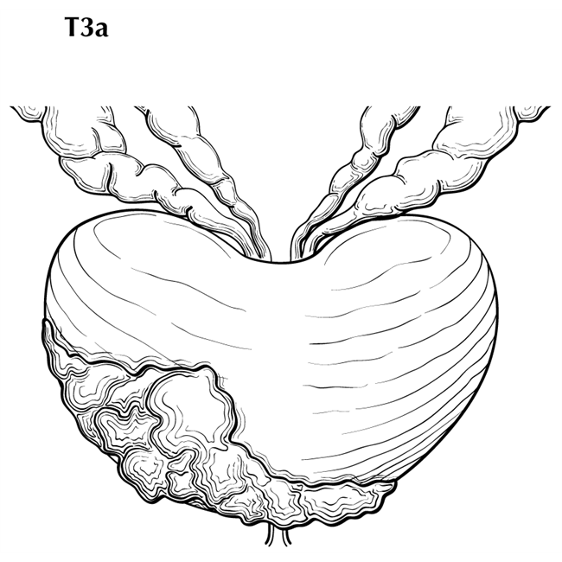
T3a is defined as a tumor with unilateral or bilateral extracapsular extension.

Slide 18
T3b is defined as tumor that invades seminal vesicle(s).

Slide 19
T4 is defined as tumor that invades adjacent structures other than seminal vesicles such as bladder, as shown here, external sphincter, rectum, levator muscles, and/or pelvic wall.

Slide 20
T4 is defined as tumor that is fixed to adjacent structures.

Slide 21
Elements of Staging: NX, N0, and N1(Clinical and Pathological)
cNX: Regional LN cannot be assessed
cN0: No regional LN metastases
cN1: Metastases in regional lymph nodes
pNx: Regional lymph nodes not sampled
pN0: No positive regional lymph nodes
pN1: Metastases in regional node(s)

Slide 22
Lymph nodes of the prostate. The shaded area represents regional distribution of lymph nodes. The non-shaded area indicates nodes outside of regional distribution.

Slide 23
N1 is metastasis in regional lymph nodes, here shown unilaterally.

Slide 24
N1 is metastasis in regional lymph nodes, here shown bilaterally.

Slide 25
Elements of Staging: MX, M0, and M1
MX: No longer exists in TNM Staging
M0: No distant metastasis (Remember: not possible for pathologic staging)
M1: Distant metastasis
M1a: Non regional lymph node(s)
M1b: Bone(s)
M1c: Other site(s) with or without bone disease

Slide 26
Stage Groups

Slide 27
Prognostic Factors for Prostate
Gleason primary and secondary patterns on bx and prostatectomy (if applicable)
Gleason Tertiary Pattern on prostatectomy (if applicable)
Clinical Staging procedures performed
Number of biopsy cores examined
Number of biopsy cores positive for cancer
Notes:
Clinical staging procedures is dre or imaging or both.

Slide 28
Prostate Case 1 Answers
Topography: C61.9
Histology: 8140/3
This case is one primary per rule M3
Clinical Staging
cT | 1c
cN | 0
cM | 0
PSA | 8.14
Gleason Score | 6
Clinical Stage Group | I
Pathological Staging
pT | Blank
pN | Blank
pM | Blank
PSA | 8.14
Gleason score | 998
Pathological Stage Group | Blank
SEER Summary Stage: 1 - Localized
Notes:
Rationale for staging choices
Clinical
T – 1c found on screening for elevated PSA, tumor clinically inapparent
N – 0 No nodes on imaging
M – 0 no signs or symptoms of mets
Pathological No surgical resection meeting stage criteria so everything is blank
T –
N –
M-

Slide 29
Prostate Case 2 Answers
Topography: c61.9
Histology: 8140/3
This case is one primary per rule M2
Clinical Staging
cT | 2b
cN | 0
cM | 0
PSA | 12.3
Gleason score | 6
Clinical Stage | IIA
Pathological Staging
pT | 2c
pN | 0
pM | cM0
PSA | 12.3
Gleason Score | 6
Pathologic Stage | IIB
SEER Summary Stage: 1 - Localized
Notes:
Rationale for staging choices
Clinical
T- 2b tumor palpated on DRE
N- 0 No nodes based on physician judgement
M- 0 no signs or symptoms of mets
Path
T – 2c
N – 0 no nodes involved
M – Use cM0 based on clinical no signs or symptoms of mets

