Slide 1
Cancer of the Uterus Endometrial Cancer

Slide 2
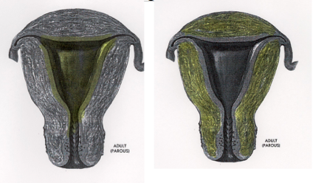

Slide 3
Uterine Cancer 2016
Cases Deaths
Breast 246,660 40,450
Ovary 22,280 14,240
Uterus 60,050 10,470

Slide 4
Uterine Cancer 2016
Deaths/100 Cases
Breast 16
Ovary 64
Uterus 17

Slide 5
Endometrial Cancer Risk Factors
Hypertension
Obesity
Diabetes
Infertility, low parity
Early menarche
Late menopause

Slide 6
Endometrial Cancer Etiology
Estrogen
Tamoxifen (Nolvadex^{R})
Raloxifene (Evista^{R})
Obesity
Anovulation
Estrogen-secreting neoplasms

Slide 7
Body Mass Index (BMI)
BMI = Wt (kg)/Height² (M)
Underweight <18.5
Normal 18.5 – 24.9
Overweight 25 – 29.9
Obese > 30
Morbidly Obese > 40 (or >35+)

Slide 8
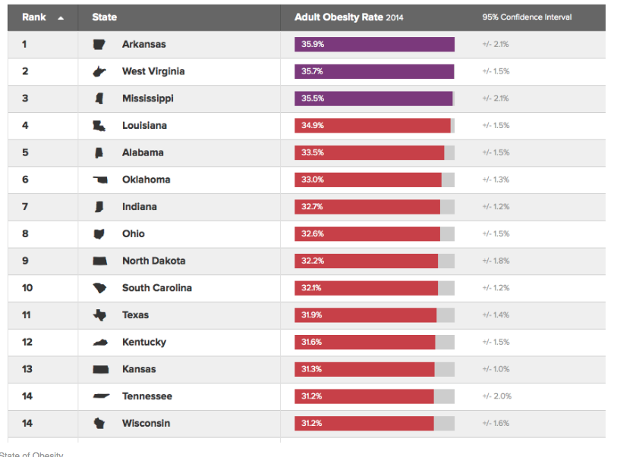

Slide 10
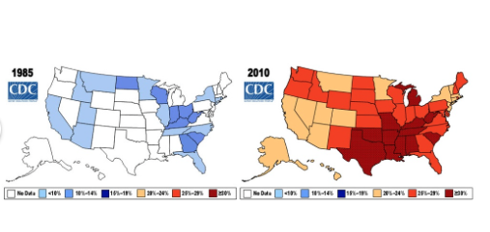

Slide 11
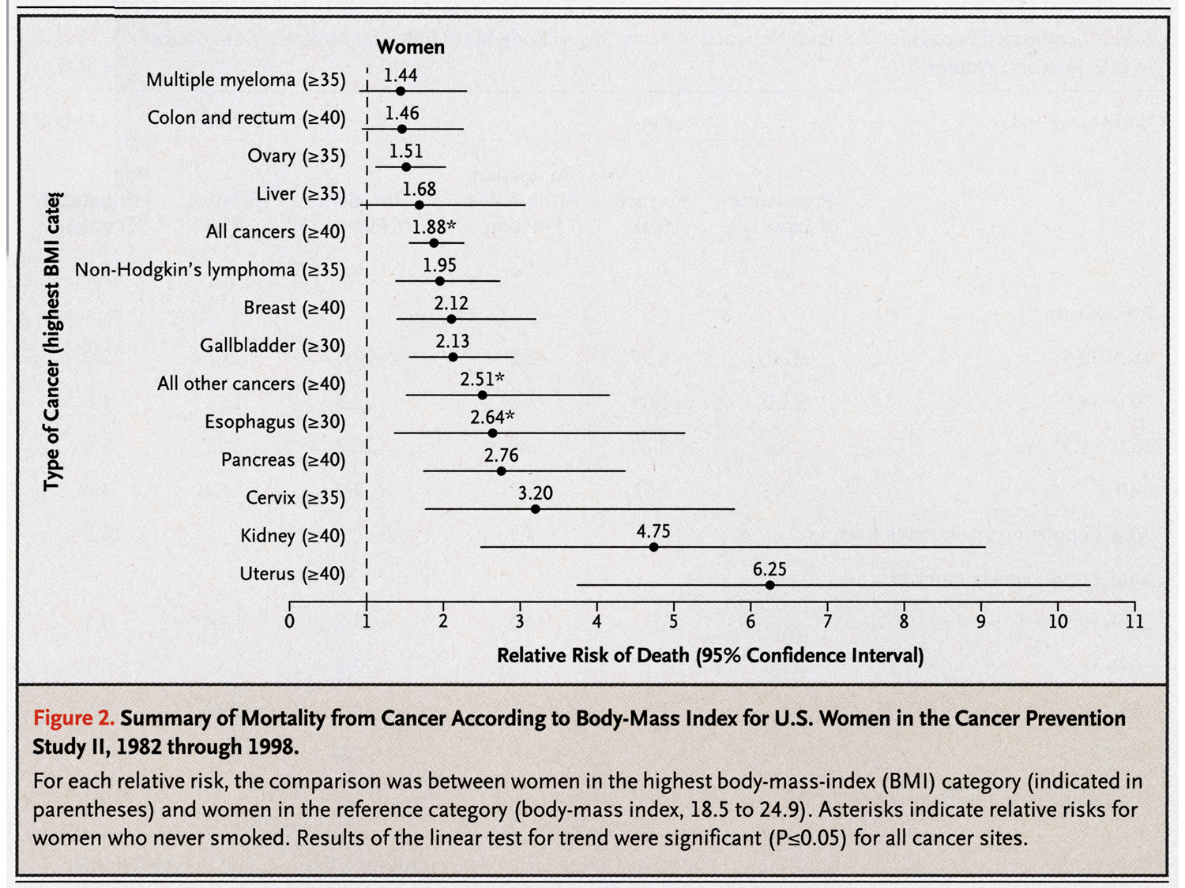

Slide 12
Endometrial Cancer Etiology
High-risk kindreds
Hereditary Non-Polyposis Colon Cancer (Lynch II)
Comprise 3% endometrial CA
BRCA-1

Slide 13
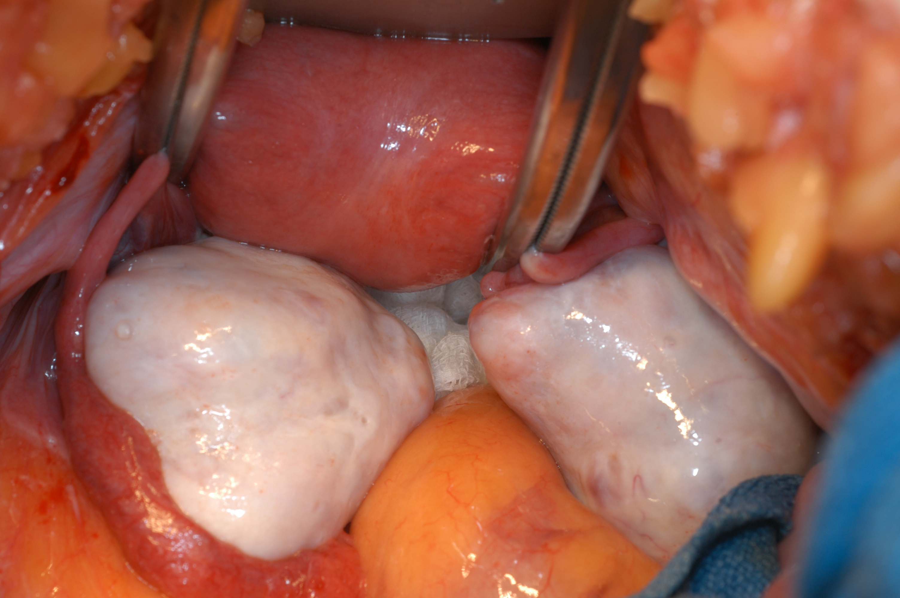

Slide 14
Endometrial Cancer Screening?
Endometrial cytology
Vaginal ultrasound

Slide 15
Endometrial Cancer Screening?
Cancer without bleeding:
Serous variety
Radiotherapy for ca cervix
Cervical stenosis
Endometrial ablation

Slide 16
Endometrial Cancer Vaginal Ultrasound
In 163 postmenopausal women with endometrial thickness < 4 mm, one endometrial cancer occurred (0.6%).
In women with endometrial thickness > 5 mm, 18.7% had malignancies.
-Gull, AJOG 2000

Slide 17
Endometrial cancer
A 62-year old with pelvic pain but NO bleeding has a vaginal ultrasound demonstrating a 23 mm uterine stripe.
Most likely diagnosis:
Endometrial polyp
Endometrial adenocarcinoma
Endometrial serous carcinoma

Slide 18
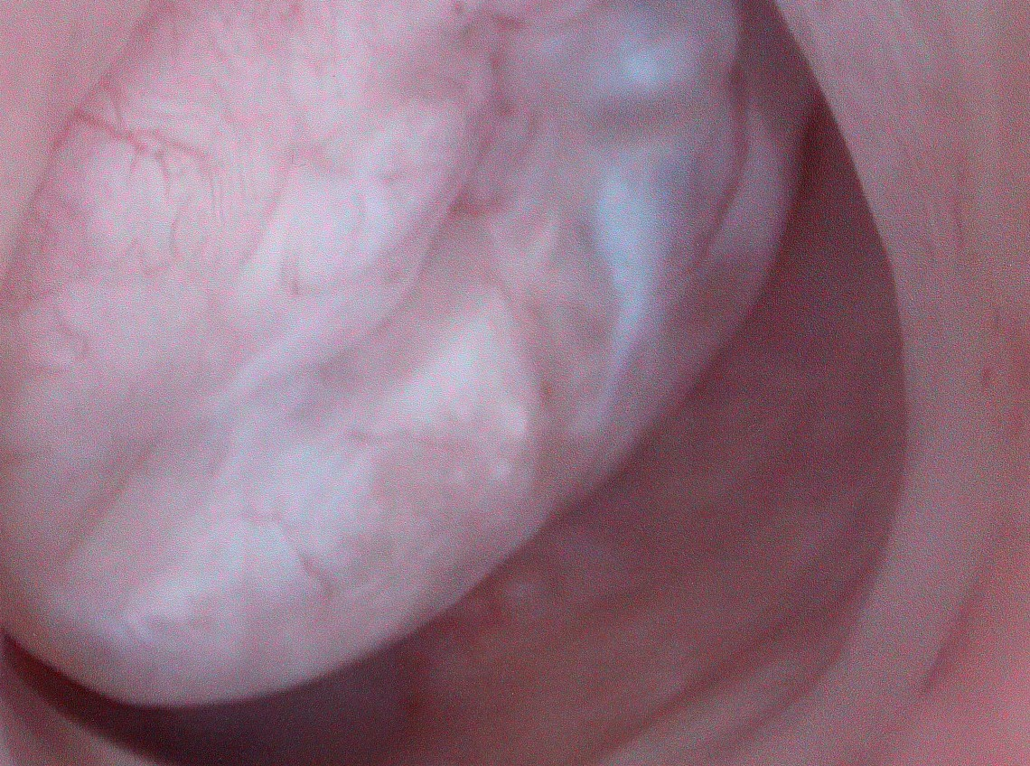

Slide 19
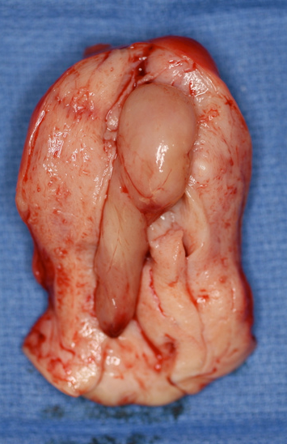

Slide 20
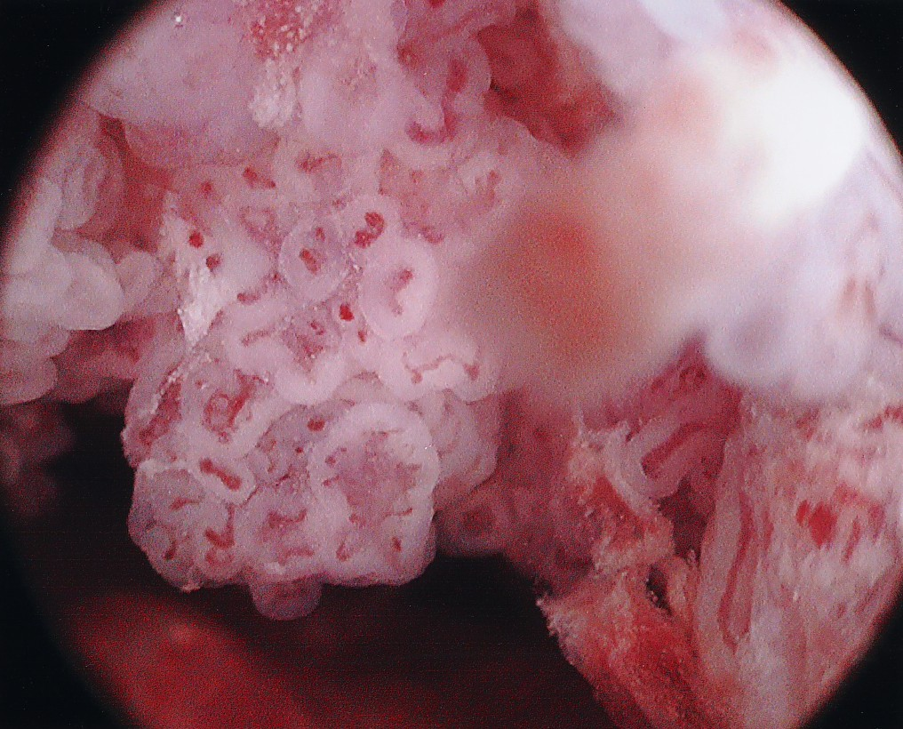

Slide 21
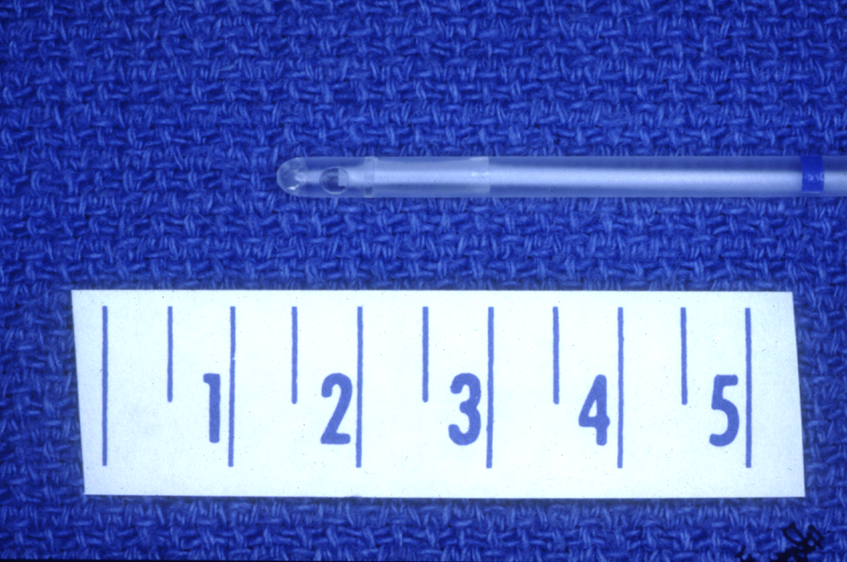

Slide 22
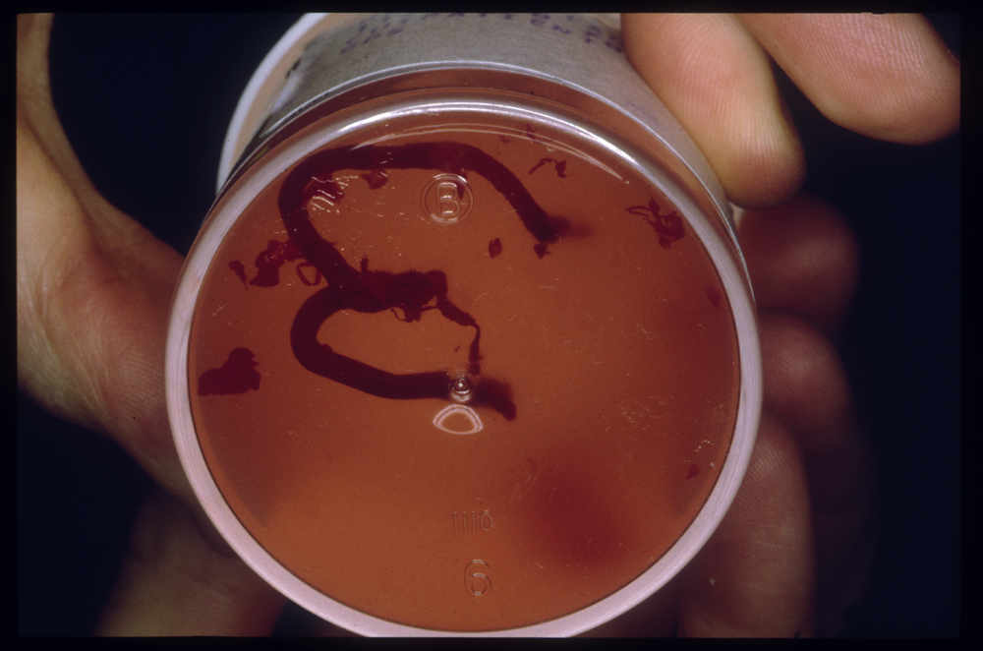

Slide 24
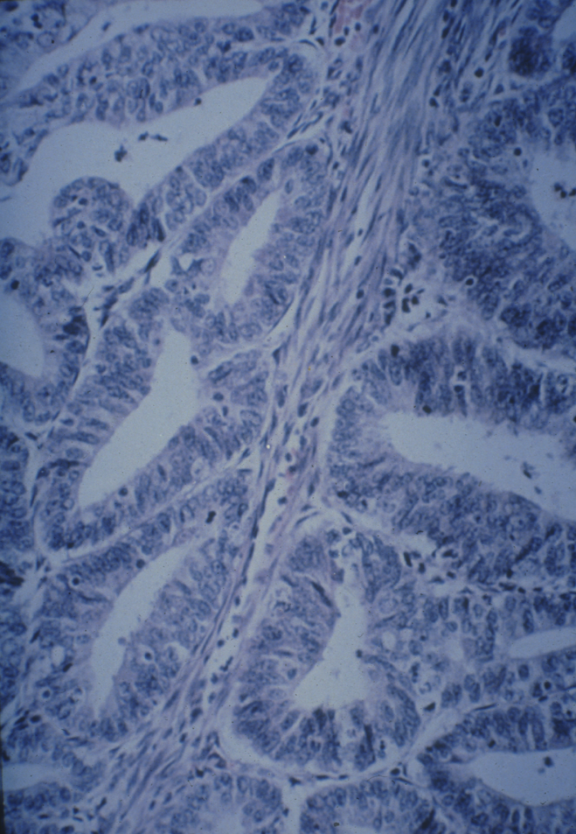

Slide 25
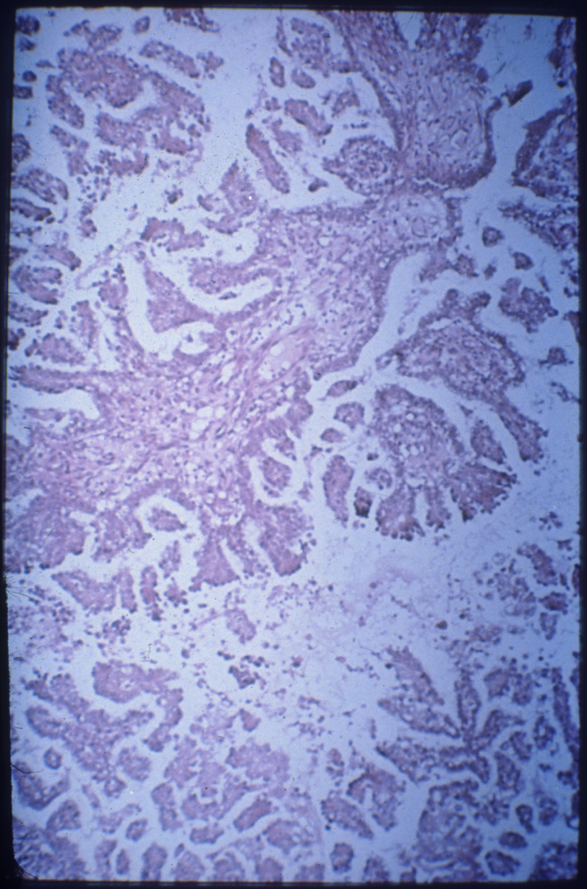

Slide 26
Endometrial Cancer and Race
California Cancer Registry Data 1988-92.
11,674 white and 423 black women with endometrial cancer
Age-adjusted incidence/100,000 women:
Plaxe et al, GO 1997;69:8

Slide 27
Surgery for endometrial cancer
Hysterectomy
Bilateral Salpingo-oophorectomy
Selective Pelvic and Para-aortic
Lymphadenectomy
Peritoneal Cytology

Slide 28
Prognosticators
Patient age
Histology
Stage
Histologic grade
Tumor size
Depth of myometrial invasion
Lymphatic invasion
Extrauterine spread

Slide 29
Staging
Uterine corpus
II. Extension to cervical stroma
IIIA. Adnexal disease
IIIB. Vaginal involvement
IIIC. Lymph node spread

Slide 30
Radiation therapy in endometrial cancer
Preop or postop
External therapy (XRT)
or
Brachytherapy

Slide 32
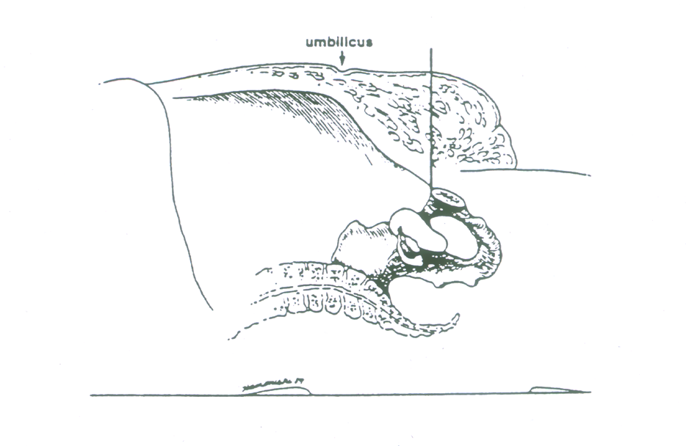

Slide 33
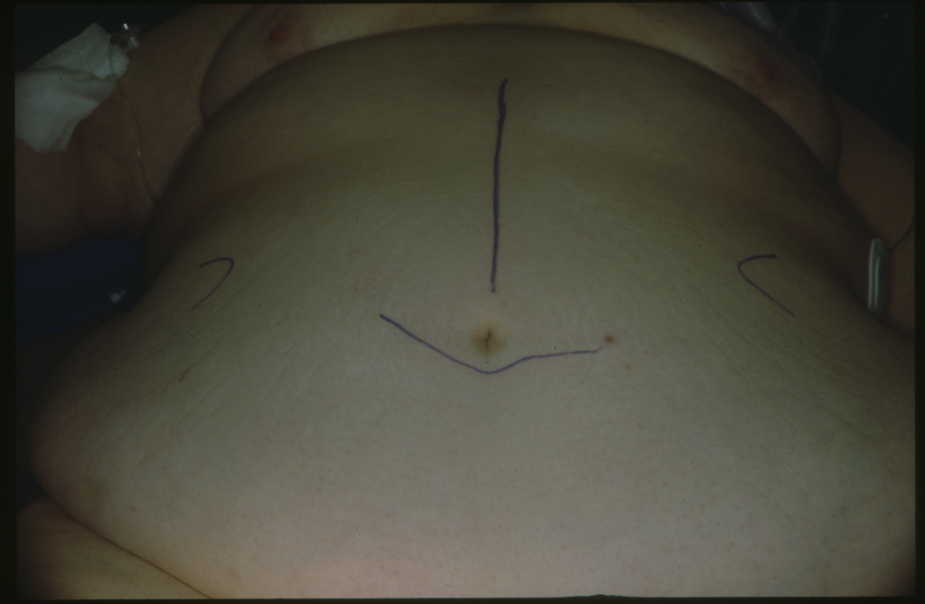

Slide 35
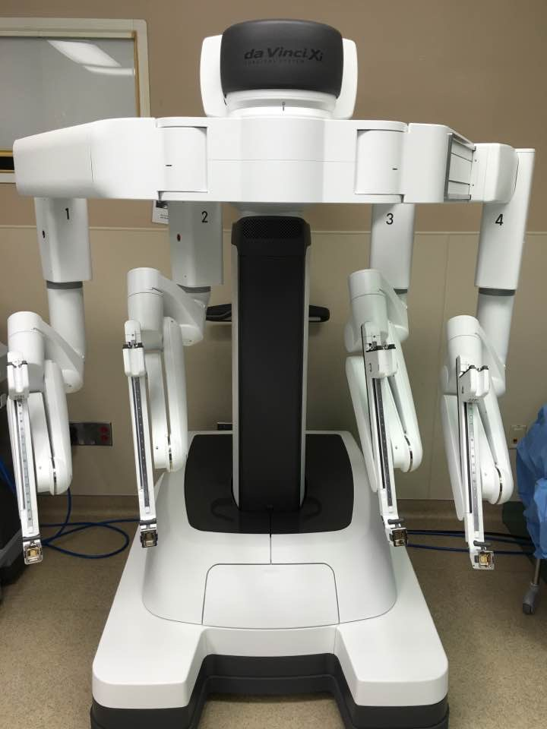

Slide 36
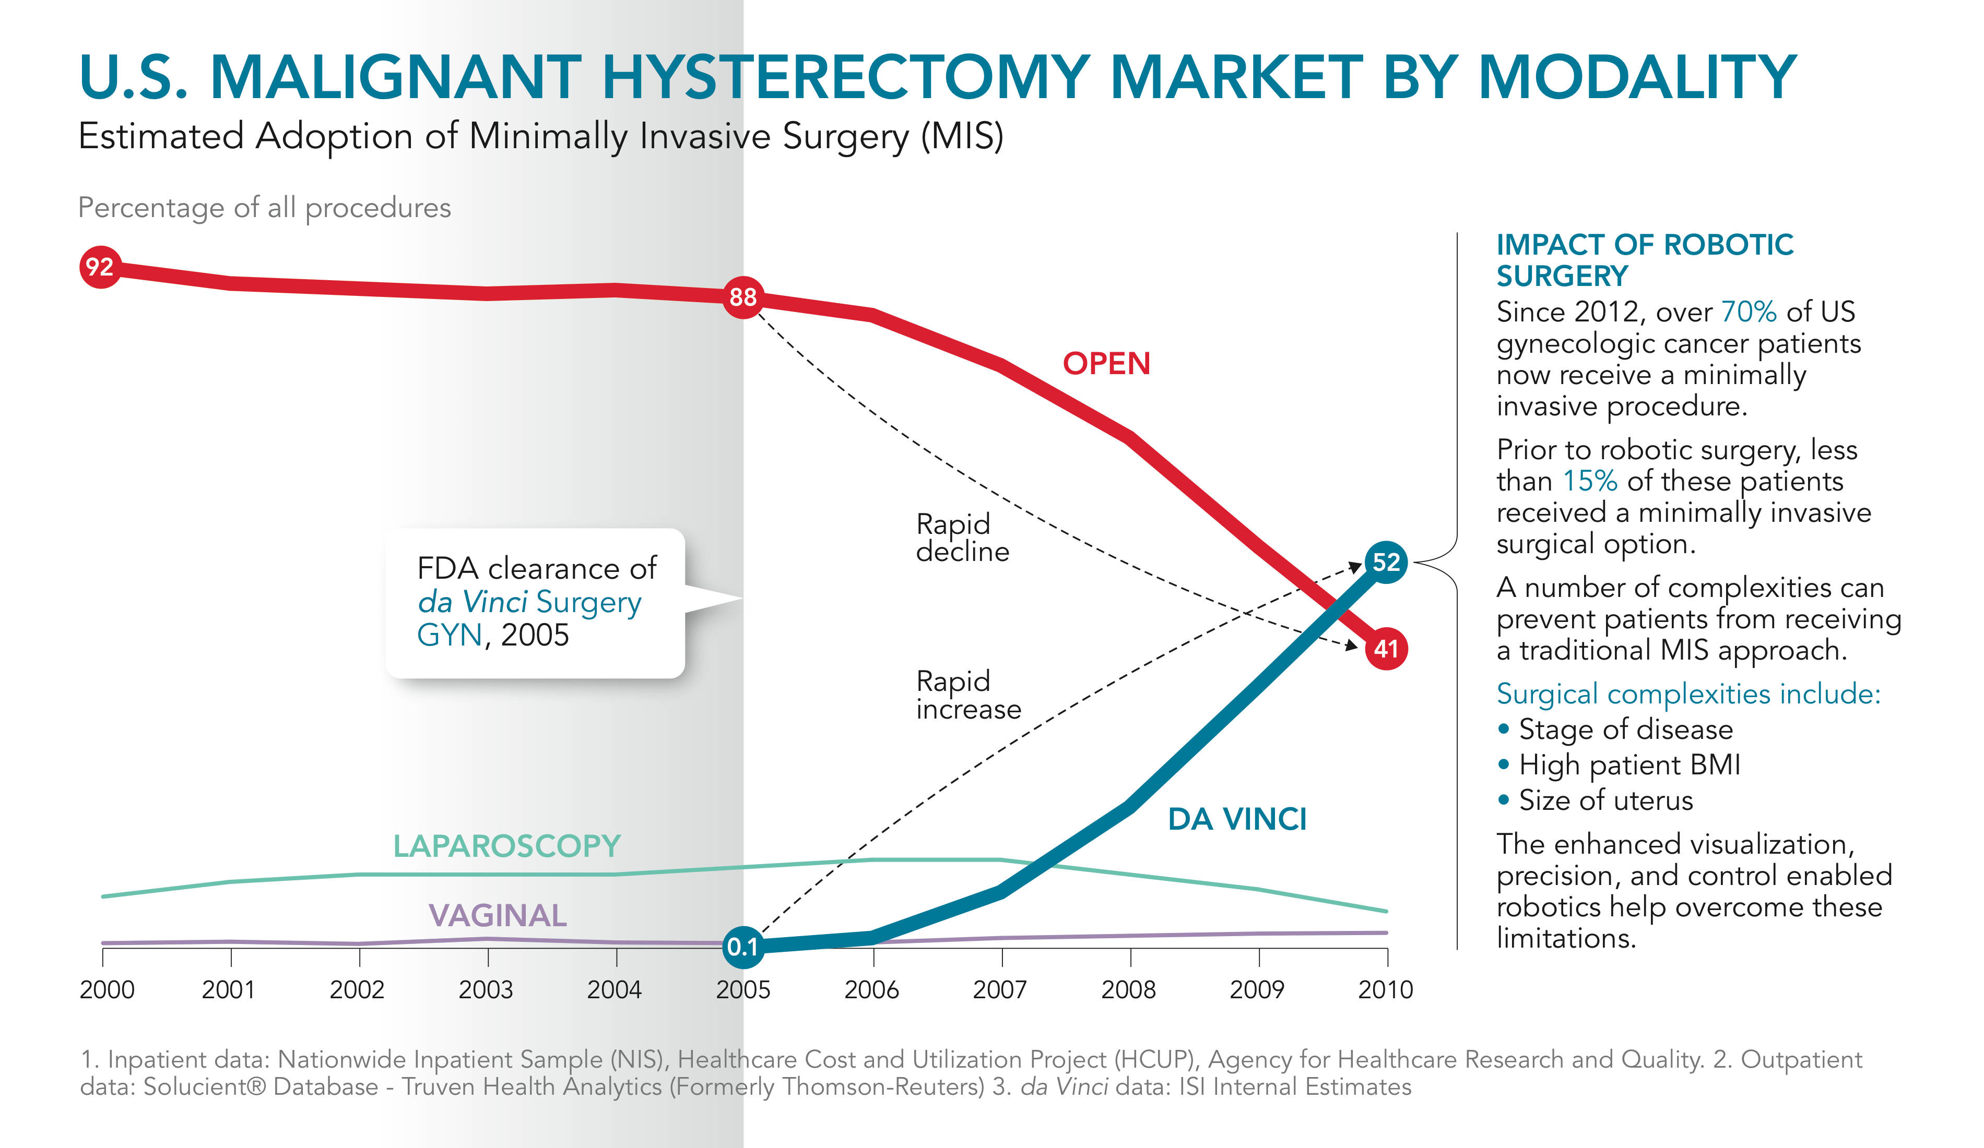

Slide 38
