Slide 1
Immunotherapy for Cancer
Success At Last!
Russell M. Eldridge MD

Slide 2
What is Immunotherapy, and why is everyone talking about it?
An old idea finally delivers the biggest breakthrough in cancer treatment in the last 30 years

Slide 3
Brief History of Cancer Treatments
Surgery is the oldest
Radiation develops next
Chemotherapy (cytotoxic and hormonal) as in The Emperor of All Maladies
Treatments expanded to multimodality, including adjuvant
Immunotherapy had a moment of early success before finally delivering on its potential

Slide 4
Definition of Immunotherapy
Using the body’s immune system to fight cancer (Lots of other more complicated definitions)
Note that we are not including the use of antibodies to “turn off” some part of the cancer cell (drugs like trastuzumab or cetuximab) [Another great breakthrough, for another talk]

Slide 5
History and Preview
Spontaneous remissions/cures occurred, especially in particular tumor types or after infections
Numerous attempts through the years including vaccines, interferons, interleukins, cellular therapy with minimal success
NOTE that all these are attempts to stimulate the immune system
Better understanding of the immune system leads to an alternative approach with a giant leap forward in results

Slide 6
Timeline and History of Immune Therapies
1890
Concept that immunity could be transferred. From Robert Koch’s laboratory, Emil von Behring and Shibasaburo Kitasato, using diphtheria toxin in rats to provide immunity in humans

Slide 7
Timeline and History of Immune Therapies
1891
William B. Coley, a surgeon in New York at Hospital for the Ruptured and Crippled (now the Hospital for Special Surgery), motivated by death of a young patient from a sarcoma, finds 47 reports of cancer remissions following infection, especially erysipelas. (Could have used a better registry?)
Injected Streptococcus into patients intending to induce erysipelas, but too toxic
He develops a safer mixture of killed bacteria and gets responses! Published in 1893

Slide 8
Timeline and History of Immune Therapies
Basic Immunology research continues but very little about cancer
1901 Blood Types discovered
1908 Paul Ehrlich “Father of Immunology” shares Nobel Prize in Physiology or Medicine
1909 Ehrlich proposes “Immune Surveillance” hypothesis, not proven until 2001
1930 NCI established
1949 FDA approves Nitrogen mustard, 1st chemotherapy drug
1953 Watson and Crick describe structure of DNA

Slide 9
Timeline and History of Immune Therapies
1957
Interferon described
Cancer Research Institute of New York founded, in part by Coley’s daughter
1959
First published first report of an effective vaccine against cancer by John and Ruth Graham

Slide 10
Timeline and History of Immune Therapies
1965
Coley’s Toxins discredited (ACS adds it to the Unproven Methods list removes it a decade later )
1975
Antibody production becomes possible
1982
First successful use of an antibody against NHL, leads to Rituxan

Slide 11
Timeline and History of Immune Therapies
1987
CTLA-4 identified
First patient treated with Tumor Infiltrating Lymphocytes (“TIL cells”)

Slide 12
Timeline and History of Immune Therapies
1997
Rituxan approved. Many similar drugs follow in the next 2 decades

Slide 13
Timeline and History of Immune Therapies
2001
PD-1 Ligands (PDL-1) discovered
2002
First trials using antibody against CTLA-4 published
First radionuclide-linked monoclonal antibody approved to treat NHL (the “smart bomb”)

Slide 14
Timeline and History of Immune Therapies
2010
Checkpoint blockade with ipilimumab extends survival in metastatic melanoma
2011
Ipilimumab approved by the FDA

Slide 15
Timeline and History of Immune Therapies
2012
An Anti-PD-1 Antibody from BMS (later called nivolumab) shows dramatic results in Phase I trial
2013
Science magazine chooses cancer immunotherapy as “Breakthrough of the Year”
CAR-T cell therapy yields complete responses in refractory leukemia
2014
Nivolumab approved by FDA
Nivolumab with ipilimumab improves response rate in melanoma

Slide 16
Timeline and History of Immune Therapies
2015 – Today
LANDSLIDE !

Slide 17
“Cold” Antibodies as the first meaningful step
Bind to the cancer cell to make it a target for the immune system
Rituximab (Rituxan) was the first – and a landmark
Lots of drugs now using similar idea: ofatumumab, obinatuzumab, daratumumab
Contrast this to other uses of antibodies like trastuzumab (Herceptin) which is a way to turn off something in the cell
Also NOT the same as using the antibody to deliver something to kill the cell, like “hot” antibodies with radioactive payload or a cell toxin, like tositumomab or brentuximab

Slide 18
The Other Half of the Story
Decades of attempts to “step on the gas”
Didn’t realize that the immune system still had the “brakes on”- we didn’t even know where they were
Why have brakes?
What happens when they malfunction?

Slide 19
Which Brakes Can We Turn Off
CTLA-4 and PD-1/PDL-1 are the most important so far
Ipilimumab was first checkpoint inhibitor
Next comes a string of PD-1/PDL-1 inhibitors

Slide 20
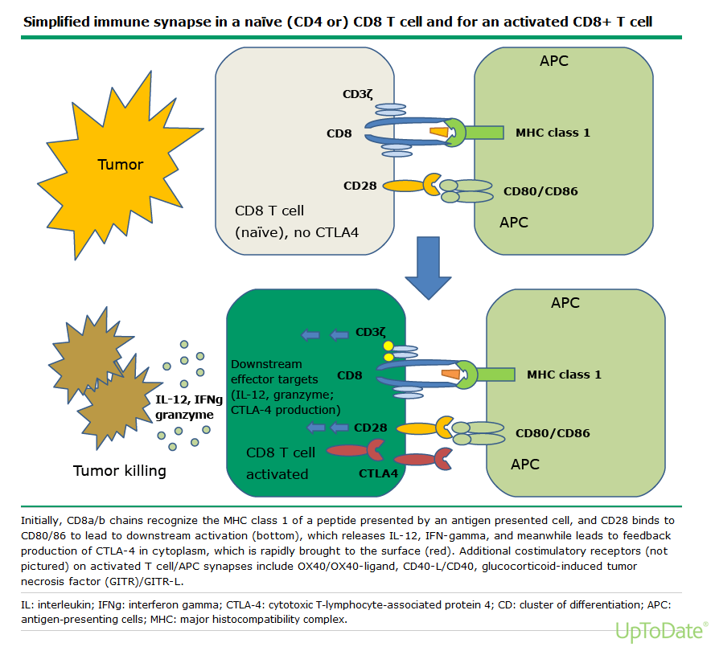

Slide 21
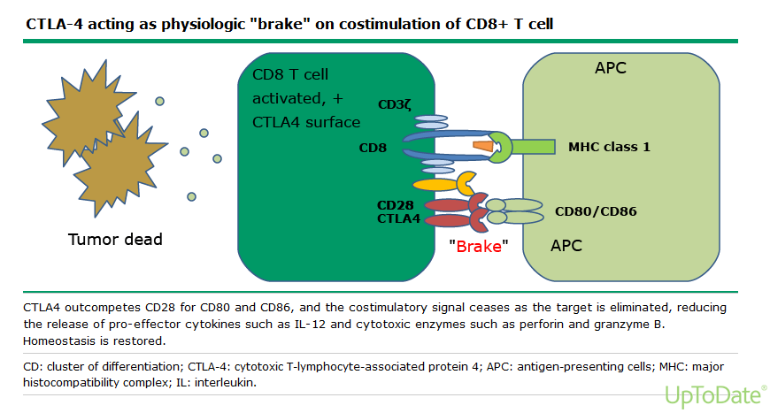

Slide 22
Ipilimumab
FDA approved in 2011 for treatment of metastatic melanoma
Response rate < 20%, but some were dramatic and long-lasting
Later used as adjuvant therapy
Side effects are “a grab bag”-many have little or no toxicity, but can be severe and life-threatening, and can occur at any time during or even after treatment

Slide 23
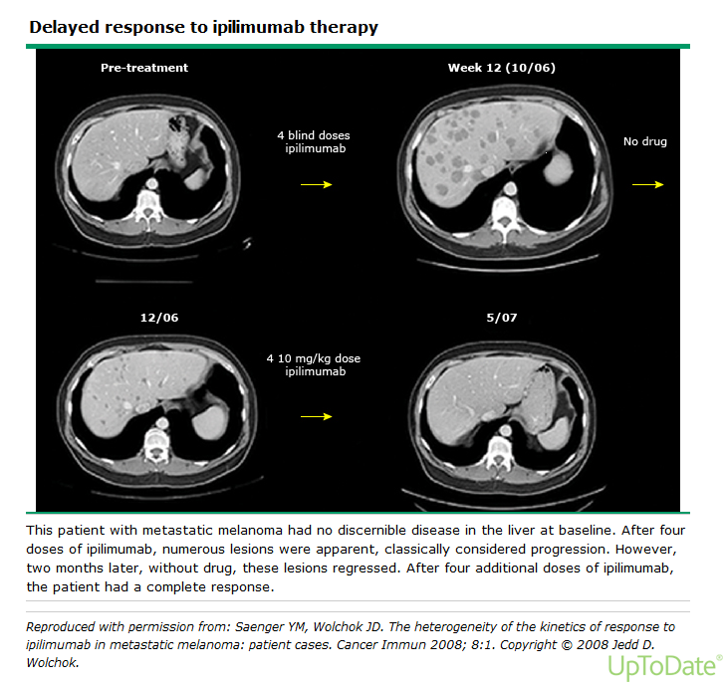

Slide 24
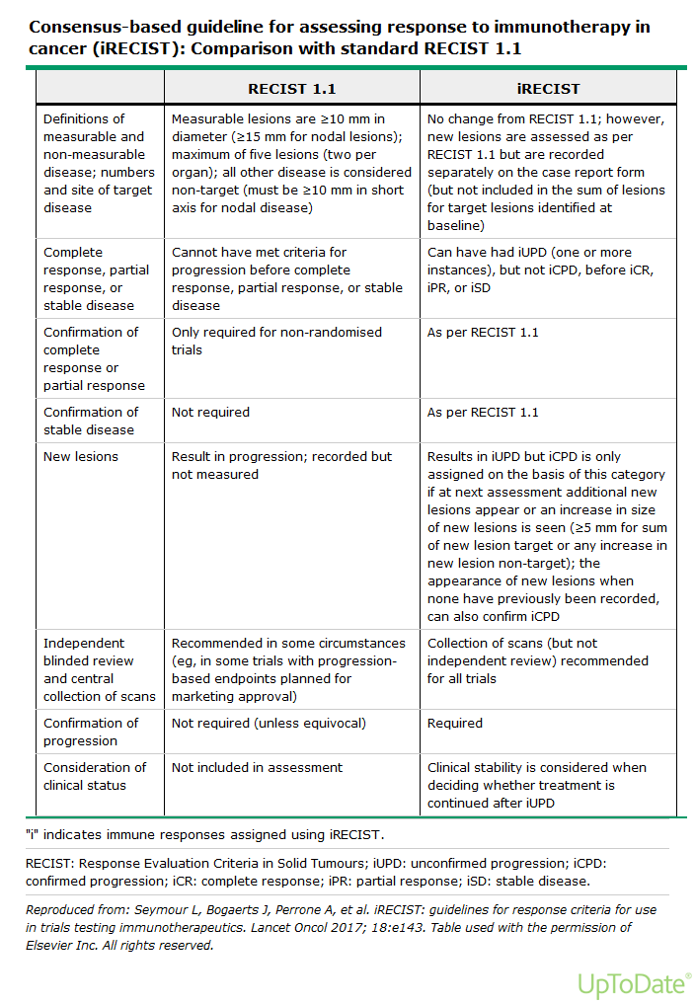

Slide 25
The PD-1 Gang Comes to Town
Generic and Brand Names
Nivolumab = Opdivo
Pembrolizumab = Keytruda
Atezolizumab = Tecentriq
Durvalmab = Imfinzi
Avelumab = Bavencio
Note that although some bind to PD-1 and others to PDL-1, clinical benefit and side effects look very similar

Slide 26
Why Are These SO Important?
Great benefit in some tumor types that had no really useful therapy
Readily available in the community (no special centers or units required)
Responses are often very long (C---?)
Many patients have little to NO side effects, and can continue their normal routine

Slide 27
Cancers Responsive to Checkpoint Inhibitors
Melanoma
Renal Cell Carcinoma
Urothelial cancer(transitional cell)
Lung Cancers- alone or combined with chemotherapy (depending on cell type, PD-1 expression, line of therapy)
Head and neck squamous cancers
Hepatocellular Carcinoma
Colon (depending on MSI status or PDl-1 expression)
Hodgkin’s Lymphoma
Breast Cancer (some, especially triple negative)

Slide 28
Side Effects of Immunotherapy the Grab Bag Effect
Most common is NONE!
Almost all of the others are autoimmune
Thyroid- both hypo and hyper
Diarrhea and colitis (can look like severe Crohn’s disease)
Hepatitis
Renal failure
Rash- multiple kinds, NOT allergic
Pneumonitis
Endocrine (other than thyroid) including type I Diabetes, adrenal, panhypophysitis

Slide 29
Management of Autoimmune Side Effects
Much like managing autoimmune diseases
Steroids are first: use enough and taper slowly
Other agents have been borrowed from autoimmune treatment, eg Remicade

Slide 30
WHAT’S NEXT?
The future is limitless

