Slide 1
Collaborative Staging for Colon
Site Specific Factors
Tonya Brandenburg, MHA, CTR
QA Manager Abstracting and Coding
Kentucky Cancer Registry
Notes:
-You’ve already heard about the core CS fields that are coded for every site - what are SSF’s?

Slide 2
Site specific factors
Collect additional information in order to generate AJCC stage
Record important prognostic indicators
A site may have anywhere from zero to twenty-five SSF’s
Part One, Section Two of the Collaborative Staging Manual contains coding instructions for the SSF’s
Notes:
Additional info for staging- i.e., thickness of melanoma, extracapsular ext in LN’s for H&N
Lab values and tumor markers- CEA for colon, AFP for testis, etc.
Factors that predict survival or response to therapy- i.e., “B” sxs in lymphoma or HER-2 positivity in breast ca
Associated diseases or conditions: HPV infection in H/N, HIV/AIDS for Kaposi
-With the advent of CSv2, some SSF’s that were collected CSv1 were made obsolete, while several others were added
- Part one, section 2 has a wealth of information, particularly regarding lab tests and values, how to round, converting units, etc.

Slide 3
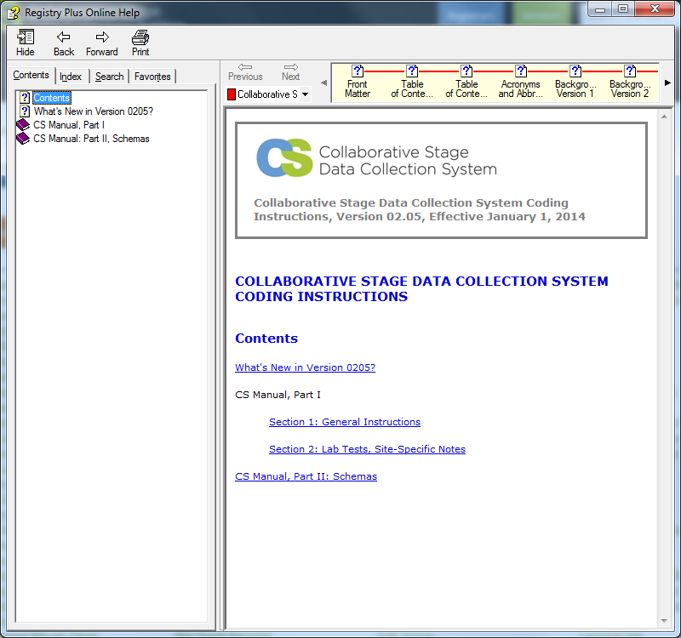
Site specific factors
Notes:
-Can be download to your desktop from the CS web site
-Hyperlinked, so you can jump directly to the topic you want

Slide 4
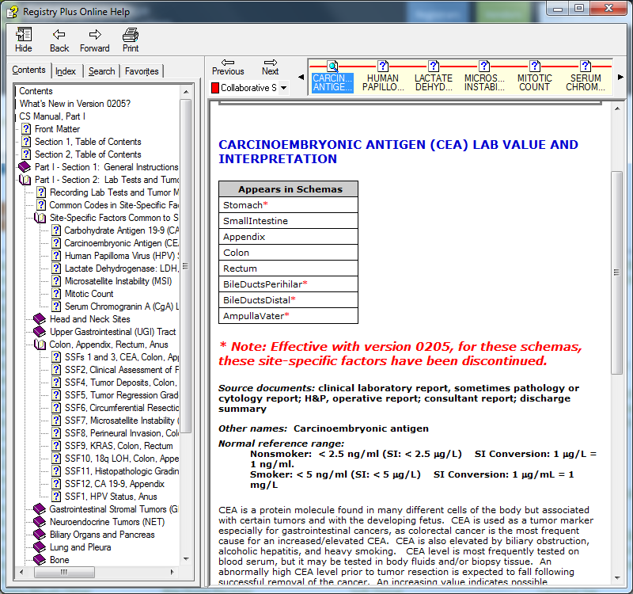
Site specific factors
Notes:
-Tells you which schemas it appears in
-Defines what CEA is and how it’s tested
-Provides reference range

Slide 5
Site specific factors
SSF25 functions as a schema discriminator for some sites
For those sites, SSF25 is coded when you create the case or if the case is key changed to a site that requires a discriminator
Notes:
-For a few sites (for example, esophagus/GE junction), SSF25 distinguishes between two different staging schemas (in that case, stomach vs esophagus), also primary peritoneum, bile duct.

Slide 6

Colon Site Specific Factors
Colon has ten site specific factors
Seven of these are required by SEER
SSF’s 5, 7, and 10 are not required
Default code for SSF’s that are not collected = 988
Notes:
-Some CS codes consistent across sites (i.e. CEA value is recorded in SSF1 for colon, appendix, and rectum)
-Default code for SSF’s that are not required is 988, for all sites-Cpdms.net will autofill this for you

Slide 7
SSF1: CEA Interpretation
010 Positive/elevated
020 Negative/normal; within normal limits
030 Borderline; undetermined if positive or negative
997 Test ordered, results not in chart OR
998 Test not done (test not ordered and not performed)
999 Unknown or no information; not documented in patient record
Notes:
-CEA stands for “carcinoembryonic antigen.” It is a protein molecule normally found in many kind of cells, but elevated rates are associated with certain tumors, particularly in GI malignancies. An elevated rate isn’t diagnostic of cancer, because other conditions (like smoking) can cause this. The higher the CEA, the more likely it is the cancer has metastasized.
-Part one, section two of the CS Manual instructs registrars to code the interpretation of the CEA lab value as stated *by the clinician*.

Slide 8
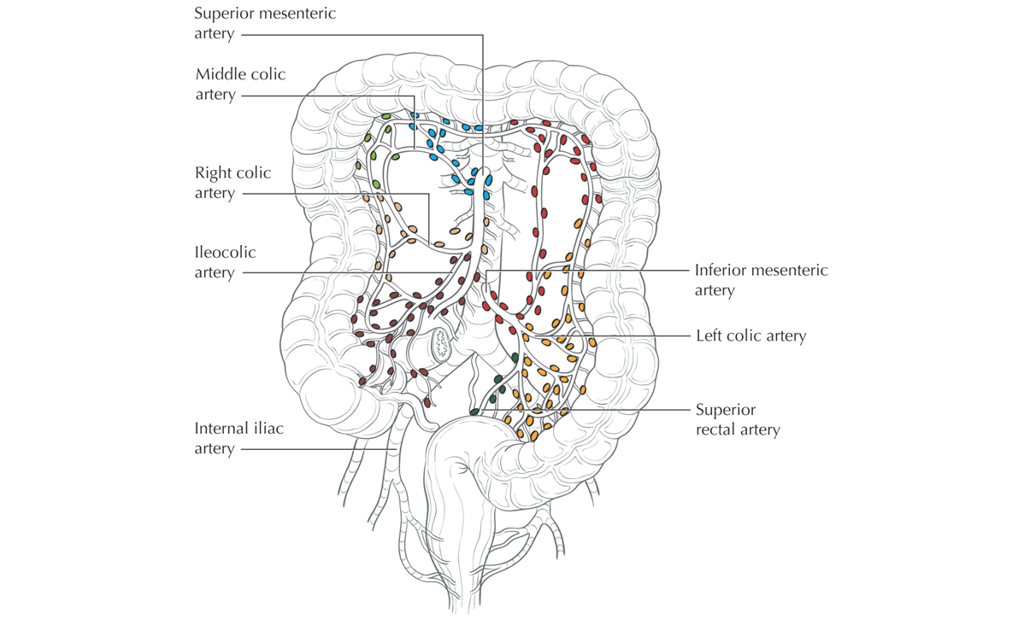
SSF2: Clinical Assess-ment of Regional Lymph Nodes
Notes:
-This field is needed in order to derive AJCC stage
-It can be important in rectal cancer and low sigmoid cancers, where pre-operative chemo or XRT may be given prior to surgery, thus making clinical staging important

Slide 9
SSF2: Clinical Assessment of LN’s
Note 1: Clinically evident regional lymph nodes are based on information from the diagnostic workup. This might include: physical examination, imaging, diagnostic lymph node biopsy and exploratory surgery (without a resection).
Note 2: In the rare instance that the number of clinically positive nodes is stated but a clinical N category is not stated, use the code that reflects the most specific statement about the number of nodes.
Note 3: If there is no diagnostic work-up to assess regional lymph nodes, use code 999. Do not apply the inaccessible nodes rule that presumes unmentioned nodes to be negative.
Notes:
-Very important to read notes!!!
-They contain essential info; failing to read them could result in miscoding!
-The exception to Note 3 would be in situ tumors.

Slide 10

SSF2: Clinical Assessment of LN’s
000 Nodes not clinically evident; imaging of regional nodes performed and nodes not mentioned
010 Metastasis in 1 regional node, determined clinically OR stated as clinical N1a
020 Metastases in 2-3 regional nodes, determined clinically OR stated as clinical N1b
030 OBSOLETE
Notes:
-The obsolete code is left in because of cases that were coded in CS version one (2004-2010)

Slide 11
SSF2: Clinical Assessment of LN’s
100 Metastases in 1-3 regional nodes, determined clinically or stated as clinical N1 [NOS]
110 Metastases in 4-6 regional nodes, determined clinically or stated as clinical N2a
120 Metastases in 7 or more regional nodes, determined clinically or stated as clinical N2b
200 Metastases in 4 or more regional nodes, determined clinically Stated as clinical N2 [NOS]
400 Clinically positive regional node(s), NOS
Notes:
-Always use the more specific code over the general

Slide 12
SSF2: Clinical Assessment of LN’s
888 OBSOLETE
988 Not applicable: Information not collected for this case (May include cases converted from code 888 used in CSv1 for "Not applicable" or when the item was not collected. If this item is required to derive T, N, M, or any stage, use of code 988 may result in an error.)
999 Regional lymph node(s) involved pathologically, clinical assessment not stated or unknown if regional lymph nodes clinically evident; not documented in patient record
Notes:
-Do NOT use code 988 for SSF’s that are required
Use code 999 when
there is no diagnostic work-up to assess regional lymph nodes
there is no imaging or ultrasound reported
it is unknown whether imaging or ultrasound was done
a scan or ultrasound states adenopathy is present without making a definite statement that the nodes are clinically positive (such as fixed, matted, or metastatic terminology). The terms adenopathy, enlargement, suspicious, and so forth, by themselves are not sufficient to code as involvement. For example, statements of “adenopathy” or “suspicious lymph nodes” should be coded as 999, but a statement of “lymph nodes suspicious for malignancy” should be coded as 400.

Slide 13

SSF3: CEA Lab Value
Note 1: CEA is a tumor marker that has value in the management of certain malignancies.
Note 2: The same laboratory test should be used to record information in CS Site-Specific Factors 1 and 3.
Note 3: Record to the nearest tenth in nanograms/milliliter (ng/ml) the highest CEA lab value documented in the medical record prior to treatment. For example, code a pretreatment CEA of
7 ng/ml as 070.
Notes:
-SSF1 recorded the *interpretation* of the value- SSF3 records the actual result of testing
-Note 2- important to use same test

Slide 14
SSF3: CEA Lab Value
Note 4: Code 000 is reserved for exactly 0.0 ng/ml (no measurable amount of CEA). Do not round tiny values down to 0.0 ng/ml; any measured value less than or equal to 0.1 ng/ml should be coded 001. For code 001, also round 0.11-0.14 ng/ml down to 0.1 ng/ml. For codes 002-980, round values to the nearest tenth of a ng/ml.
Note 5: For an uncertain value, record the stated closest value. For example, code a value stated as "less than 0.5 ng/ml" as 005.
Notes:
-You may need to round!

Slide 15
SSF 3: CEA Lab Value
000 0.0 nanograms/milliliter (ng/ml) exactly
001 0.1 or less ng/ml; stated as less than 0.1 ng/ml with no exact value
002-979 0.2-97.9 ng/ml; (Exact value to nearest tenth in ng/ml)
980 98.0 or greater ng/ml

Slide 16
SSF 3: CEA Lab Value
988 Not applicable: Information not collected for this case; (May include cases converted from code 888 used in CSv1 for "Not applicable" or when the item was not collected. If this item is required to derive T, N, M, or any stage, use of code 988 may result in an error.)
997 Test ordered, results not in chart
998 Test not done (test not ordered and not performed)
999 Unknown or no information; not documented in patient record
Notes:
-These codes explain why no CEA value was available
-998 is only used in the rare instance when it is stated in the medical record that the test was NOT done; if you don’t see whether it was done, use 999

Slide 17
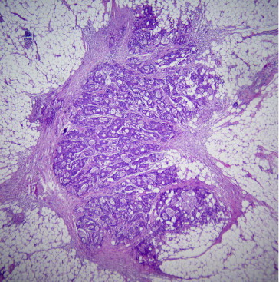
SSF4: Tumor Deposits
Note 1: Tumor deposits (TD) are defined as one or more satellite peritumoral nodules in the pericolorectal adipose tissue of a primary carcinoma without histologic evidence of residual lymph node in the nodule. Such TD may represent discontinuous spread, venous invasion with extravascular spread, or a totally replaced lymph node.
Notes:
-Tumor nodules in the fat outside the colon or rectum that have no LN structure

Slide 18
SSF4: Tumor Deposits
Note 2: Record the number of TD whether or not there are positive lymph nodes.
Note 3: Assign code 000 if surgical resection of the primary site is performed, the pathology report is available for review, and tumor deposits are not mentioned.
Notes:
-Do not code actual LN’s in the field
-This info should be on the CAP protocol for the resection of the primary site

Slide 19
SSF4: Tumor Deposits
000 None
001-080 1-80 Tumor deposits (TD)(Exact # of TD)
081 81 or more TD
888 OBSOLETE

Slide 20
SSF4: Tumor Deposits
988 Not applicable: Information not collected for this case; (May include cases converted from code 888 used in CSv1 for "Not applicable" or when the item was not collected. If this item is required to derive T, N, M, or any stage, use of code 988 may result in an error.)
990 TD identified, number unknown
998 No surgical resection of primary site
999 Unknown or no information; Insufficient information; indeterminate if TD present; Not documented in patient record

Slide 21
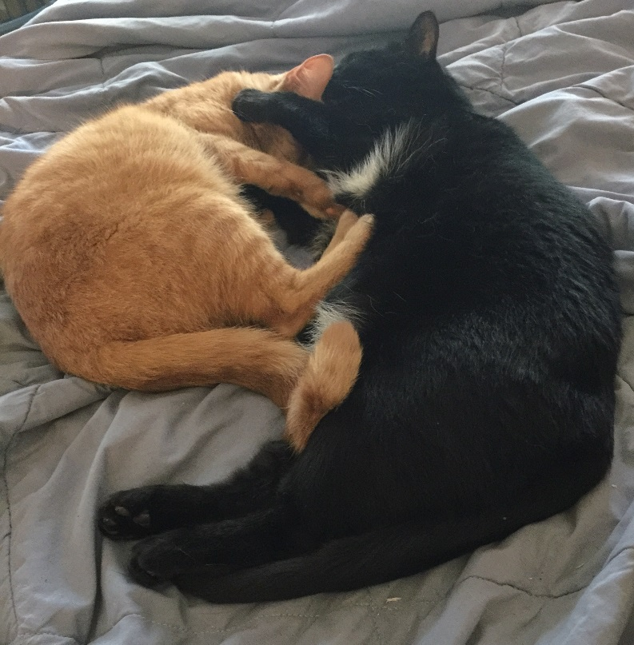
SSF5 is not required!
Nap with a friend.
Notes:
Code 988 is entered by default

Slide 22
SSF6: Circumferential Resection Margin
The CRM may also be referred to as the circumferential radial margin or mesenteric margin
The CRM is a significant prognostic indicator for recurrence, so it’s important to record it accurately
Note 4: Record to the nearest tenth in millimeters (mm) the distance between the leading edge of the tumor and the nearest edge of surgically dissected margin as recorded in the pathology report. For example, if the CRM is 2 mm, code 020. If the margin is involved (positive), use code 000. If the margin is described as less than 1 mm with no more specific measurement, use code 000; margins of 0-1 mm are recorded by the pathologist as involved.
Notes:
-CRM is the most important factor in predicting local recurrence
-Should also be on CAP protocol

Slide 23
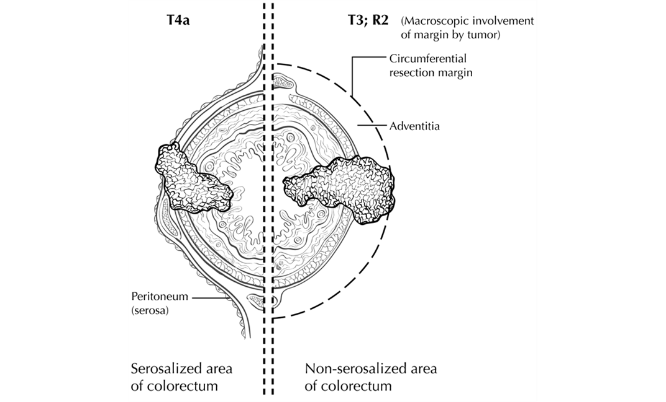
SSF6: CRM
Circumferential resection margin. T4a (left side) has perforated the visceral peritoneum. In contrast, T3; R2 (right side) shows macroscopic involvement of the circumferential resection margin of a non-peritonealized surface of the colorectum by tumor with gross disease remaining after
surgical excision
Notes:
Parts of the colon wall (and rectum) are covered by the visceral peritoneum (as seen on the left above); some parts are not (as seen on the right). When the surgeon dissects the non-serosalized parts, the CRM is the margin between the colon itself, and the mesentery.

Slide 24
SSF6: CRM
000 Margin IS involved with tumor; Circumferential resection margin (CRM) positive; Described as "less than 1 millimeter (mm)“
001-980 0.1- 98.0 millimeter (mm); (Exact size to nearest tenth of millimeter)
981 98.1 mm or greater
Notes:
-

Slide 25
SSF6: CRM
988 Not applicable: Information not collected for this case; (May include cases converted from code 888 used in CSv1 for "Not applicable" or when the item was not collected. If this item is required to derive T, N, M, or any stage, use of code 988 may result in an error.)
990 No residual tumor identified on specimen
991 Margins clear, distance from tumor not stated
Notes:
-990, for example, polypectomy during colonoscopy, no residual dz on colon resection
-991 states CRM is negative, but no measurement given

Slide 26
SSF6: CRM
992 Described as "less than 2 mm," or "greater than 1 mm," or "between 1 mm and 2 mm"
993 Described as "less than 3 mm," or "greater than 2 mm," or "between 2 mm and 3 mm"
994 Described as "less than 4 mm," or "greater than 3 mm," or "between 3 mm and 4 mm"
995 Described as "less than 5 mm," or "greater than 4 mm," or "between 4 mm and 5 mm"
996 Described as "greater than 5 mm"
Notes:
-More ‘described as’ codes…

Slide 27
SSF6: CRM
998 No resection of primary site
999 Unknown or no information; CRM not mentioned; Not documented in patient record

Slide 28
SSF6: CRM
Read through all codes!
Note that there are specific codes for situations in which there is no residual tumor in the resected specimen (990) and when no resection of the primary site is done (998)

Slide 29
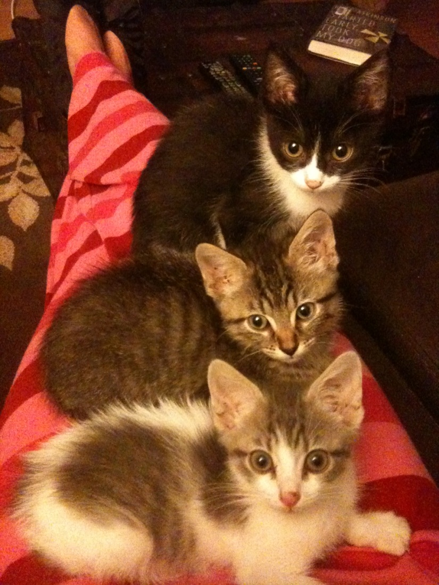
SSF 7 is not required
Take a break with some friends
Notes:
Code 988

Slide 30
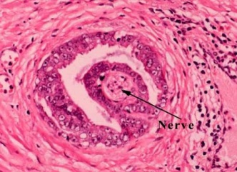
SSF8: Perineural Invasion
Note: Code the presence or absence of perineural invasion as documented in the pathology report. Assign code 000 if histologic examination of primary site was performed, the pathology report is available for review, and perineural invasion is not mentioned.
Notes:
-This SSF documents whether tumor cells has spread along nerve pathways; *not* invasion of the actual nerve itself
-The cancer cells are spreading along the path of least resistance
-Tumors with perineural invasion have a poorer prognosis than those without it
-If it’s not mentioned in the path report, assume it’s not present

Slide 31
SSF8: Perineural Invasion
000 None; no perineural invasion present
010 Perineural invasion present
988 Not applicable: Information not collected for this case; (If this information is required by your standard setter, use of code 988 may result in an edit error.)
998 No histologic examination of primary site
999 Unknown; Not documented in patient record

Slide 32
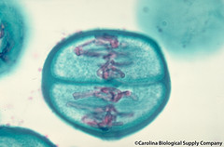
SSF9: KRAS
KRAS is a gene which belongs to a class of genes known as oncogenes. When mutated, oncogenes have the potential to cause normal cells to become cancerous. Studies suggest that KRAS gene mutations are often present in colorectal cancer.
Notes:
-normal KRAS is also referred to as “wild type,” meaning unmutated
-tumors with a mutated KRAS are unlikely to respond to certain expensive and toxic drugs (i.e., cetuximab [Erbitux])

Slide 33
SSF9: KRAS
010 Abnormal (mutated); Positive for mutations
020 Normal (wild type); Negative for mutations
988 Not applicable: Information not collected for this case (If this information is required by your standard setter, use of code 988 may result in an edit error.)

Slide 34
SSF9: KRAS
997 Test ordered, results not in chart
998 Test not done (test was not ordered and was not performed)
999 Unknown; Not documented in patient record
Notes:
ASCO recommends that Stage IV colorectal patients be tested for KRAS if anti-EGFR therapy is being considered. Code 999 will usually be coded for colon cancer patients with Stage 1 or Stage 2 cancer.

Slide 35

Questions?

